Slide 1
The mystery of the Minoans
By Alexa Anne Gubler

Slide 2
Question
To what extent has the minoan civilization and it’s mysterious downfall affected our world's history and the world as we know it today?

Slide 3
The Legend...
King Minos, the son of Zeus and Europa, lived on the Mediterranean island of Crete. While King Minos is very reputable in the world of Greek Mythology for dominating the ocean with his naval fleets, making codes of law, and establishing educational systems, he is most known for his role in the myth “Theseus and the Minotaur”. This story depicts King Minos travelling to the city of Athens in order to avenge his son, Androgeos, who died while fighting a bull. In order to achieve his revenge Minos made it so that every nine years the Athenians would have to choose seven boys and seven girls, who would be sent to Crete as sacrifices to the Minotaur who lived under the kingdom in a maze like labyrinth. However, in the end a boy named Theseus defeats the beast so that no more people will have to be killed.

Slide 4
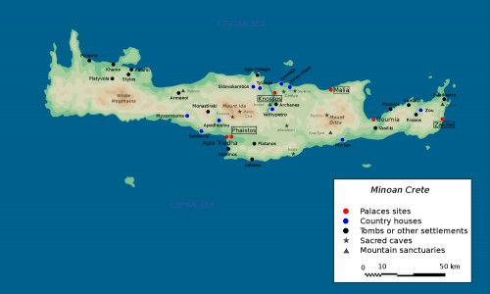
Map

Slide 5
Background
Upon the discovery of the Minoan ruins, archaeologist Sir Arthur Evans named them after that mythical Kingdom believing the civilization to be so astonishing it could only be one of legendary status.
The real Minoans we are researching today are thought to be the very first European civilization, established around 2000 BCE, ruled by an all powerful Priestess. Their civilization’s initial growth in what we now call European soil contributed to the development of some of the most noteable Civilizations the West has ever known.

Slide 6
Minoan basics
Cretan culture was so influential that it was written about extensively by the Greeks, mentioned again and again throughout literature, historical documents, and mythology. So far what we have gathered about the Minoan civilization is that it was a very sophisticated place that held a lot of power and structure. We know this because the Minoans established a large Kingdom with four main cities; Knossos, Phaistos, Malia, and Zakros. These cities consisted of large, complicated palace structures some of which towered three stories high. Archaeologists argue that these buildings must of been some version of a local storage place holding wine, oil, grain, metals, and ceramics; all of which are considered to be rare and valuable items for that time period.

Slide 7
Minoan Basics
The Minoans benefited and protected this extensive kingdom through very powerful naval control. Meaning they dominated the oceanic trade that flourished at the time giving them a lot of precious materials and notoriety. The Minoans worshipped several gods a lot of which is unclear. However, we do know that they participated in rituals such as Bull leaping and other events circulating around the worship of bulls (probably why Sir Arthur thought it was the mythological King Minos’ Kingdom). The Minoans also had an astonishing language similar to that of Egyptian Hieroglyphs and it is still undeciphered. The Minoans, like the greeks, we’re very involved in art whichever form it granted itself in.

Slide 8
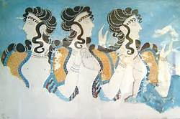
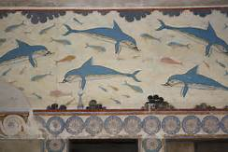
Paintings
Bull leaping Art More Art

Slide 9
The downfall...
As a historian we all wonder how such a prominent civilization could just disappear in about fifty years. Well, while there is no definite answer there are three main theories. One, the Minoans were smothered by the ash and smog of the erupting Satorini Volcano. Two, tsunamis plundered the civilization with wave after wave of powerful water. Three, The invading Mycenaeans destroyed the Minoans pushing them into a mysterious chaotic place in history.

Slide 10
Santorini Volcano
This first theory entertains the idea that the Santorini Volcano, situated close to Crete, erupted in an explosion more powerful than that of an Atomic Bomb. This eruption, like Bastille, would’ve covered the minoans in foot after foot of ash not allowing anyone to breathe, it would’ve been so immense that it could have lead to our second theory: Tsunamis.

Slide 11
Tsunamis
Archaeologists and biologists believe that tsunamis more than fifty feet bombarded the civilization one after another, wiping the Minoans out in an Atlantis type fashion. These researchers believe this because of the numerous microorganisms and marine species usually only found right on the seabed so far inland. This horrific event could’ve possibly lead to the next theory as well: Invaders.

Slide 12
Mycenaean Invasion
Perhaps all of these terrible events acted as a domino chain ending with these invaders, that could be an explanation as to why their downfall was so quick and precise. It is plausible seeing as how the Minoans were, for the majority, an extremely peaceful society which would’ve been easy to attack and maintain control of.

Slide 13
How it affects us today...
What does it mean for us today? Well, it means that the very roots of Western Civilization is not due to the Greeks or the Romans but the Minoans who acted as the catalyst into this crazy chain of events which could be argued lead to the popular culture we invest in today. Overall we need to acknowledge that we will not know everything, that there will always be mystery in our past, but what we cannot do is not investigate. The more we research and explore the more we learn about about who we are who we came from and that changes what our future looks like.

