Slide 1
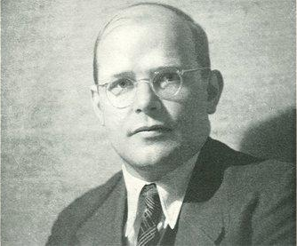
Dietrich Bonhoeffer
1906-1945

Slide 2
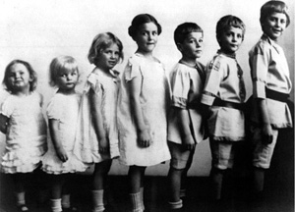
Early Life
Born February 4, 1906
Born in Breslau, Germany
The sixth out of eight children
Has a twin sister, Sabine
His father is a renowned professor of psychiatry and neurology
His mother was one of the few women at the time to obtain a university degree
Decided to become a pastor at age 14
He studied at the Tubingen University (1923-1927)*
*sources vary, some say he studied at University of Berlin while yet other sources suggest he studied at the Protestant Faculty of Theology of the University

Slide 3
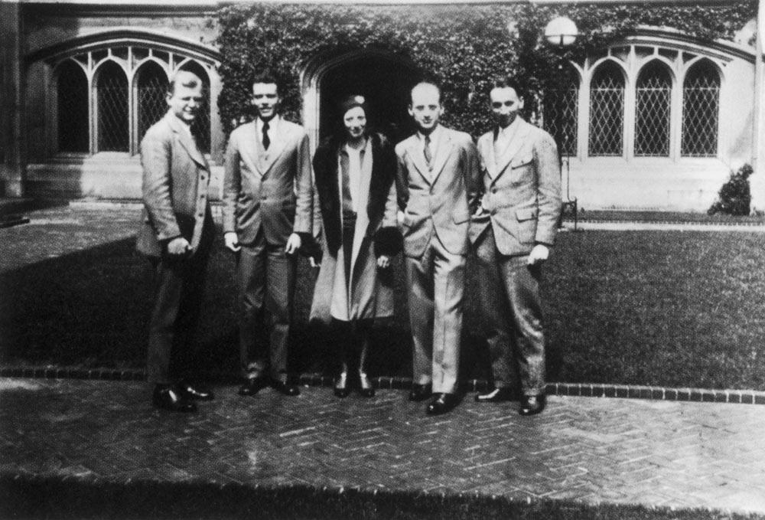
His Travels
After completing his studies in 1927, he went to Barcelona for a year. There he served as a vicar where he established divine services and children's worship services that filled up the church completely. He also traveled to Cordoba, Seville, Granada, and Madrid while in Spain.
He returned to Berlin but as he was still too young to become an ordained minister, he traveled to New York to study at the Union Theological Seminary. While in New York, he spent quite a bit of time in Harlem where he became very involved with the Black Abyssinian Church. He also traveled to Mexico and Cuba.
In August 1931, he returned to Germany where he became a lecturer in theology at University of Berlin. That November, he became an ordained minister and published his first work, his lectures titled “Creation and Fall” in 1932.

Slide 4
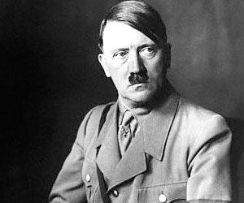
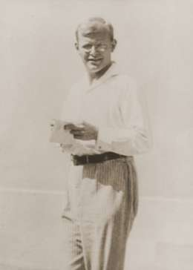
In 1933, Hitler became chancellor of Germany, and many members of the protestant church welcomed the rise of Nazism. Bonhoeffer released an essay called “The Church and the Jewish Question”, which called for “the church to defend the victims of state persecution”* . Bonhoeffer was against the persecution of Jewish people, but he did believe that they should be
converted to Christianity.
In September, he became
the pastor of two German
speaking Lutheran churches
In London, but he returned
to Germany quickly in order
to aid in the fight against
Nazism.
1933
*quote from: https://www.ushmm.org/information/exhibitions/online-exhibitions/special-focus/dietrich-bonhoeffer/church-and-jewish-question

Slide 5
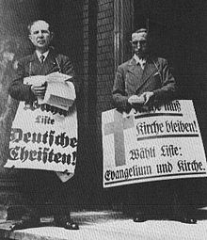
Bonhoeffer help establish the Anti-Nazi Confessing Church in 1934 (protesters from this church pictured to the right); later he also becomes a member of the Universal Christian Council for Life and Work. In 1935, he helps to develop an underground seminary in Zingst by the Baltic Sea for the Anti-Nazi Confessing Church because their teachings have been banned in
Germany. It was later moved to Finkenwalde in Pomerania.
1934-1936
In 1936, Bonhoeffer was banned from lecturing at University of Berlin due to the fact that his teachings went directly against Nazi philosophy. Even though he was banned from lecturing, he continued to spread his opinion.

Slide 6
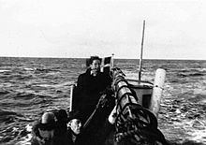
1937-1941
In 1937, the underground seminary in Finkenwalde was discovered and shut down by the Gestapo, and 27 of its students were arrested. It was shortly after this that Bonhoeffer published “The Cost of Discipleship” one of his most popular works. He spent two years traveling between German villages conducting “seminaries on the run”. In February 1938, he becomes part of a group of political conspirators against Hitler’s regime. In early June of 1939, he leaves for New York only to return shortly in late July to officially join the political
resistance. March 1941, he is banned for printing
or publishing his works in Germany. Later in 1941,
he became part of a Jewish Rescue crew, a mission
later named Operation 7. He discovered the
German military intelligence organization Abwehr
through his brother-in-law. He was involved in
many efforts to help Jews escape to Switzerland.
Pictured to the left is a crew assisting Danish Jews
get to Switzerland.

Slide 7
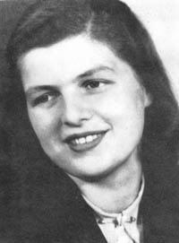
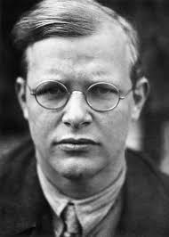
1942-1945
In January 1943, he secretly gets engaged to Maria von Wedemeyer. In April of 1943, he is arrested under the charge of conspiring against Hitler and is sent to Tegel Prison in Berlin along with his older sister Christine, her husband, and his older brother
Klaus. He continued his Christian outreach
with a series of letters smuggled out by
sympathetic guards and his fiancée. These
letters were received and later published by
Eberhard Bethge in a book called “Letters and
Papers from Prison”. In February 1945, he was
moved to Buchenwald Concentration Camp.
April 1945, the diary of Admiral Canaris, one
of the leaders of Abwehr, was discovered.
Hitler called for the annihilation of the
Canaris team, and on April 9, Bonhoeffer was
executed in the concentration camp.

Slide 8
Bibliography
"Dietrich Bonhoeffer." Dietrich Bonhoeffer Official International. N.p., n.d. Web. 03 June 2017. <http://www.dbonhoeffer.org/>.
Pierard, Richard, Clifford Green, and F. Burton Nelson. "Dietrich Bonhoeffer." Christian History | Learn the History of Christianity & the Church. Christianity Today, n.d. Web. 03 June 2017. <http://www.christianitytoday.com/history/people/martyrs/dietrich-bonhoeffer.html>.
"Dietrich Bonhoeffer." Dietrich Bonhoeffer. Jewish Virtual Library, n.d. Web. 03 June 2017. <http://www.jewishvirtuallibrary.org/dietrich-bonhoeffer>.
"Dietrich Bonhoeffer." United States Holocaust Memorial Museum. United States Holocaust Memorial Museum, n.d. Web. 03 June 2017. <https://www.ushmm.org/wlc/en/article.php?ModuleId=10008205>.
"Dietrich Bonhoeffer." Wikipedia. Wikimedia Foundation, 30 May 2017. Web. 03 June 2017. <https://en.wikipedia.org/wiki/Dietrich_Bonhoeffer>.
Ley, Stephen. "FWIW." Bonhoeffer's Childhood: A Turning Point. Blogspot, 14 Apr. 2011. Web. 03 June 2017. <https://frightfullypleased.blogspot.com/2011/04/bonhoeffers-childhood-turning-point.html>.
"Dietrich Bonhoeffer Portal." Dbp . Dietrich Bonhoeffer Biografie: Barcelona – Berlin – New York. Dietrich Bonhoeffer Portal, n.d. Web. 03 June 2017. <http://www.dietrich-bonhoeffer.net/leben/barcelona-berlin-new-york/>.
"Confessing Church." Wikipedia. Wikimedia Foundation, 31 May 2017. Web. 03 June 2017. <https://en.wikipedia.org/wiki/Confessing_Church>.
"Humboldt University of Berlin." Wikipedia. Wikimedia Foundation, 02 June 2017. Web. 03 June 2017. <https://en.wikipedia.org/wiki/Humboldt_University_of_Berlin>.
"The Secret Engagement of Dietrich Bonhoeffer Maria Von Wedemeyer." Bonhoefferblog. Wordpress, 23 Oct. 2009. Web. 03 June 2017. <https://bonhoefferblog.wordpress.com/2009/10/23/the-secret-engagement-of-dietrich-bonhoeffer-maria-von-wedemeyer/>.
"Operation 7." Wikipedia. Wikimedia Foundation, 14 Apr. 2017. Web. 03 June 2017. <https://en.wikipedia.org/wiki/Operation_7>.

