Slide 1
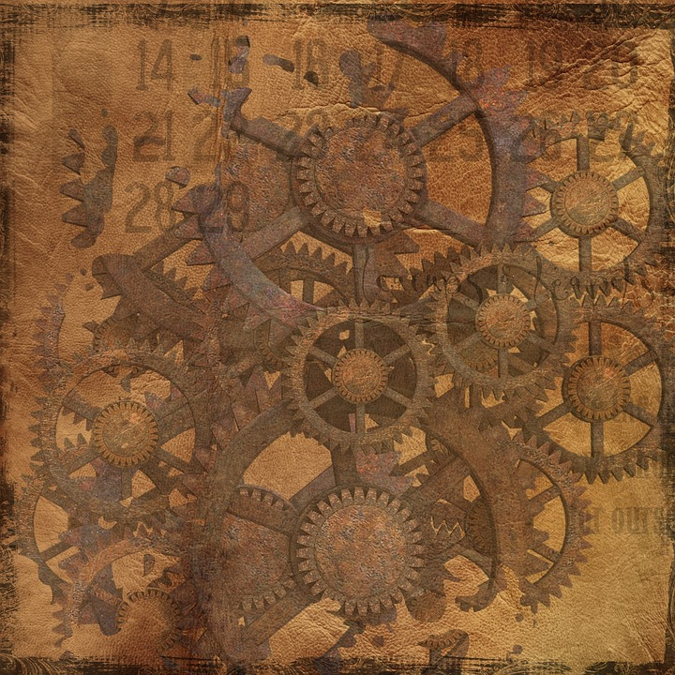
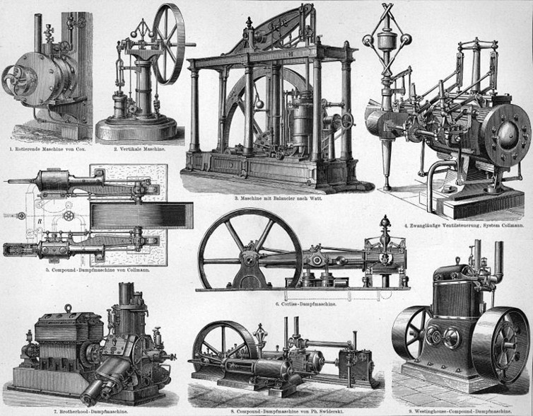
Steam Engine
Gabriel Suzuki, Colin Doyle

Slide 2
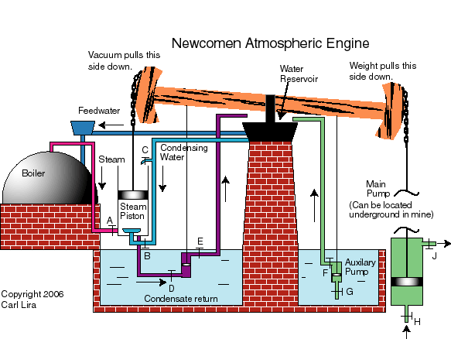
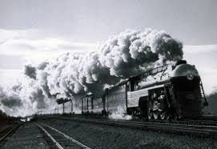
What was it used for?
1700s- was used to pump water from mines and flooded areas.
1800s- Used for transportation of materials (coal) and people on railroads..

Slide 3
Who invented it?
Thomas Savery (1698) patented the idea of using steam to pump water from mines.
Thomas Newcomen (1663-1729) made a more successful steam engine that could pump water from mines
James Watt/Matthew Boulton (1736-1819) invented the separate condenser, which are used in current systems today.
Richard Trevithick (1802) patented the first “high pressure engine” and created the first steam powered locomotive.
George Stephenson (1800s) built the first practical steam locomotive.
Horatio Allen (1828) built one of the first locomotives to be in America.
Mathias Baldwin (1831) established the Baldwin Locomotive Works.

Slide 4
How did it work/function?
One of the fundamental principles in steam-based power is condensation of water vapor which will create a vacuum.
Savery’s pump heated water and vaporized it, which created a vacuum that drew up waters from the mines
Newcomen’s pump involved differences with its mechanical structure, which removed the need for stream pressure, and used the vacuum in different method.
Steam engines in locomotives heat up water into steam and build up pressure. That pressure is then shot through a small pipe and into the piston which turns the crankshaft which turns the wheels.
Stephenson built a new locomotive using a multi-tube boiler, which allowed for improved heat transfer and greater steam vaporization.

Slide 5
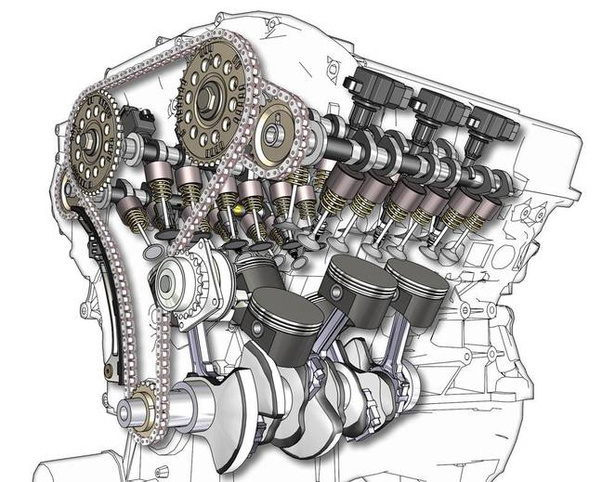
What innovations did it lead to?
The steam engine led to innovation of the combustion engine which has a similar kind of pressure chamber that uses vacuums, alongside newer technologies.
The steam engine also lead to the building of factories that didn’t have to be near rivers

Slide 6
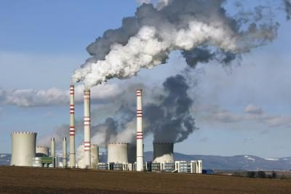
What impacts did those innovations have?
These innovations provide for many thriving countries in both their need for efficient transportation and their need for more effective production of energy.
These innovations also have some negative impacts too, both gasoline and these improved factories engines tend to be a major cause of pollution within a country. This can lead to many catastrophic events, such as global warming.

Slide 7
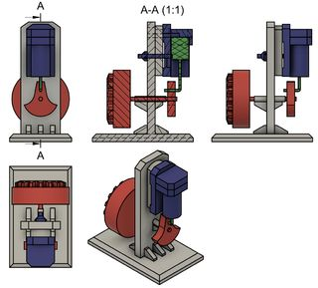
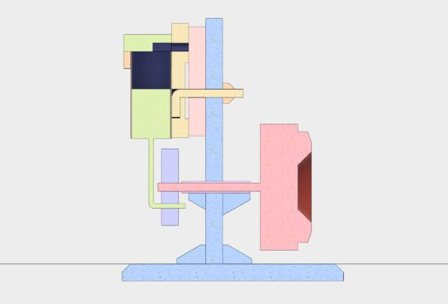
Our Steam Engine
http://www.instructables.com/id/A-Simple-Steam-Engine-Anyone-Can-Build/

Slide 8
“Steam Engine.” Wikipedia, Wikipedia, en.wikipedia.org/wiki/Steam_engine. Accessed 1 June 2017.
“Invention Of The Steam Engine.” Invention Of The Steam Engine, www.his.com/~pshapiro/steam.engines.html. Accessed 1 June 2017.
“Industrial History: The History of the Steam Engine.” ThomasNet, ThomasNet, www.thomasnet.com/articles/custom-manufacturing-fabricating/steam-engine-history. Accessed 1 June 2017.
Bibliography
“It's All About Steam.” The Transcontinental Railroad, LindaHall, railroad.lindahall.org/essays/locomotives.html. Accessed 1 June 2017.
6, CSABA CSERE. “The Future of the Internal-Combustion Engine - Feature.” Car and Driver, Car and Driver, 27 Apr. 2010, www.caranddriver.com/features/the-future-of-the-internal-combustion-engine. Accessed 1 June 2017.
Liam2317. “Cheap and Simple Steam Engine.” Instructables.com, Instructables, 26 Sept. 2016, www.instructables.com/id/A-Simple-Steam-Engine-Anyone-Can-Build/. Accessed 2 June 2017.
Lira, Carl. “Steam Engine History.” Steam Engine History, Carl Lira, 21 May 2013, www.egr.msu.edu/~lira/supp/steam/. Accessed 1 June 2017.

