Slide 1
COLD CALL
Chapter 5
Severing the Bonds of Empire

Slide 2
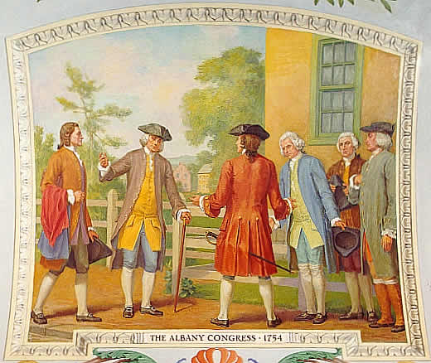
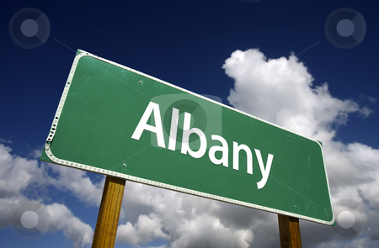
Summarize the Albany Congress by explaining the motivation for and goals of this political meeting.
What was the result of the Albany Plan of Union, specifically upon colonial unity?

Slide 3
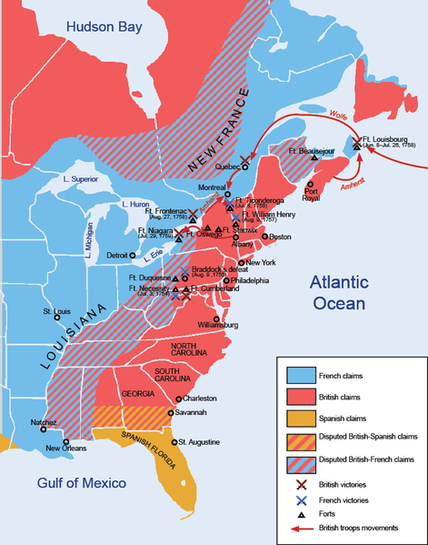
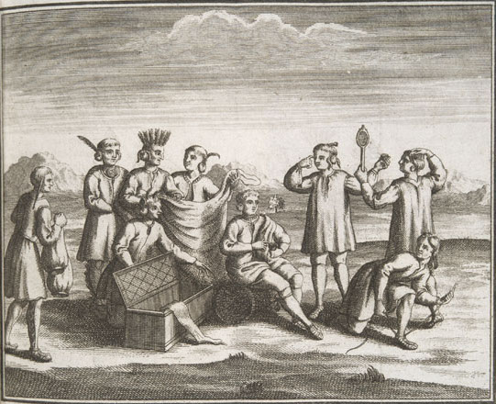
How did the British, French and Native interests in the Ohio River Valley lead to a controversy that would spark a major war?

Slide 4
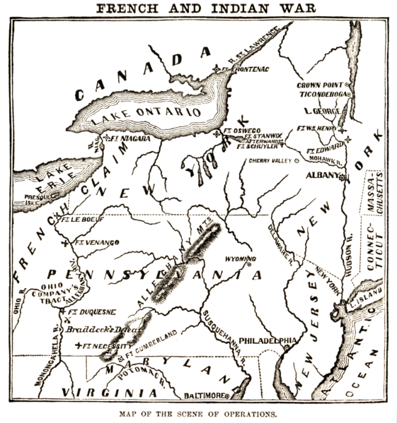
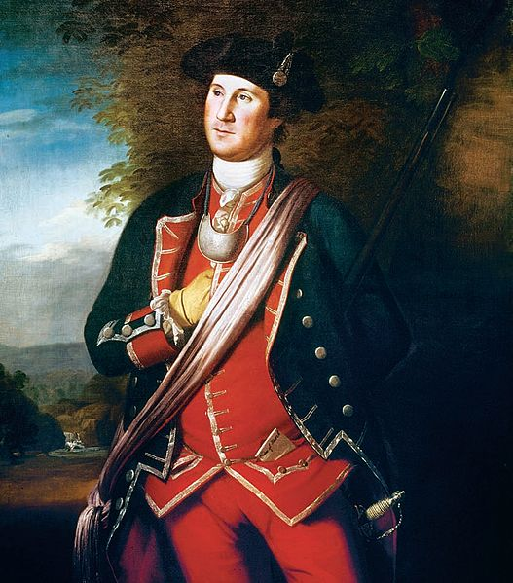
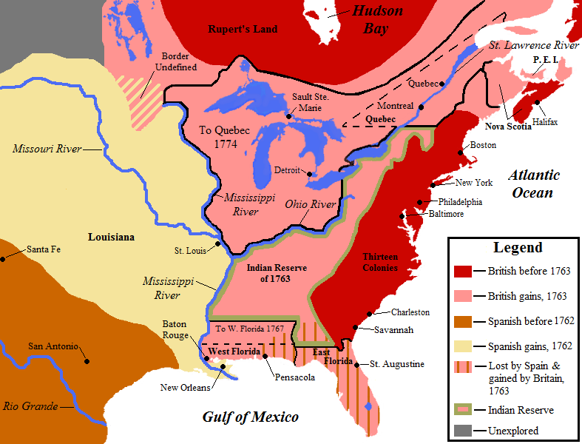
Explain the outcome of the Seven Years War, including an explanation of the Treaty of Paris.

Slide 5
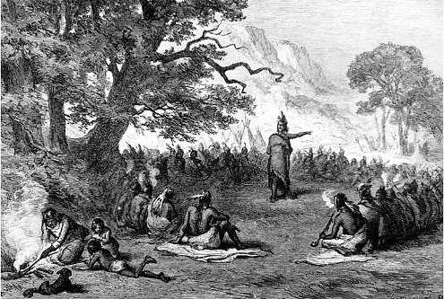
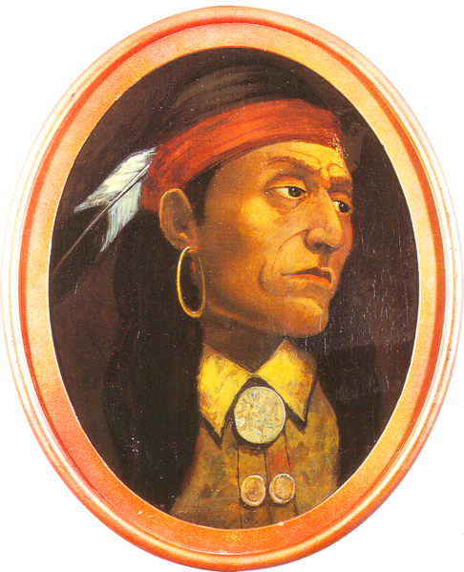
Summarize the strategies and actions taking by Neolin and Pontiac.
What did these uprisings demonstrate to the British?

Slide 6
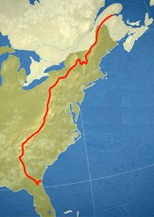
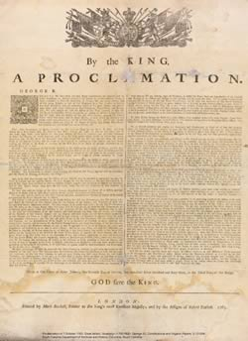
Summarize the Proclamation of 1763
Explain why this law angered colonists?
Which groups in particular were “infuriated” by this law?

Slide 7
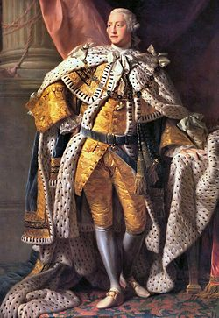
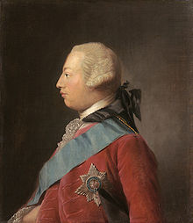
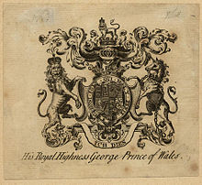
Characterize the personality, leadership, and decision making of King George III.
Be sure to include his relationship with George Grenville.

Slide 8
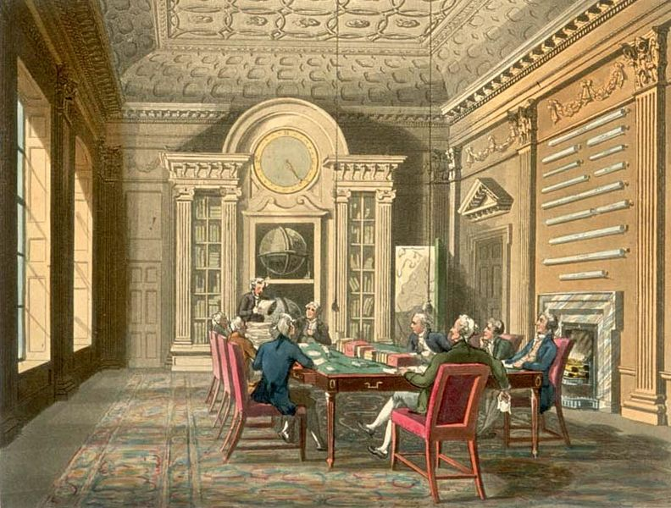
Explain how the Sugar Act and the Currency Act affected both the colonists’ economic and legal rights.
Compare and Contrast these laws to the long accepted Navigation Acts.

Slide 9
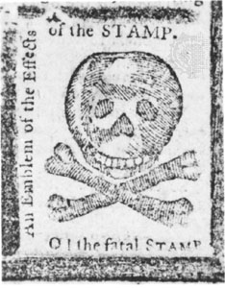
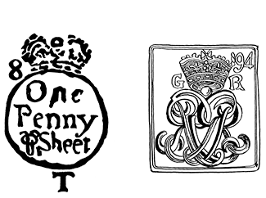
Summarize the stipulations of the Stamp Act.
Explain why merchants and the colonial elite were effected more so than the average colonist.

Slide 10
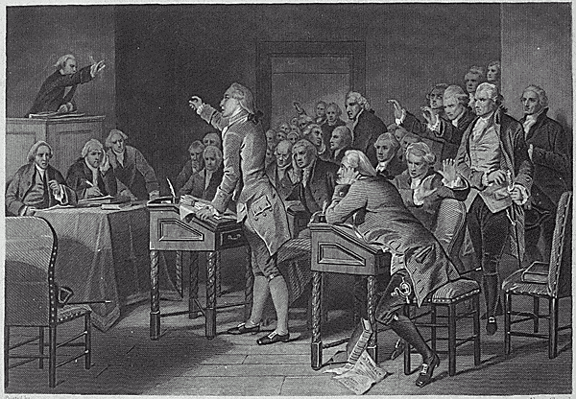
Summarize the arguments proposed first by James Otis and then by Patrick Henry as part of the Virginia Stamp Act Resolves.

Slide 11
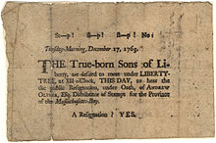
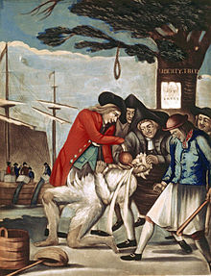
Describe the early attempts and strategies of organized colonial protest.
Discuss the results of these protests.
Be sure to include the Loyal Nine, Sons of Liberty, and Stamp Act Congress in your answer

Slide 12
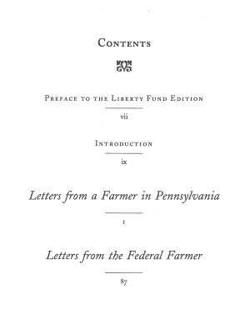
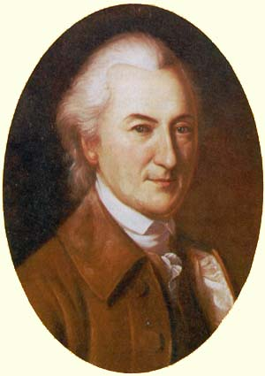
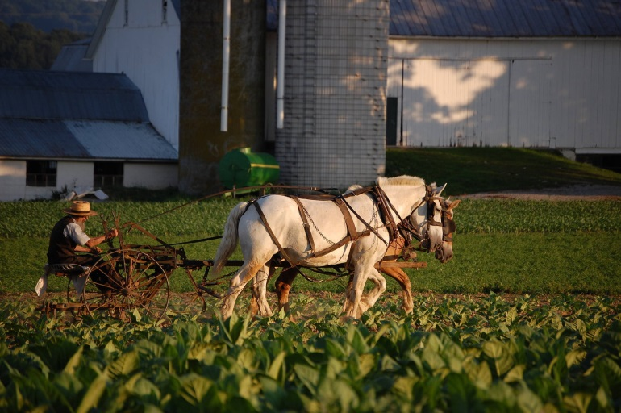
In response to escalating taxation such as the Townshend Act, colonial protest increased.
How did essays, public rituals, and protest organizations help to spread revolutionary thought and educate colonists?

Slide 13
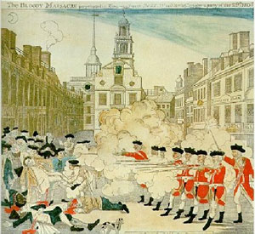
Describe the Boston Massacre.
How did, the Boston Massacre in 1770, and later the Committees of Correspondence that began in 1772, fuel revolutionary thought in the colonies?

Slide 14
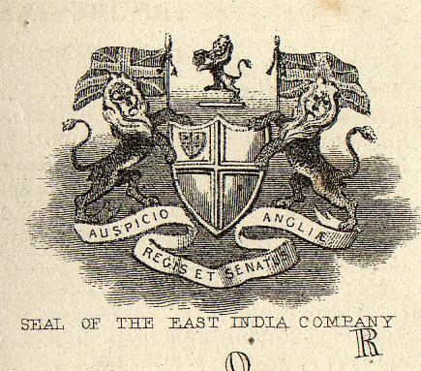
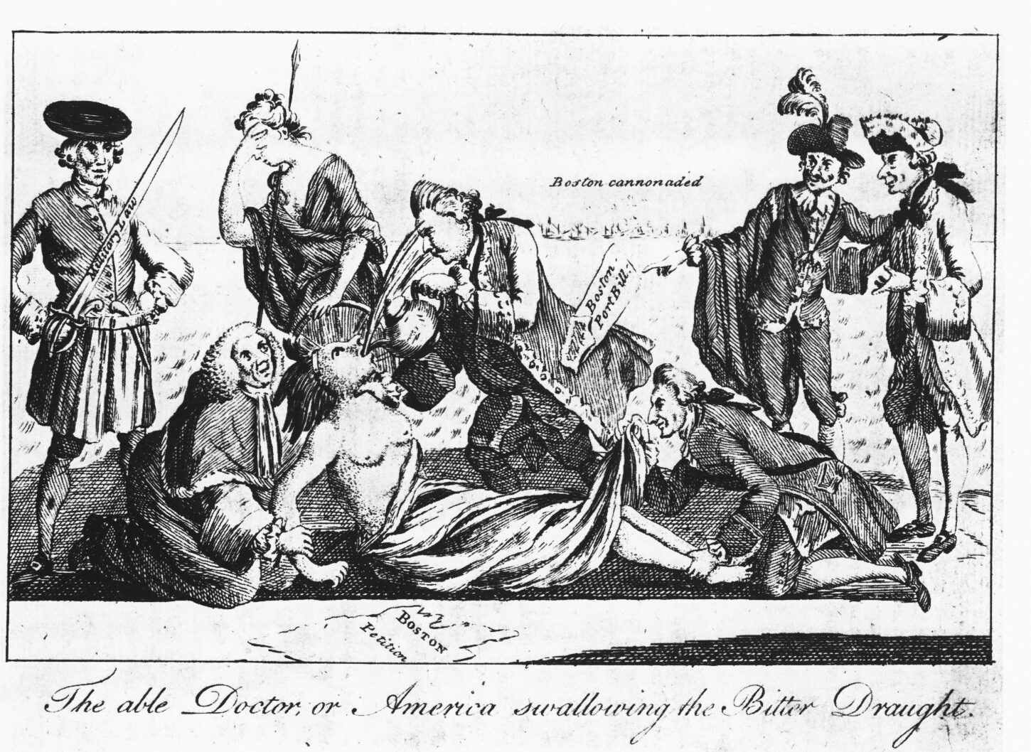
Summarize the
Tea Act
Coercive Acts or Intolerable Acts, including the Quartering Act
Quebec Act
How did these laws threaten the economic, political, and social rights of the colonists?

Slide 15
Lightning Round
1754 meeting of Colonial delegates to coordinate defense against growing threat of French
Negotiated end to the Seven Year’s War granting Great Britain territorial claim to a majority of North America

Slide 16
Lightning Round
British declaration that denied colonists access to land beyond the Appalachian Mountains
Tyrant British ruler who assumed the crown in 1760 and initiated tighter control of the American colonies

Slide 17
Lightning Round
1754 meeting of Colonial delegates to coordinate defense against growing threat of French
Negotiated end to the Seven Year’s War granting Great Britain territorial claim to a majority of North America

Slide 18
Lightning Round
Virginia lawyer who advocated for colonial rights in his “Virginia Stamp Act Resolves”
British legislation that levied taxes on important trade goods such as paper, glass, led, and tea.

Slide 19
Lightning Round
One of the earliest British regulations that laid duties or import taxes along with establishing a vice-admiralty court to discourage smuggling
An intercolonial association that channeled resistance (mostly) acceptable forms of protest

Slide 20
Lightning Round
1770 incident at a New England Custom’s House between colonists and the British military, resulting in the death of 5 people
Formed to communicate colonial grievances, “infringements, and violations” throughout the colonies

Slide 21
Lightning Round
British legislation in 1773 that granted an economic trade monopoly to the East India Company
British legislation that allowed for military officers to commandeer privately owned property to house troops

Slide 22
Lightning Round
December 1773 incident in which colonists disguised as Native Americans boarded ships in a New England Harbor
Series of four laws aimed at punishing Boston by closing the harbor, adjusting the colonial charter, increasing the power of British governors, and outlawing town meetings

