Slide 1
COLD CALL
Chapter 11 / 12C, 14A and 13A
Manifest Destiny
and Expansion,
The South and Slavery

Slide 2
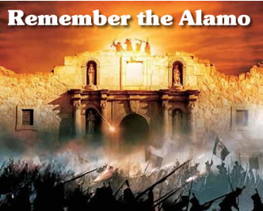
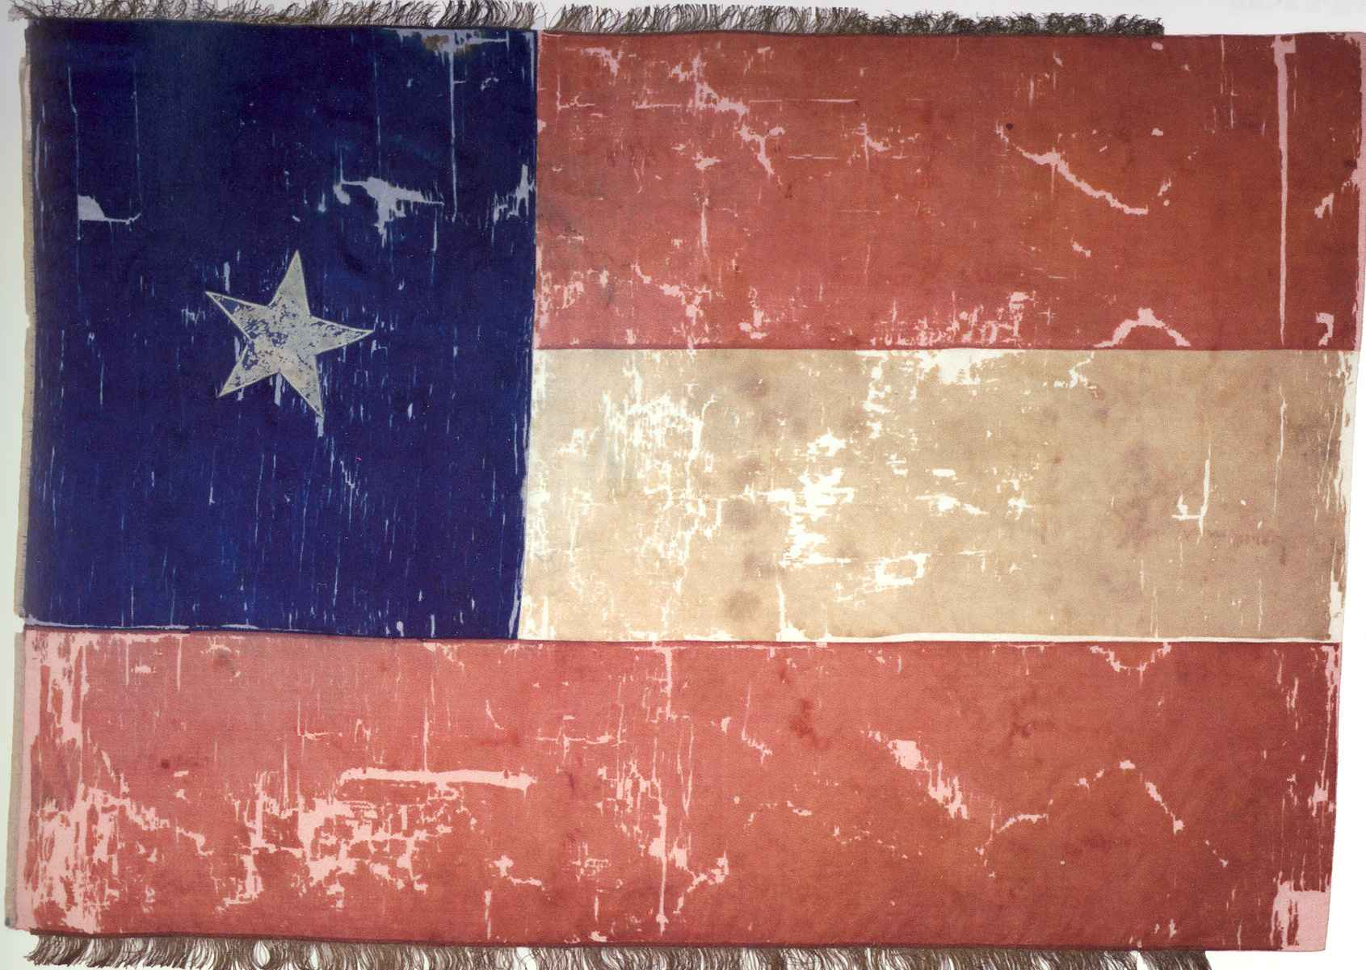
Explain how many Americans came to eventually settle in Texas
Describe how this settlement led to a war for Texas’ independence

Slide 3
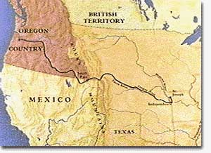
Summarize the significance of the phrase “Fifty-Four Forty or Fight” and the expansion of the U.S. to the Pacific Ocean.
How did the United States finally come to acquire Oregon?

Slide 4
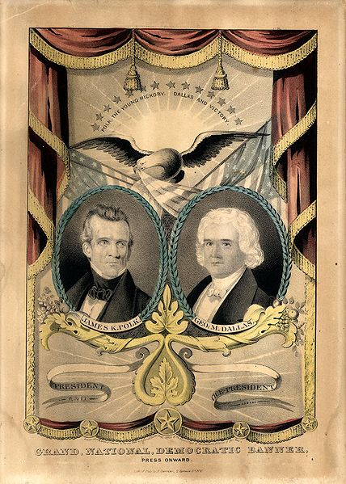
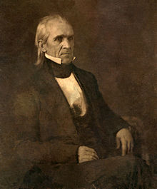
Describe the…
candidates
key issues and
the outcome
of the Presidential Election in 1844.

Slide 5
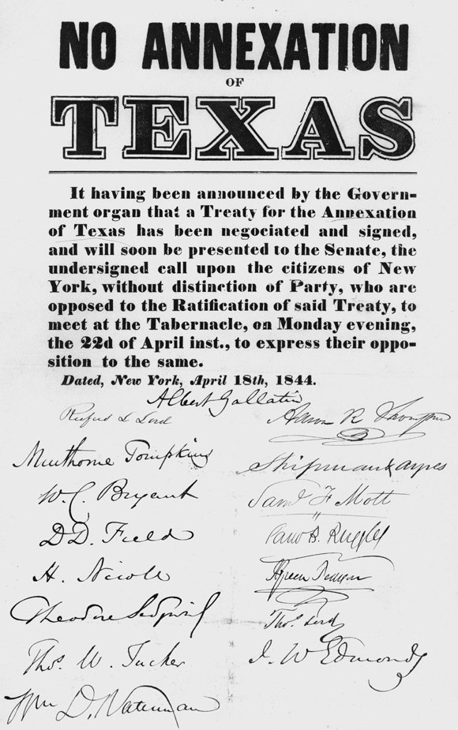
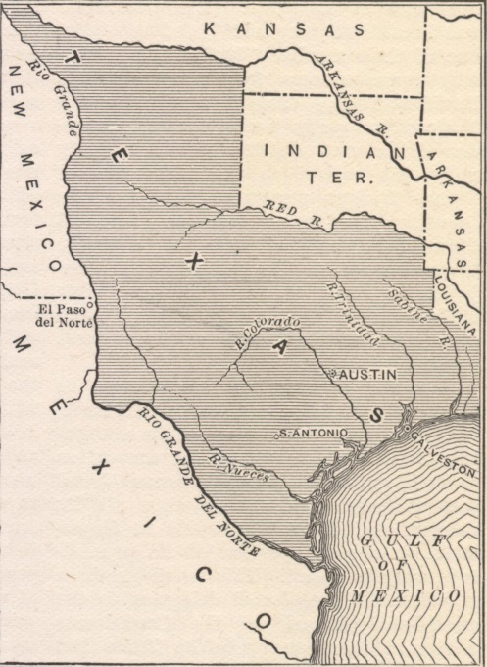
Explain the course of events that eventually led to the United States officially annexing Texas in December of 1845.

Slide 6
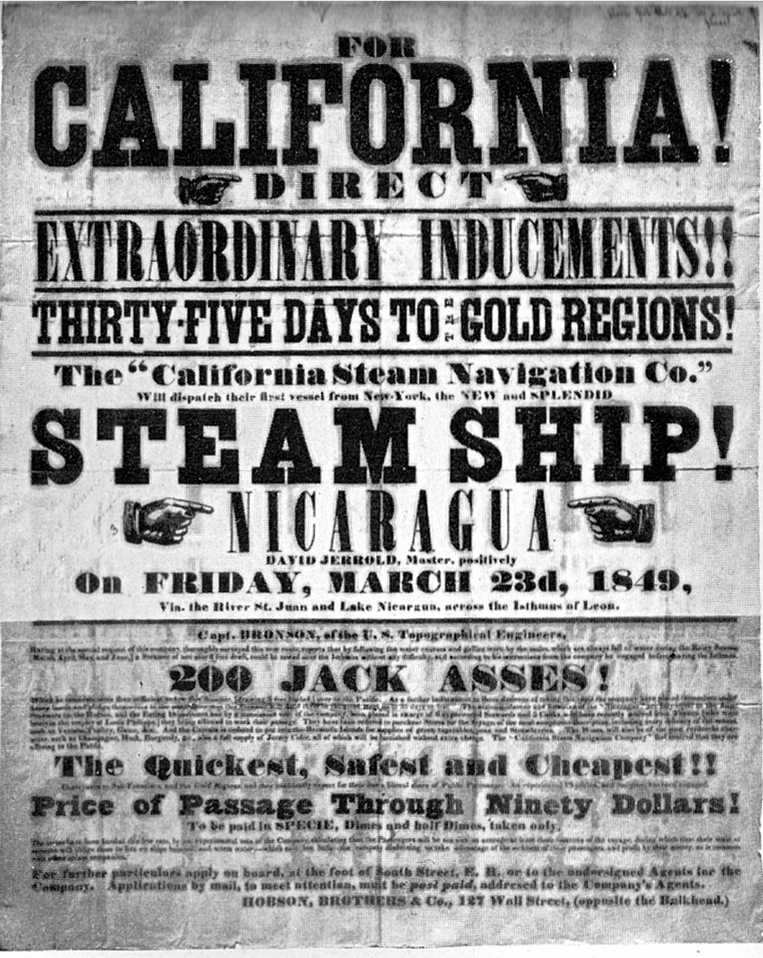
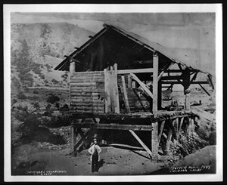
Who is James Marshall and what impact did he have on westward expansion?

Slide 7
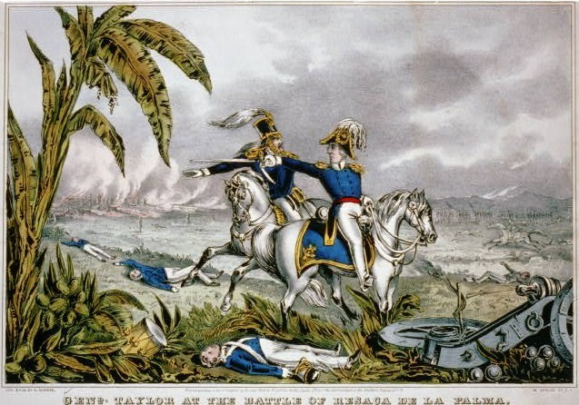
Discuss the stipulations of the Treaty of Guadalupe Hidalgo and the overall impact of the War with Mexico

Slide 8
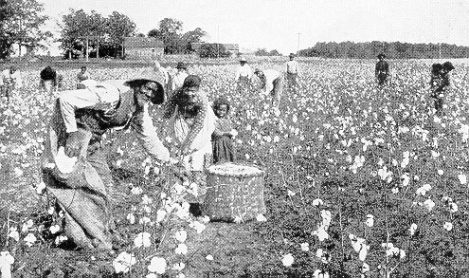
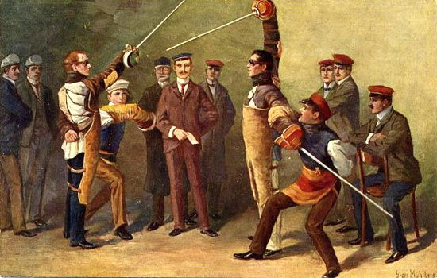
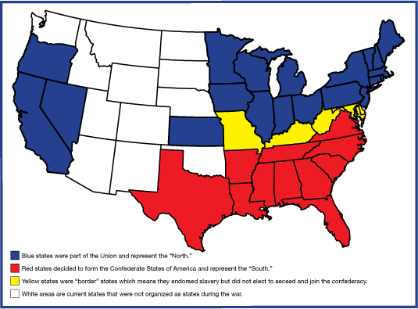
Compare and Contrast the North and South by the mid 1800s.
Think about various aspects of
social life
traditions,
geography,
economic activity, and
religion

Slide 9
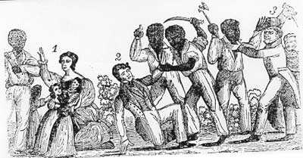
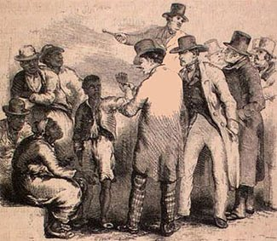
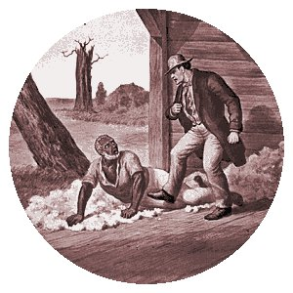
Summarize the various proslavery arguments that existed in the 1800s

Slide 10
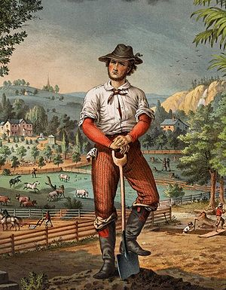
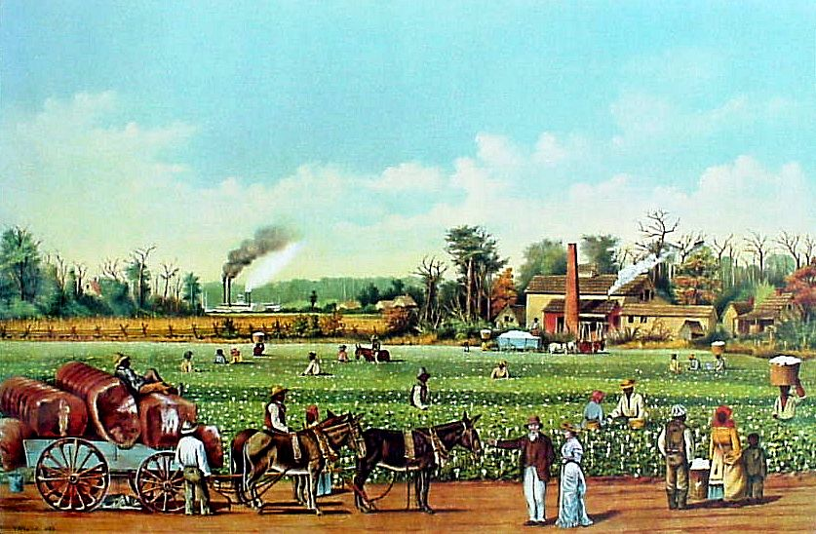
Explain the social hierarchy that existed in the South leading up to the Civil War.

Slide 11
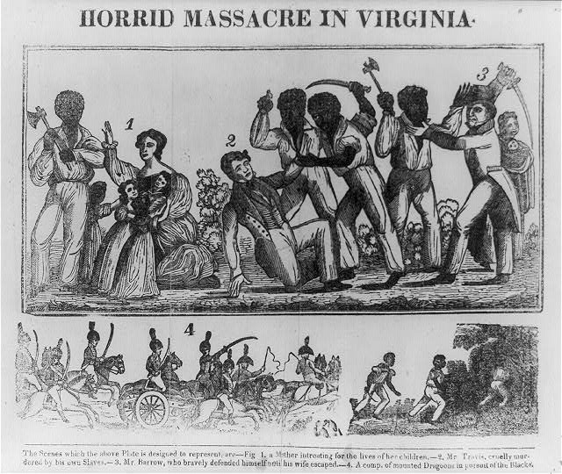
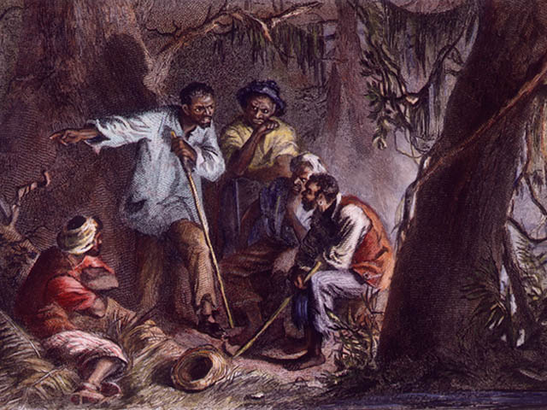
Summarize the various resistance efforts made by African Americans Slaves in the early 1800s
Hint….Gabriel, Vesey and Turner
Explain the changes brought about by these rebellions.

Slide 12
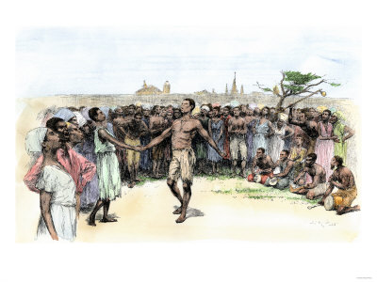
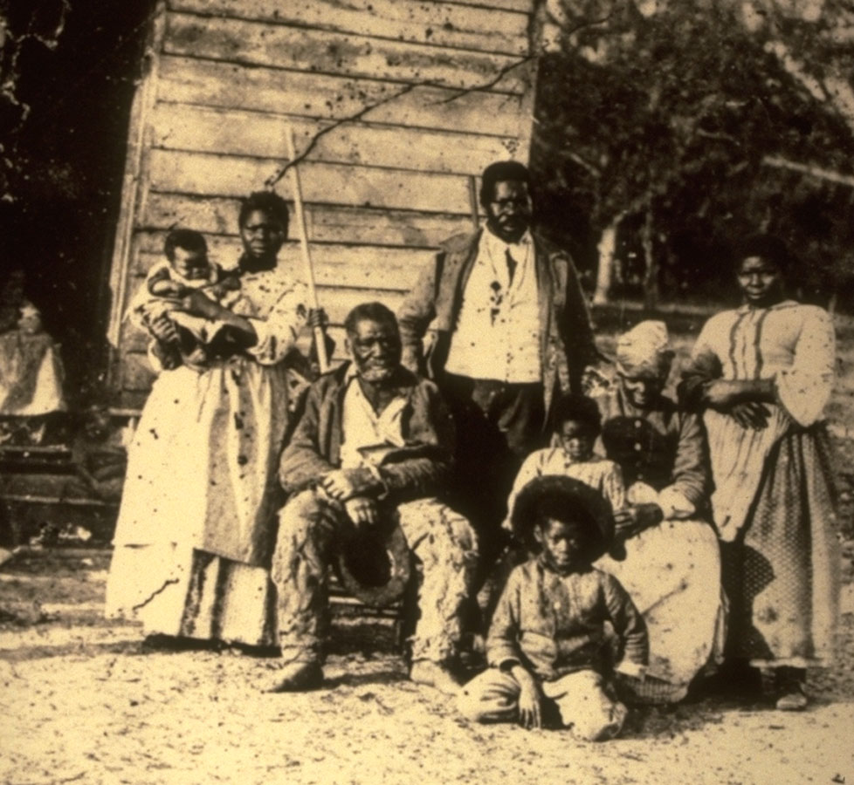
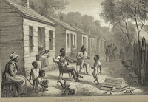
Explain how African-Americans were able to maintain a unique slave culture despite obvious obstacles and poor treatment

