Slide 1
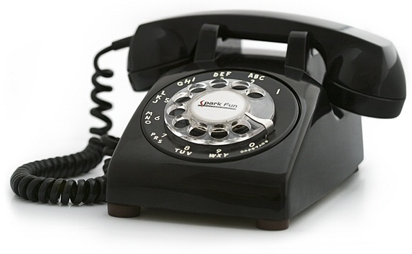
COLD CALL
Chapter 9
Partisan Politics and War: The Democratic-Republicans in Power
1801 - 1815

Slide 2
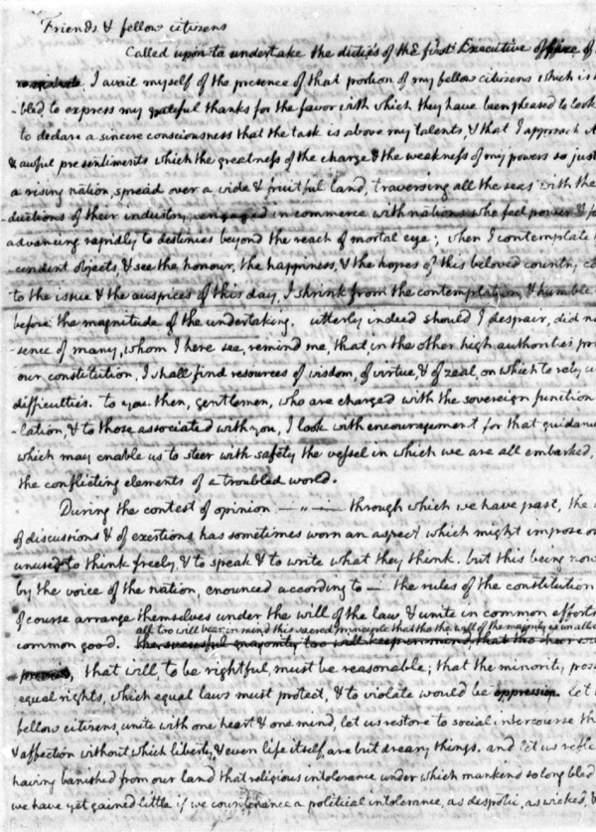
Jefferson referred to his winning the presidency as the “Revolution of 1800,” and in his Inaugural Address he reached out to his opponents and laid out his vision of a restored republicanism.
Explain the significance of this political revolution and summarize Jefferson’s vision for the future of America.

Slide 3
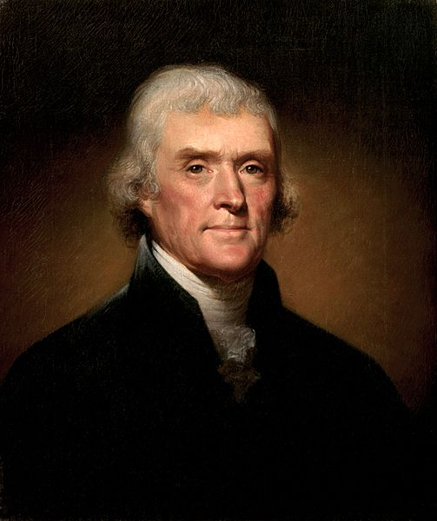
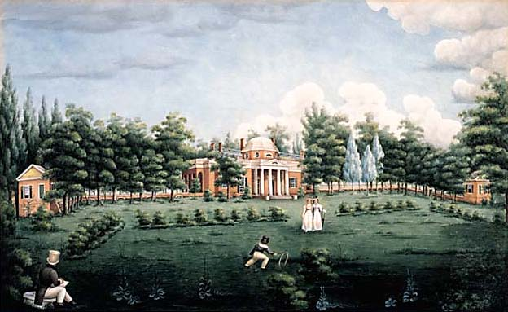
Explain how Jefferson worked to extend the power of the Democratic-Republicans and diminish the political control of the Federalists. Be sure to give specific examples.

Slide 4
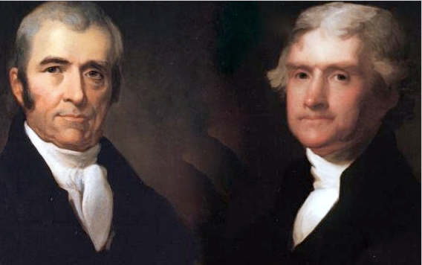
Compare and Contrast John Marshall and Thomas Jefferson.

Slide 5
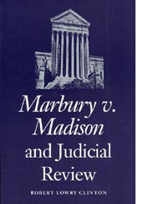
Summarize the details of the SCOTUS case, Marbury v. Madison (1803) and explain the significance of the ruling handed down by Chief Justice John Marshall.

Slide 6
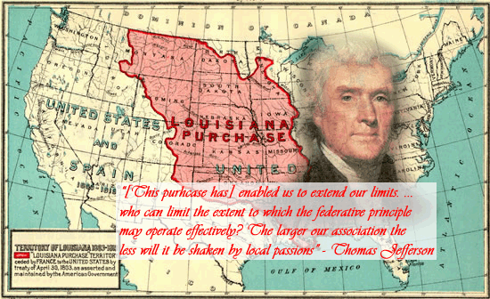
Describe how the United States came to acquire the Louisiana Territory and the overall impact of the Louisiana Purchase on the young nation.

Slide 7
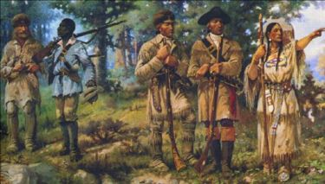
The Lewis and Clark expedition has been described as diverse, legendary, democratic, and controversial. Support, modify, or refute these characterizations.

Slide 8
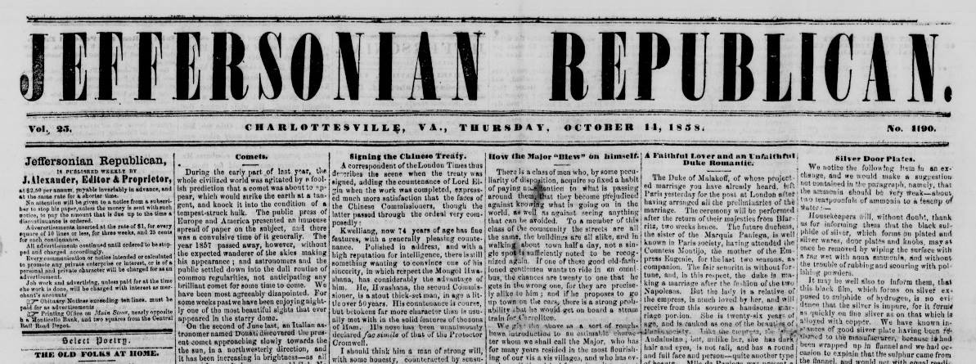
Jefferson is quoted in the chapter “The great extent of our republic is new. Its sparse habitation is new. The mighty wave of public opinion which has rolled over is new.”
Describe the efforts of Democratic-Republicans to control that wave.

Slide 9
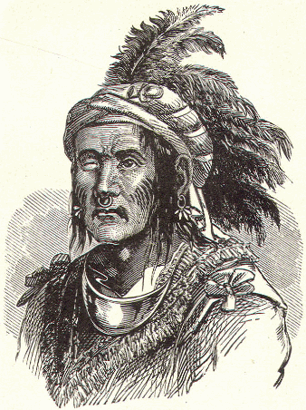
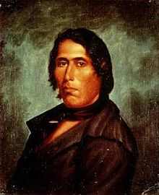
Examine the methods and evaluate the results of the efforts by the Prophet and Tecumseh to resist further American encroachment on Native American land in the west.

Slide 10
Jefferson advocated for “Peace, commerce, ad honest friendship with all nations, entangling alliances with none.” Analyze the ways in which American commerce and neutrality where threatened by the actions of Great Britain and the American response to this aggression.

Slide 11
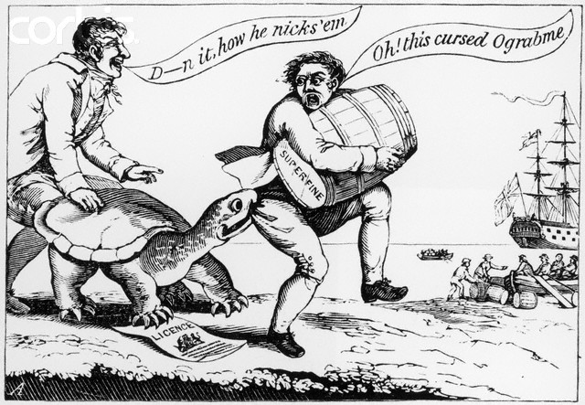
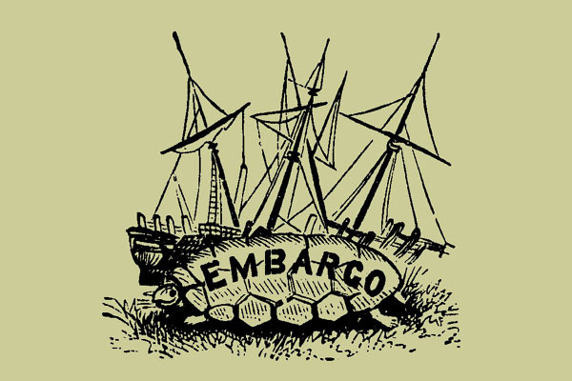
In an attempt to avoid war Jefferson helped to pass the Embargo Act.
Summarize stipulations of this law and examine the reactions of Americans to this law and its long term impact on American commercial interests.

Slide 12
Both President James Madison and the “War Hawks” in Congress urged American involvement in the conflict that would become the War of 1812.
Explain the causes of the War of 1812 by analyze the debate over American foreign policy.

Slide 13
Describe the folklore associated with Dolley Madison during the Burning of Washington and Francis Scott Key in the bombardment of Fort McHenry in Baltimore.

Slide 14
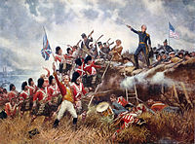
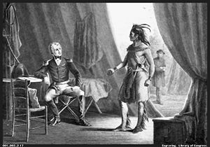
Explain how Andrew Jackson’s role in the Campaign against the Creeks and the Battle of New Orleans gave rise to his political prominence.

Slide 15
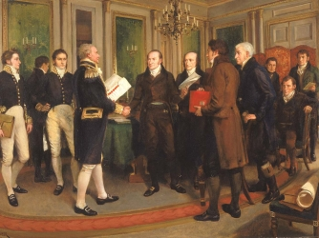
Summarize the diplomatic negotiations that resulted in the Treaty of Ghent. Be sure to include a description of the treaty’s details.

Slide 16
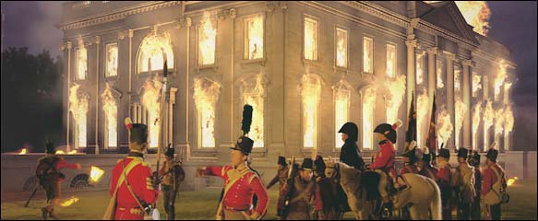
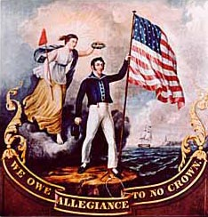
Analyze the consequences of the war in regards to three of the following issues or groups:
military,
American foreign policy aims,
Native Americans,
African Americans,
American defense and transportation,
economic growth, and
the fate of the Federalist Party

Slide 17
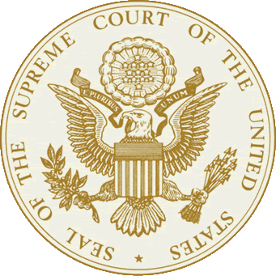
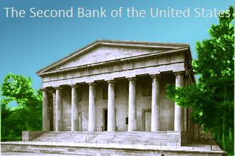
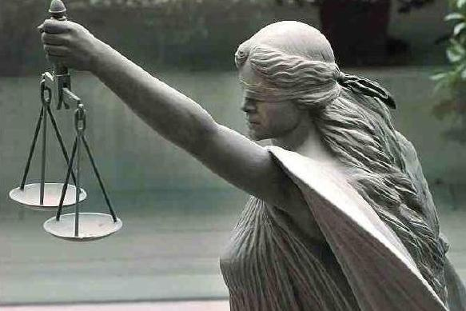
Describe the details of the Supreme Court Case, McCulloch v. Maryland (1819) and explain the significance of the ruling handed down by Chief Justice John Marshall.

Slide 18
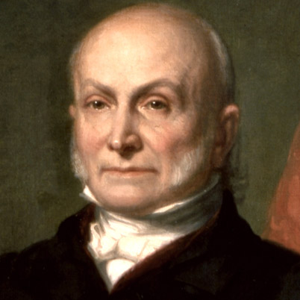
Summarize American foreign policy under Sec. of State John Quincy Adams.
“The U.S. goes not abroad, in search of monsters to destroy. She is the well-wisher to the freedom and independence of all.”

Slide 19
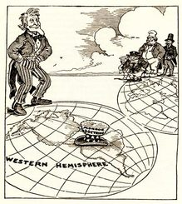
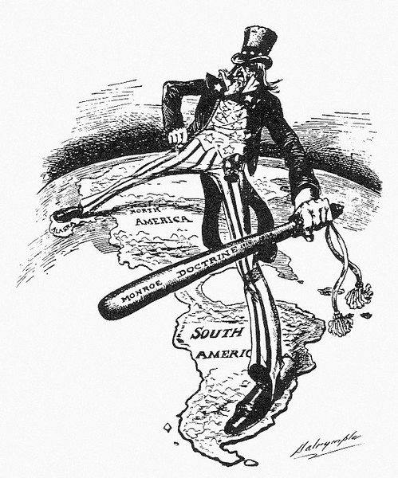
Describe the details of the Monroe Doctrine and American involvement in Latin America.

Slide 20
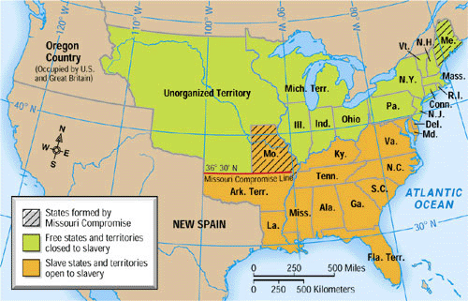
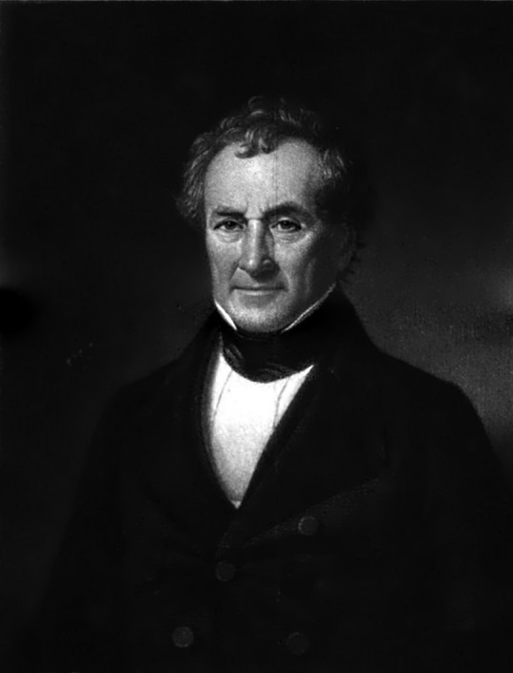
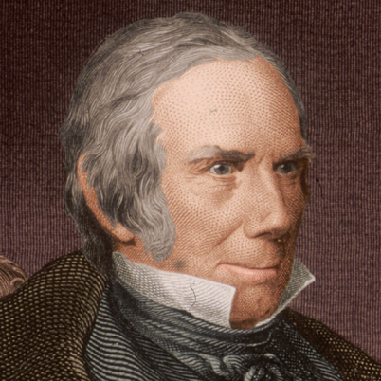
How did the issue of slavery “like a fire bell in the night awaken” in the U.S. by 1819?
Be sure to describe both the Tallmadge Amendment and the Missouri Compromise

