Slide 1
The Cold War
By Morgan Birthright and Ellie Aguilar

Slide 2
To what extent did the people, events and alliances of the Cold War represent the global tension of 1945 to 1991?

Slide 7
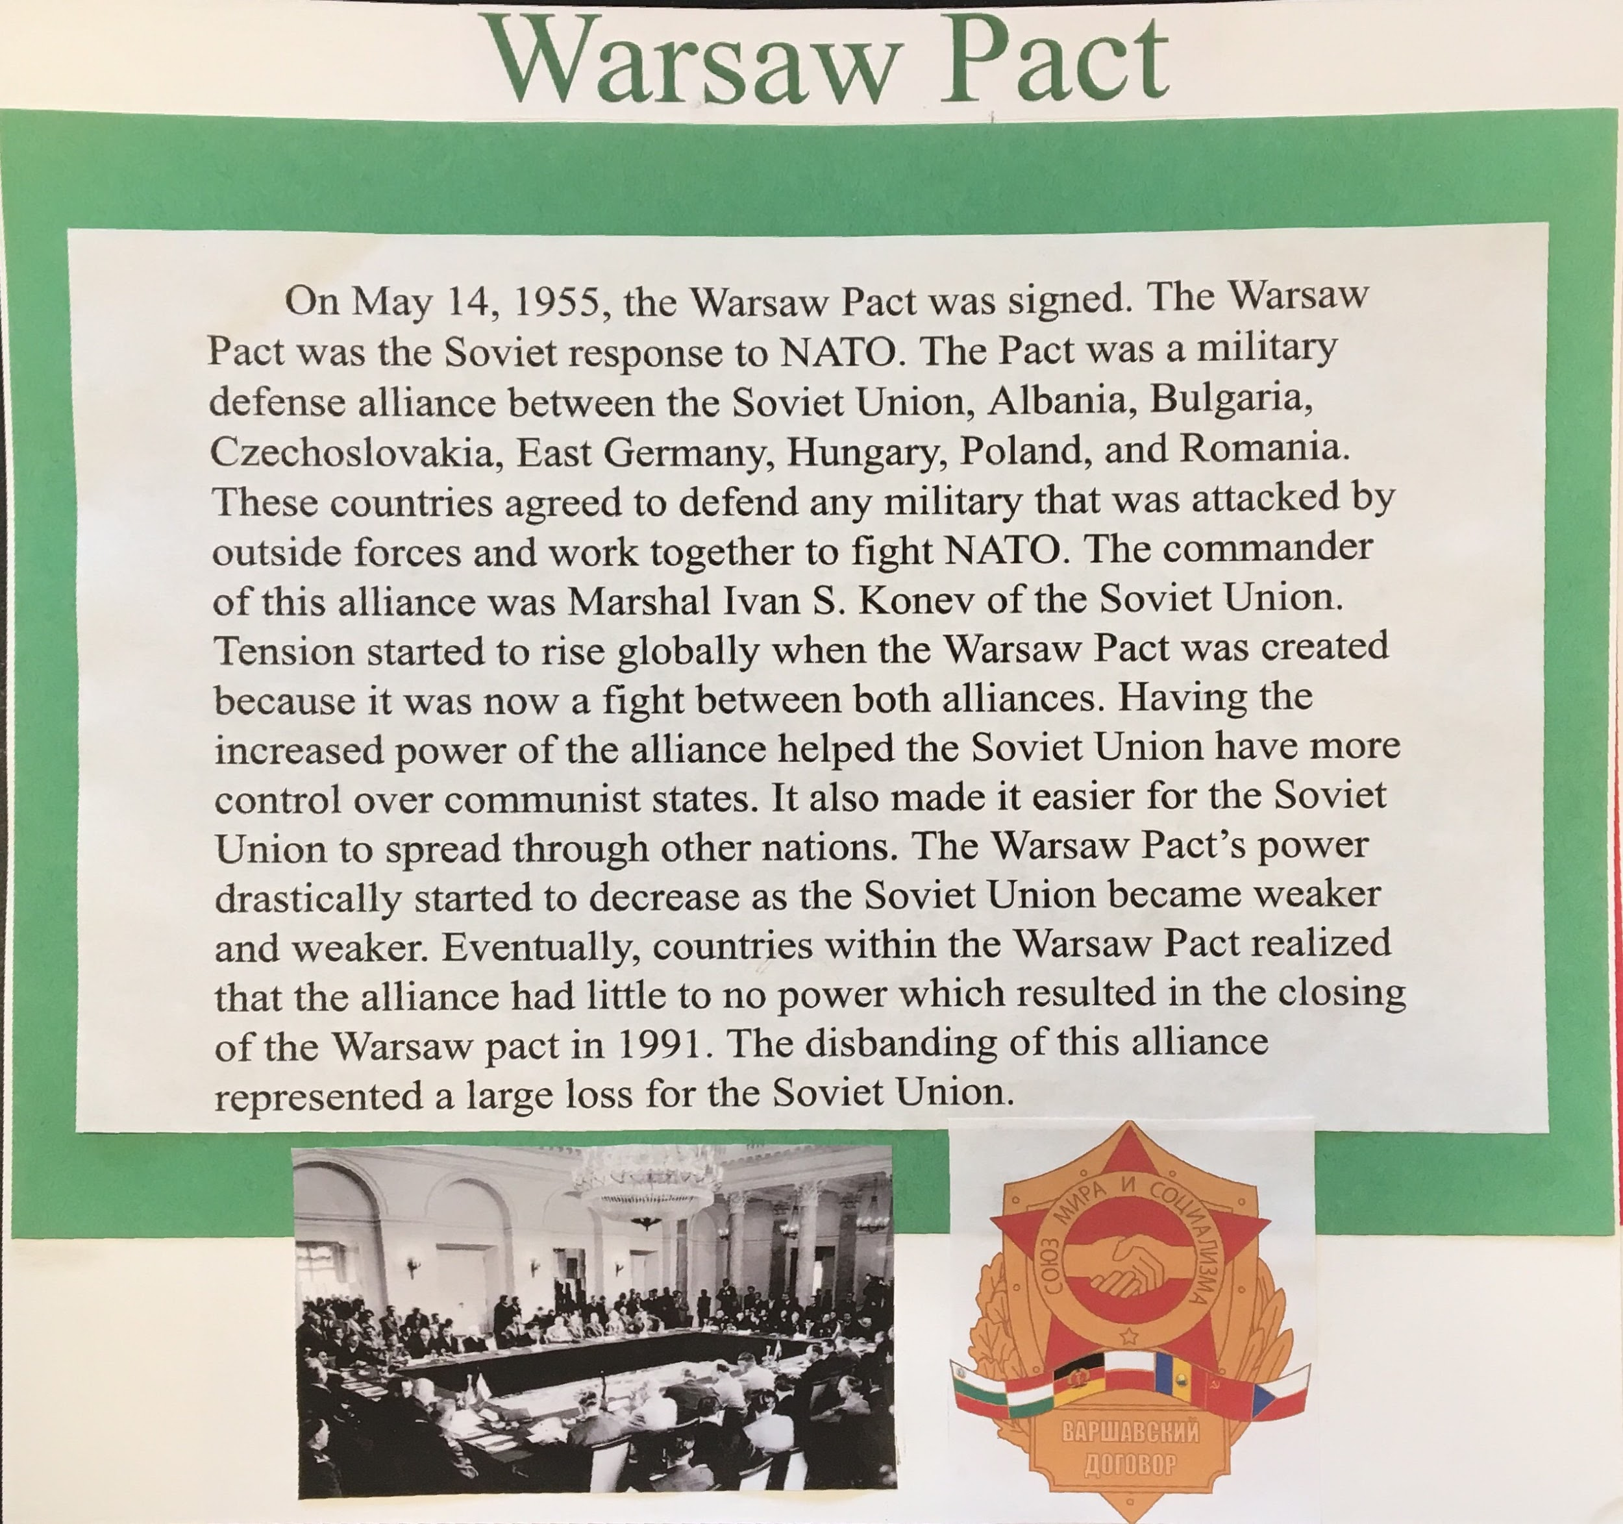

Slide 9
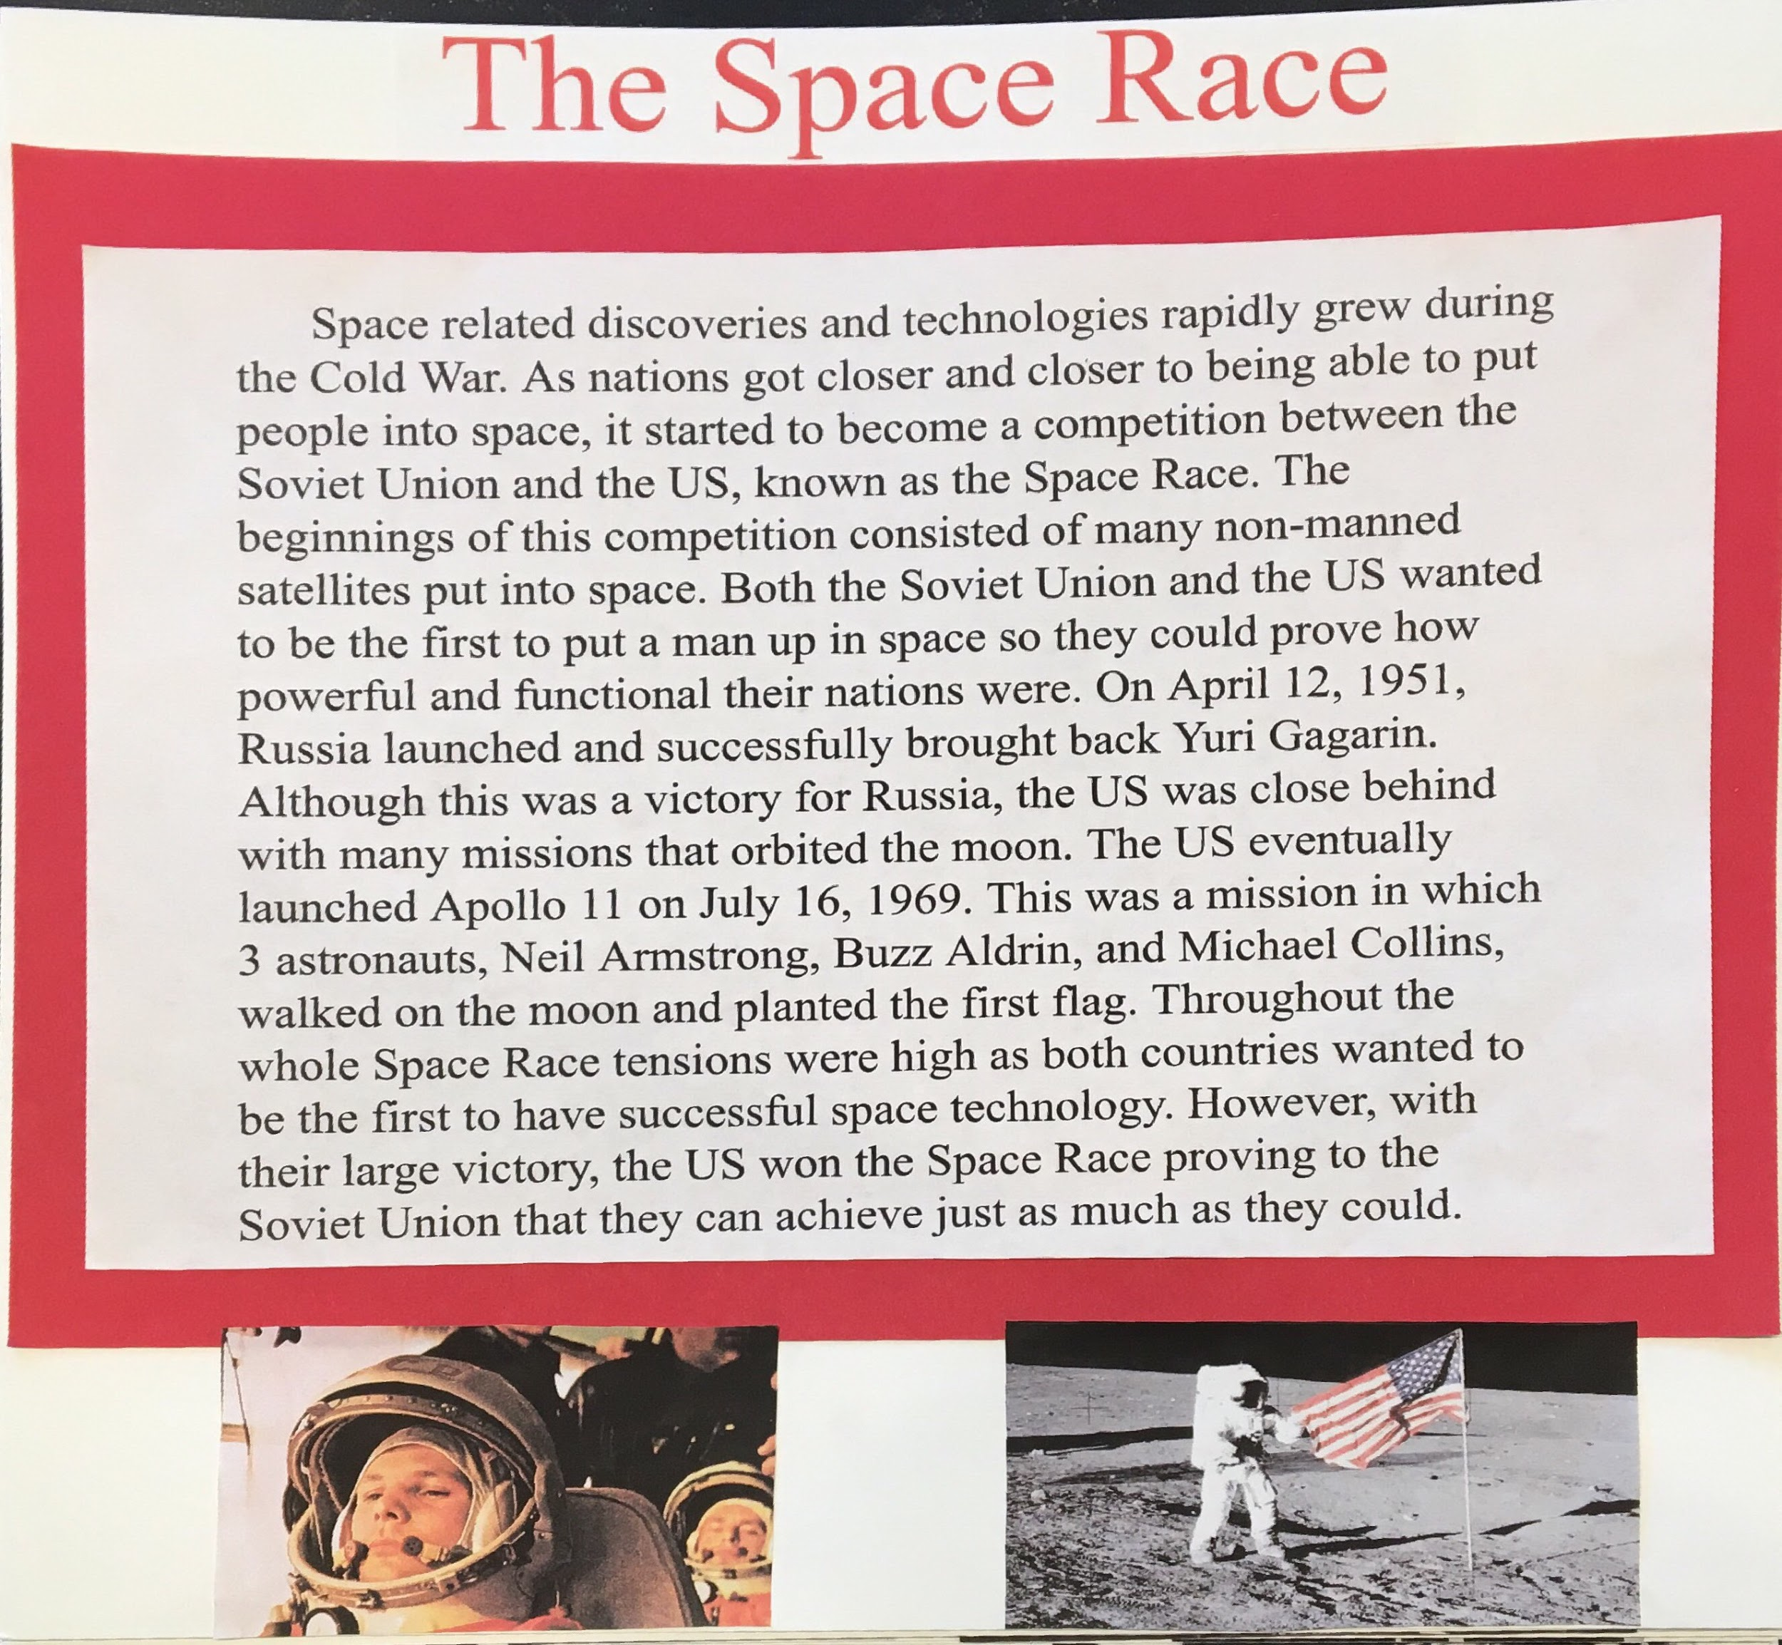

Slide 10
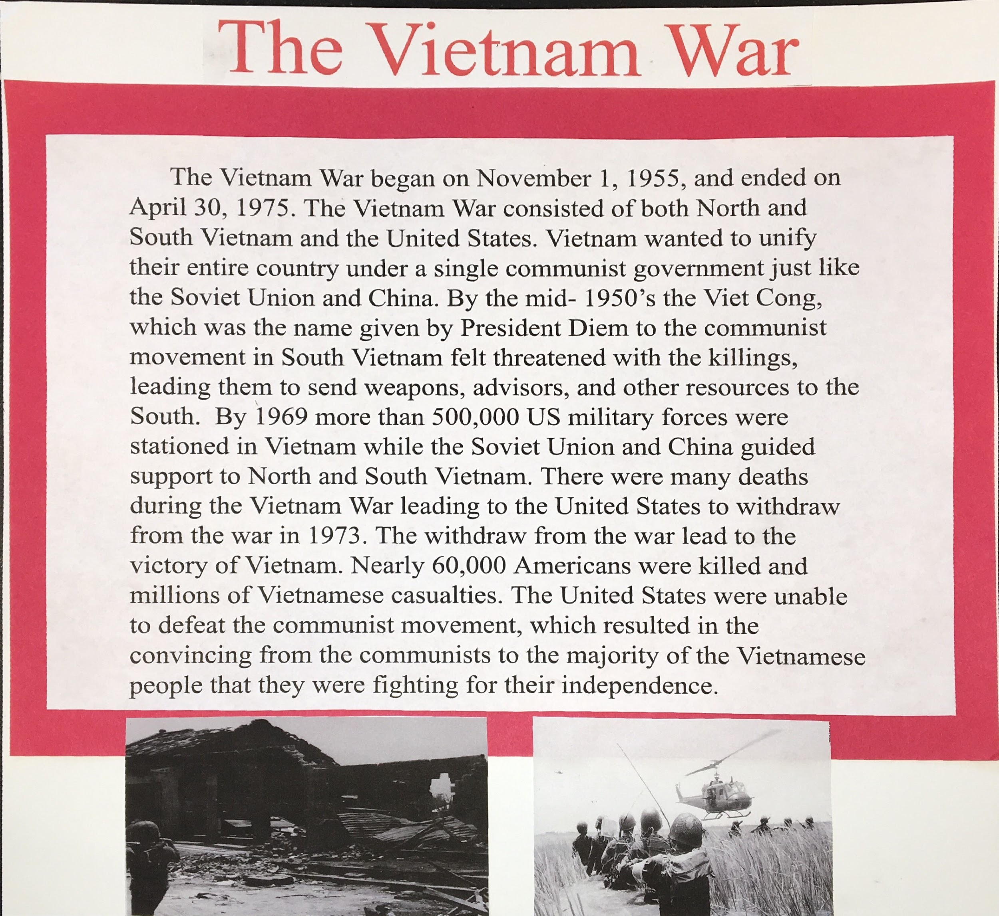

Slide 11
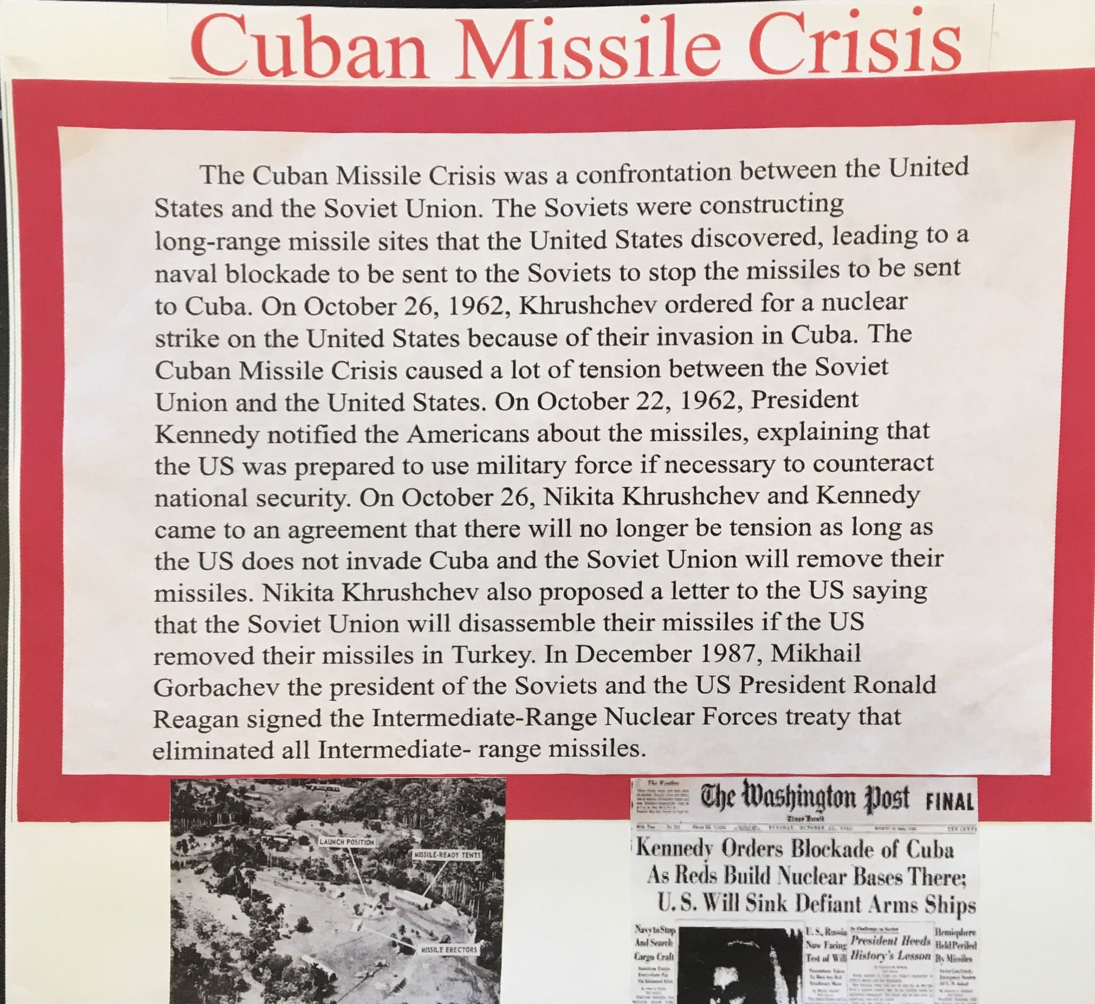

Slide 12
