Slide 1
World Powers Before and After the Industrial Revolution
By: Elijah Moss

Slide 2
France 1st Pre-Industrial Revolution
France dominated the globe and exerted their power and influence through their superior navy and maritime navigation skills and tactics.

Slide 3
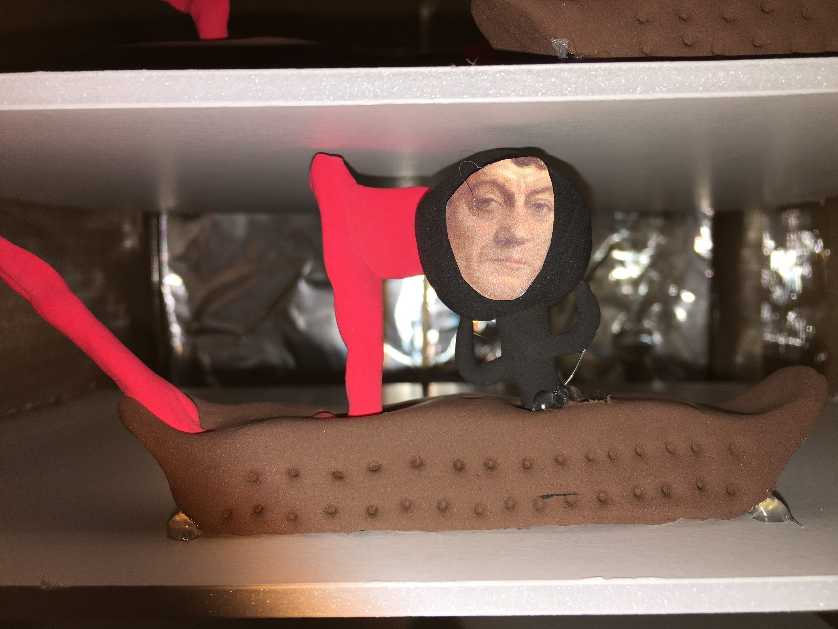
Spain 2nd Pre-Industrial Revolution
Spain’s extreme efforts to expand and conquer new lands in order to obtain resources was a main factor in them becoming a world power.

Slide 4
England 3rd Pre-Industrial Revolution
England participated in the triangle trade by receiving cash crops and raw materials from the New World and producing manufactured goods and exporting them to Africa. This increased their economy dramatically and allowed them to become a world power.

Slide 5
Ottoman 4th Pre-Industrial Revolution
The Ottomans primarily rose to power because of their military might and technology as well as being one of the first to implement gunpowder into their society.

Slide 6
Mughal 5th Pre-Industrial Revolution
The Mughal empire derived a lot of their military tactics, and weapons, as well as their methods of expansion from the Mongols, which together contributed to their large territory and control in the region, cementing the Mughal empire as a world power.

Slide 7
Britain 1st Post-Industrial Revolution
This exact replica of factories in Britain is a prime example of how Britain was the industrial capital of the world post-revolution and derived most of their economy from production.

Slide 8
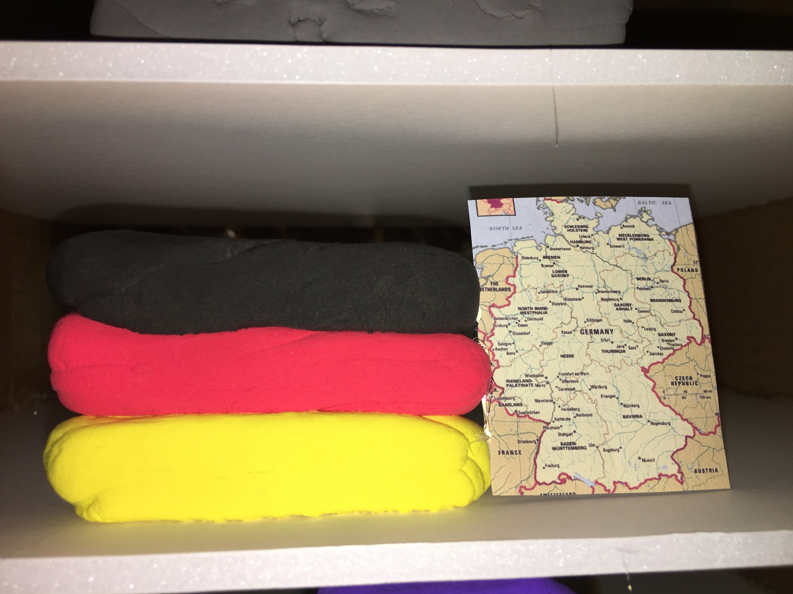
Germany 2nd Post-Industrial Revolution
Germany(as well as Britain and many others post-revolution) gained power from the four key qualities of a successful world power which are having a large working population, strong political structure, natural resources, and trade networks. This map shows how Germany was formed by combining multiple small, separated European nations, which caused their large population and natural resources.

Slide 9
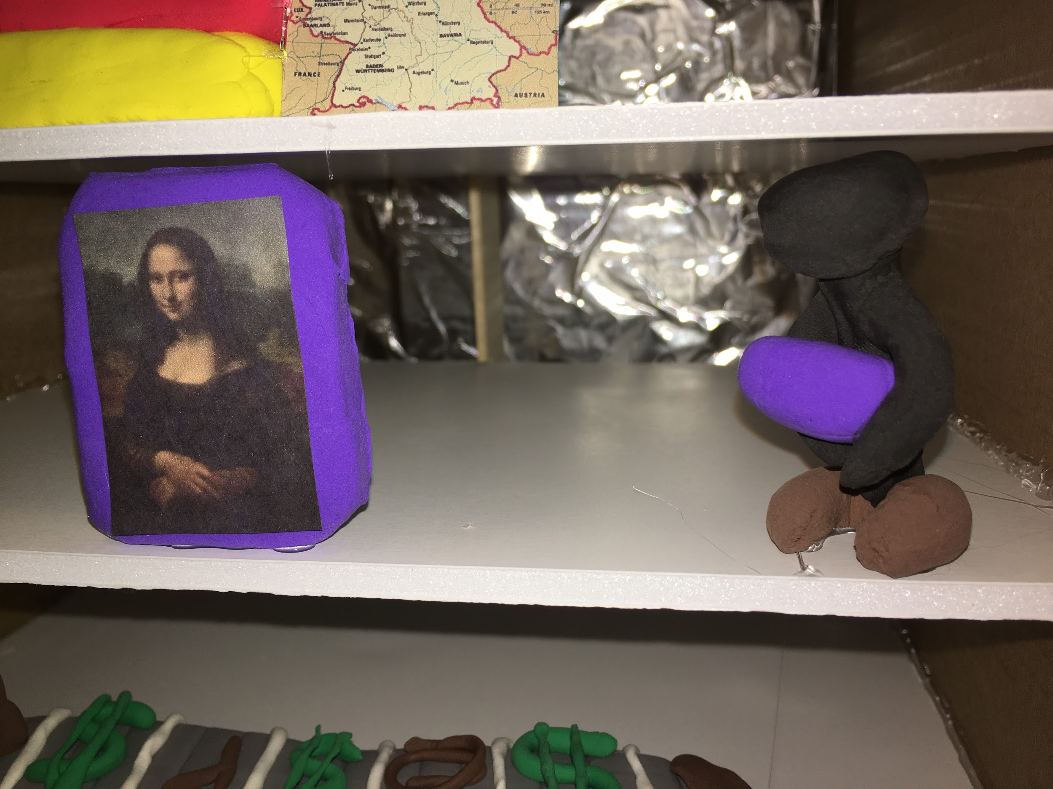
France 3rd Post-Industrial Revolution
The Renaissance, which was spurred on by the industrial revolution increased France’s economy and saw advancements in art, culture, philosophy, technology, which further increased France’s influence globally.

Slide 10
Austria-Hungary 4th Post-Industrial Revolution
This image represents Austria-Hungary’s main cause of rising to power being their superior economy and production ability, which allowed them to sustain the highest percentage growth of GNP at 1.76% every year from 1870-1913. Higher growth than any of the other world powers.

Slide 11
Russia 5th Post-Industrial Revolution
Russia’s huge population and amount of land allowed for it to have the most productive workforce and most natural resources than most other world powers, allowing them to produce and grow a strong economy and political structure. This strong political structure and economy helped Russia sustain their population and become a world power.

