Slide 1
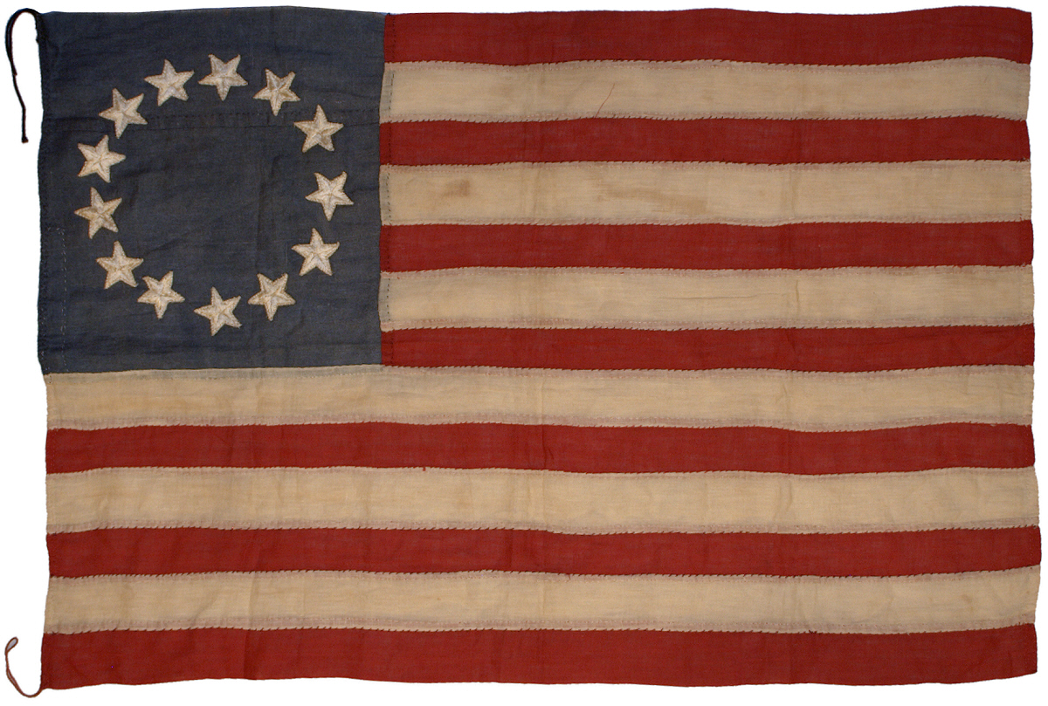
Founding Ideals and Democratic Influences

Slide 2
Founding Ideals and Democratic Influences
Focus Question:
From where did the American colonies draw their democratic influences?
How did those influences shape political and revolutionary thought in the colonies?

Slide 3
The Declaration of Independence - Founding Ideals
In writing the Declaration of Independence, Thomas Jefferson set forth a vision of a new nation based on revolutionary democratic idealism. In the years leading up to the Declaration, the ideas that Jefferson mentioned had been written about and discussed by many colonists. Since that time, Americans have sometimes fought for and sometimes ignored these ideals. Yet, throughout the years, Jefferson’s words have continued to provide a vision of what it means to be an American.
E R L O D

Slide 4
E R L O D
EQUALITY
The situation in which all people are treated the same way and valued equally

Slide 5
E R L O D
RIGHTS
Powers or privileges granted to people by an agreement among themselves, a social contract, or by law

Slide 6
E R L O D
LIBERTY
Freedom, or the ability to make your own decisions, self-determination

Slide 7
E R L O D
OPPORTUNITY
the chance for people to pursue their hopes and dreams, their pursuit of happiness

Slide 8
E R L O D
DEMOCRACY
System of government in which the power to rule comes from the consent of the people

Slide 9
Focus Question:
From where did the American colonies draw their democratic influences?
How did those influences shape political and revolutionary thought in the colonies?

Slide 10
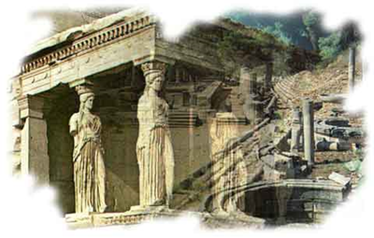
Ancient Greece and Rome
Greeks were the first to experiment with ideas of democracy over 2,000 years ago
Organized small city-states or nations
Ex. Sparta, Athens
“Demos” = People + “Kratia” = Power or authority
Roman Republic = elected representatives were Senators

Slide 11
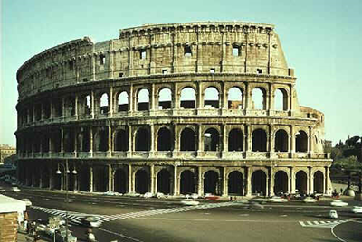
Ancient Greece and Rome
Direct Democracy
Citizens vote and make decisions for the society
Representative Democracy
Citizens elect officials to govern and make decisions in their best interests
Question to Think About….
What form of democracy do we have in the United States today?
What evidence and examples do we have to support this?

Slide 12
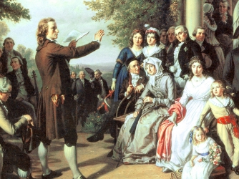
II. Enlightenment Philosophy
What? When? 18th century philosophical and intellectual movement that stressed importance of learning and reason to challenge authority
3 Enlightenment Philosophers
Question to Think About….
How did Enlightenment philosophy further the democratic ideas established in Green and Rome?

Slide 13
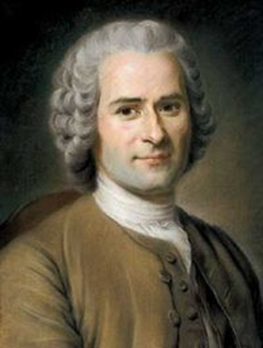
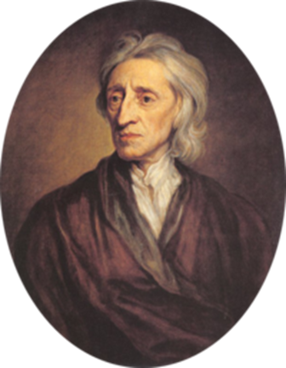
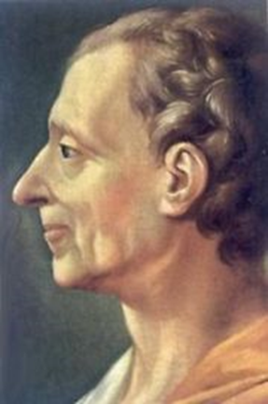
II. Enlightenment Philosophy
John Locke = idea of natural rights; life, liberty, health, and possessions
Jean Jacques Rousseau = social contract or agreement among members in a society
Baron de Montesquieu = called for the separation of powers into three branches of government
Question to Think About….
How did Enlightenment philosophy further the democratic ideas established in Green and Rome?

Slide 14
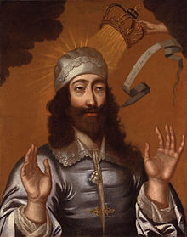
III. British History
Divine Right = monarchies and rulers claimed power was god-given
Common Law = local customs, rules, and court systems established by Henry II in 1100s

Slide 15
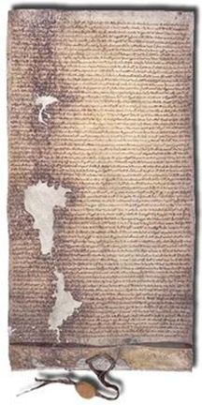
III. British History
Magna Carta = the great charter signed in 1215 limits the power of the King
Parliament and the British Bill of Rights = elected representatives and definitive power of government
Question to Think About….
How has British history influenced the formation of the United States government?

