Slide 1
Ceramics in Ancient Mesopotamia
Jacob Perisho

Slide 2
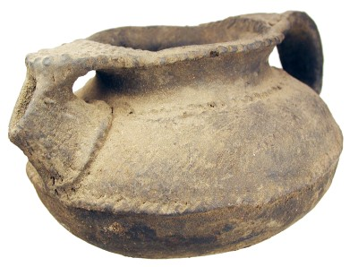
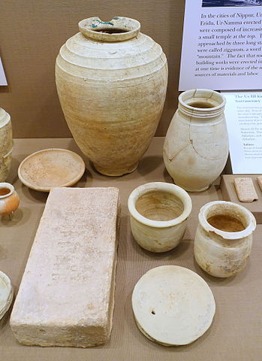
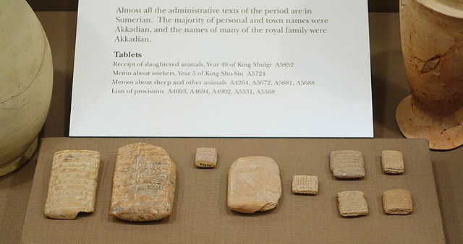
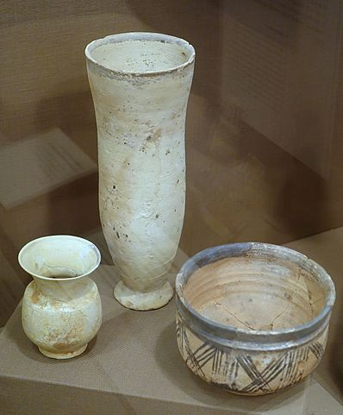
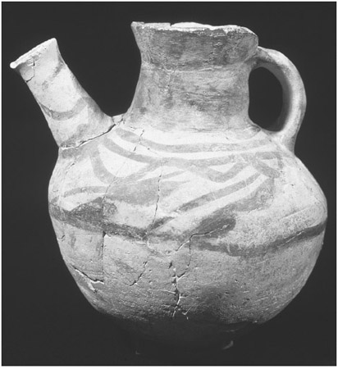
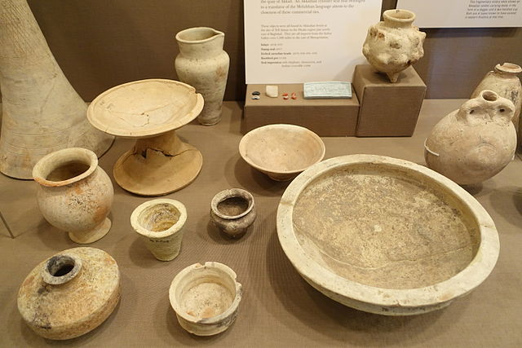
Background & Introduction
In what ways did Mesopotamians utilize ceramics and pottery to advance their civilization?
Compare various forms of ceramics and pottery.
Notes:
Read the response to the question:
From the earliest stages of humanity, people and civilizations have often explored the many ways in which to better improve quality of life and ease. Between the Tigris and Euphrates Rivers, after the formation of major cities in the 3500s, humans stumbled upon a technological advancement. Clay. With waterproof properties, clay became a valuable resource. Clay was used to make the earliest forms of pottery capable of hold water and other items. In time, society graduated from storing items in baskets and woven materials to storing these items in more reliable ceramic vessels. After the invention of the potter’s wheel in the early 3000s, people were able to create more efficient vessels for storage. A more efficient design would consist of a wider base and a relatively tall form. Also rather than make pottery to store food and other materials, pottery graduated into a form of art. This helped build a society that became engaged in more leisurely activities. As a side note, modern society defines an advanced society as one that is engaged scholastically, architecturally, and artistically. Pottery, by definition, helped advance Mesopotamian Society. Although clay and pottery may have been the highest technology in ancient times, ceramics continues to influence and shape society today.

Slide 3
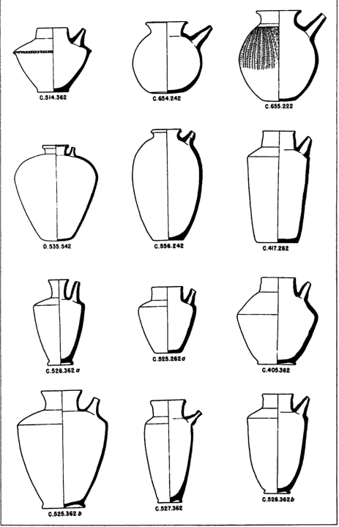
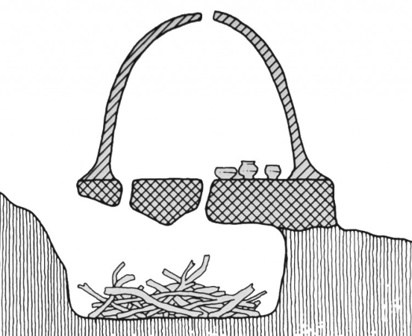
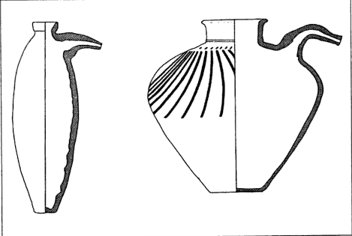
How?
Large amounts of clay were formed in Mesopotamian region due to river flooding
Then, form the vessel
Let it dry, then…
Put it in a kiln (usually stone rooms that were heated by large fires)
Notes:
Walk through how pottery is made.
Collect clay of the same type (i.e. white brown and grey)
Wedge clay (like kneading dough) to get out air bubbles
Center the clay on the wheel, while someone else turn the wheel (a slave most likely)
Let the clay dry in the open air, because if you try to fire the clay right away the water inside the clay will turn to steam and explode
Fire the clay (fire powered) {click}

Slide 4
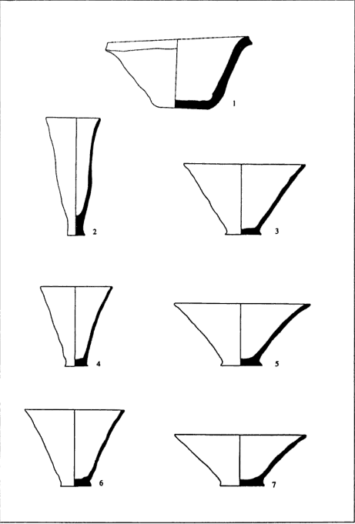
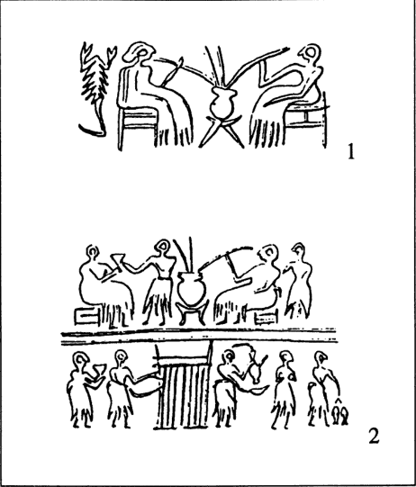
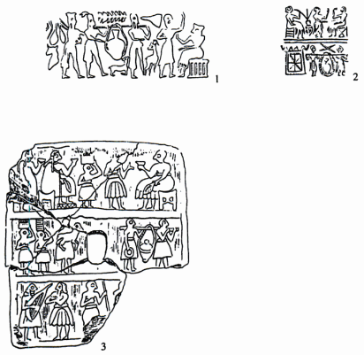
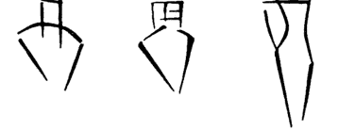
Why?
Storage of grains and other precious materials
Fermentation of wine and grapes
Preservation of Milk PRODUCTS...not milk.
Fermentation of beer (from wheat and barley)
Storage of oil
Used as serving utensils (i.e. bowls, cups, vases, etc.)
Notes:
First Picture: Drinking wine from vats
Second Picture: Evidence of Mass Production
Third Picture: jars of oil being carried by slaves

Slide 5
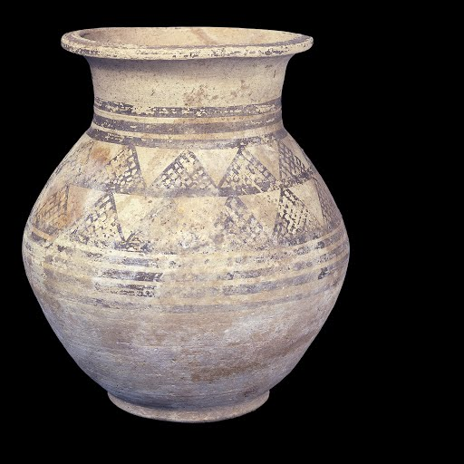
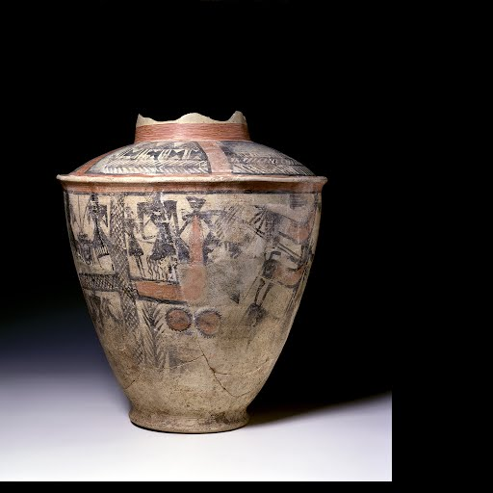
How About Now?
A major source of information about the past
We are able to study the artistic styles and forms
Spurred development in other regions as a form of communication and storytelling
Techniques developed then are stilled in use today (i.e. firing in kiln, and using potter’s wheel)
Notes:
First pic: khabur Ware (from Khabur river)
Second pic: Scarlet Ware (from a temple dedicated to the moon god Sin.

Slide 6
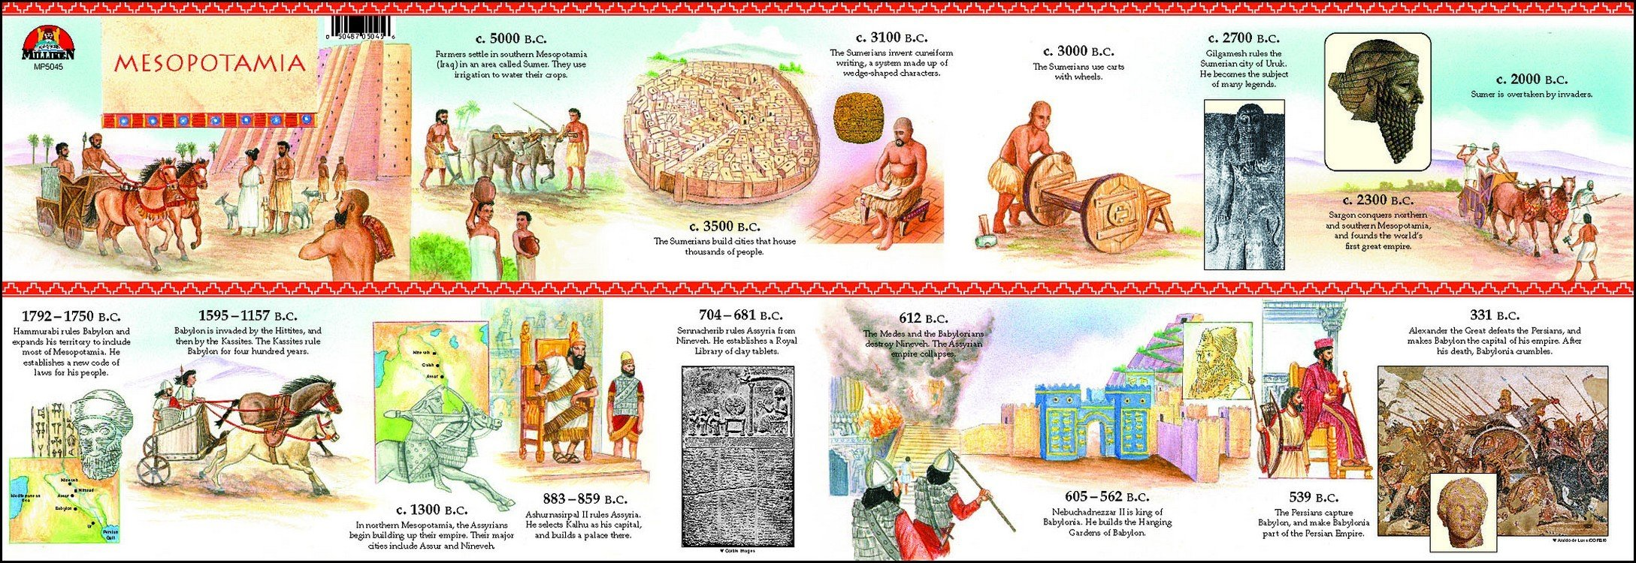
The Evolution: (timeline)
5300-4000 BC- Early forms of pottery; made using dark clay, and with a throwing wheel. The Uruk began to mass produce pottery.
5000 BC - The Sumerians form the first towns and cities. They use irrigation to farm large areas of land.
3300 BC - The Sumerians invent the first writing. They use pictures for words and inscribe them on clay tablets.
3200 BC - The Sumerians begin to use the wheel on vehicles.
3000 BC - The Sumerians start to implement mathematics using a number system with the base 60.
612 BC was the Achaemenid Persian; we see an increase in the production of pottery and an expansion in their uses

Slide 7
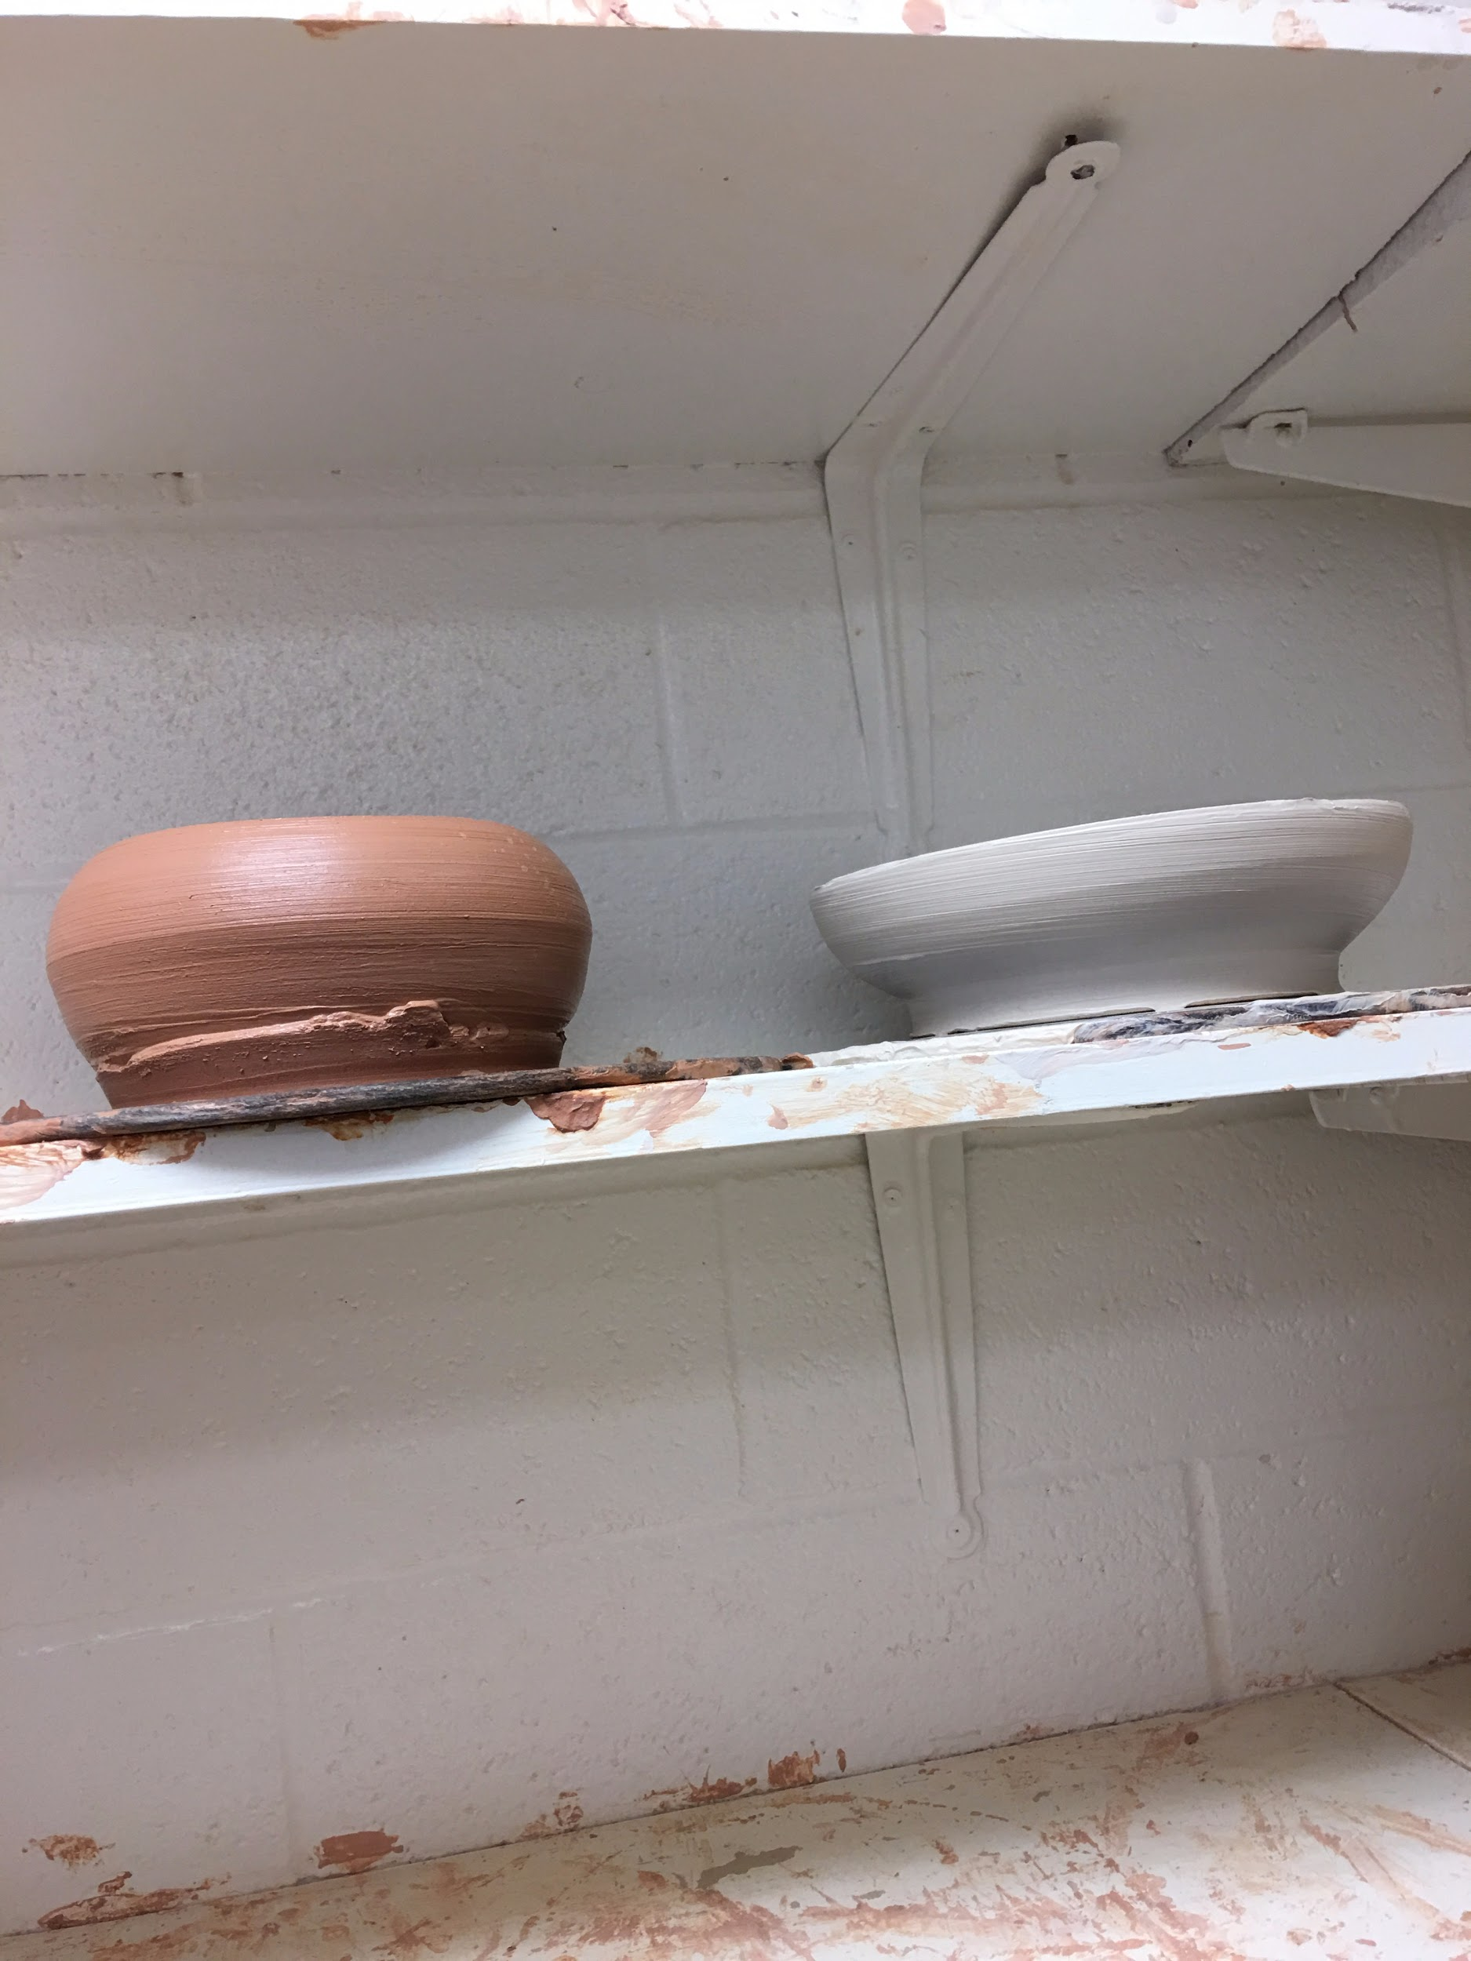
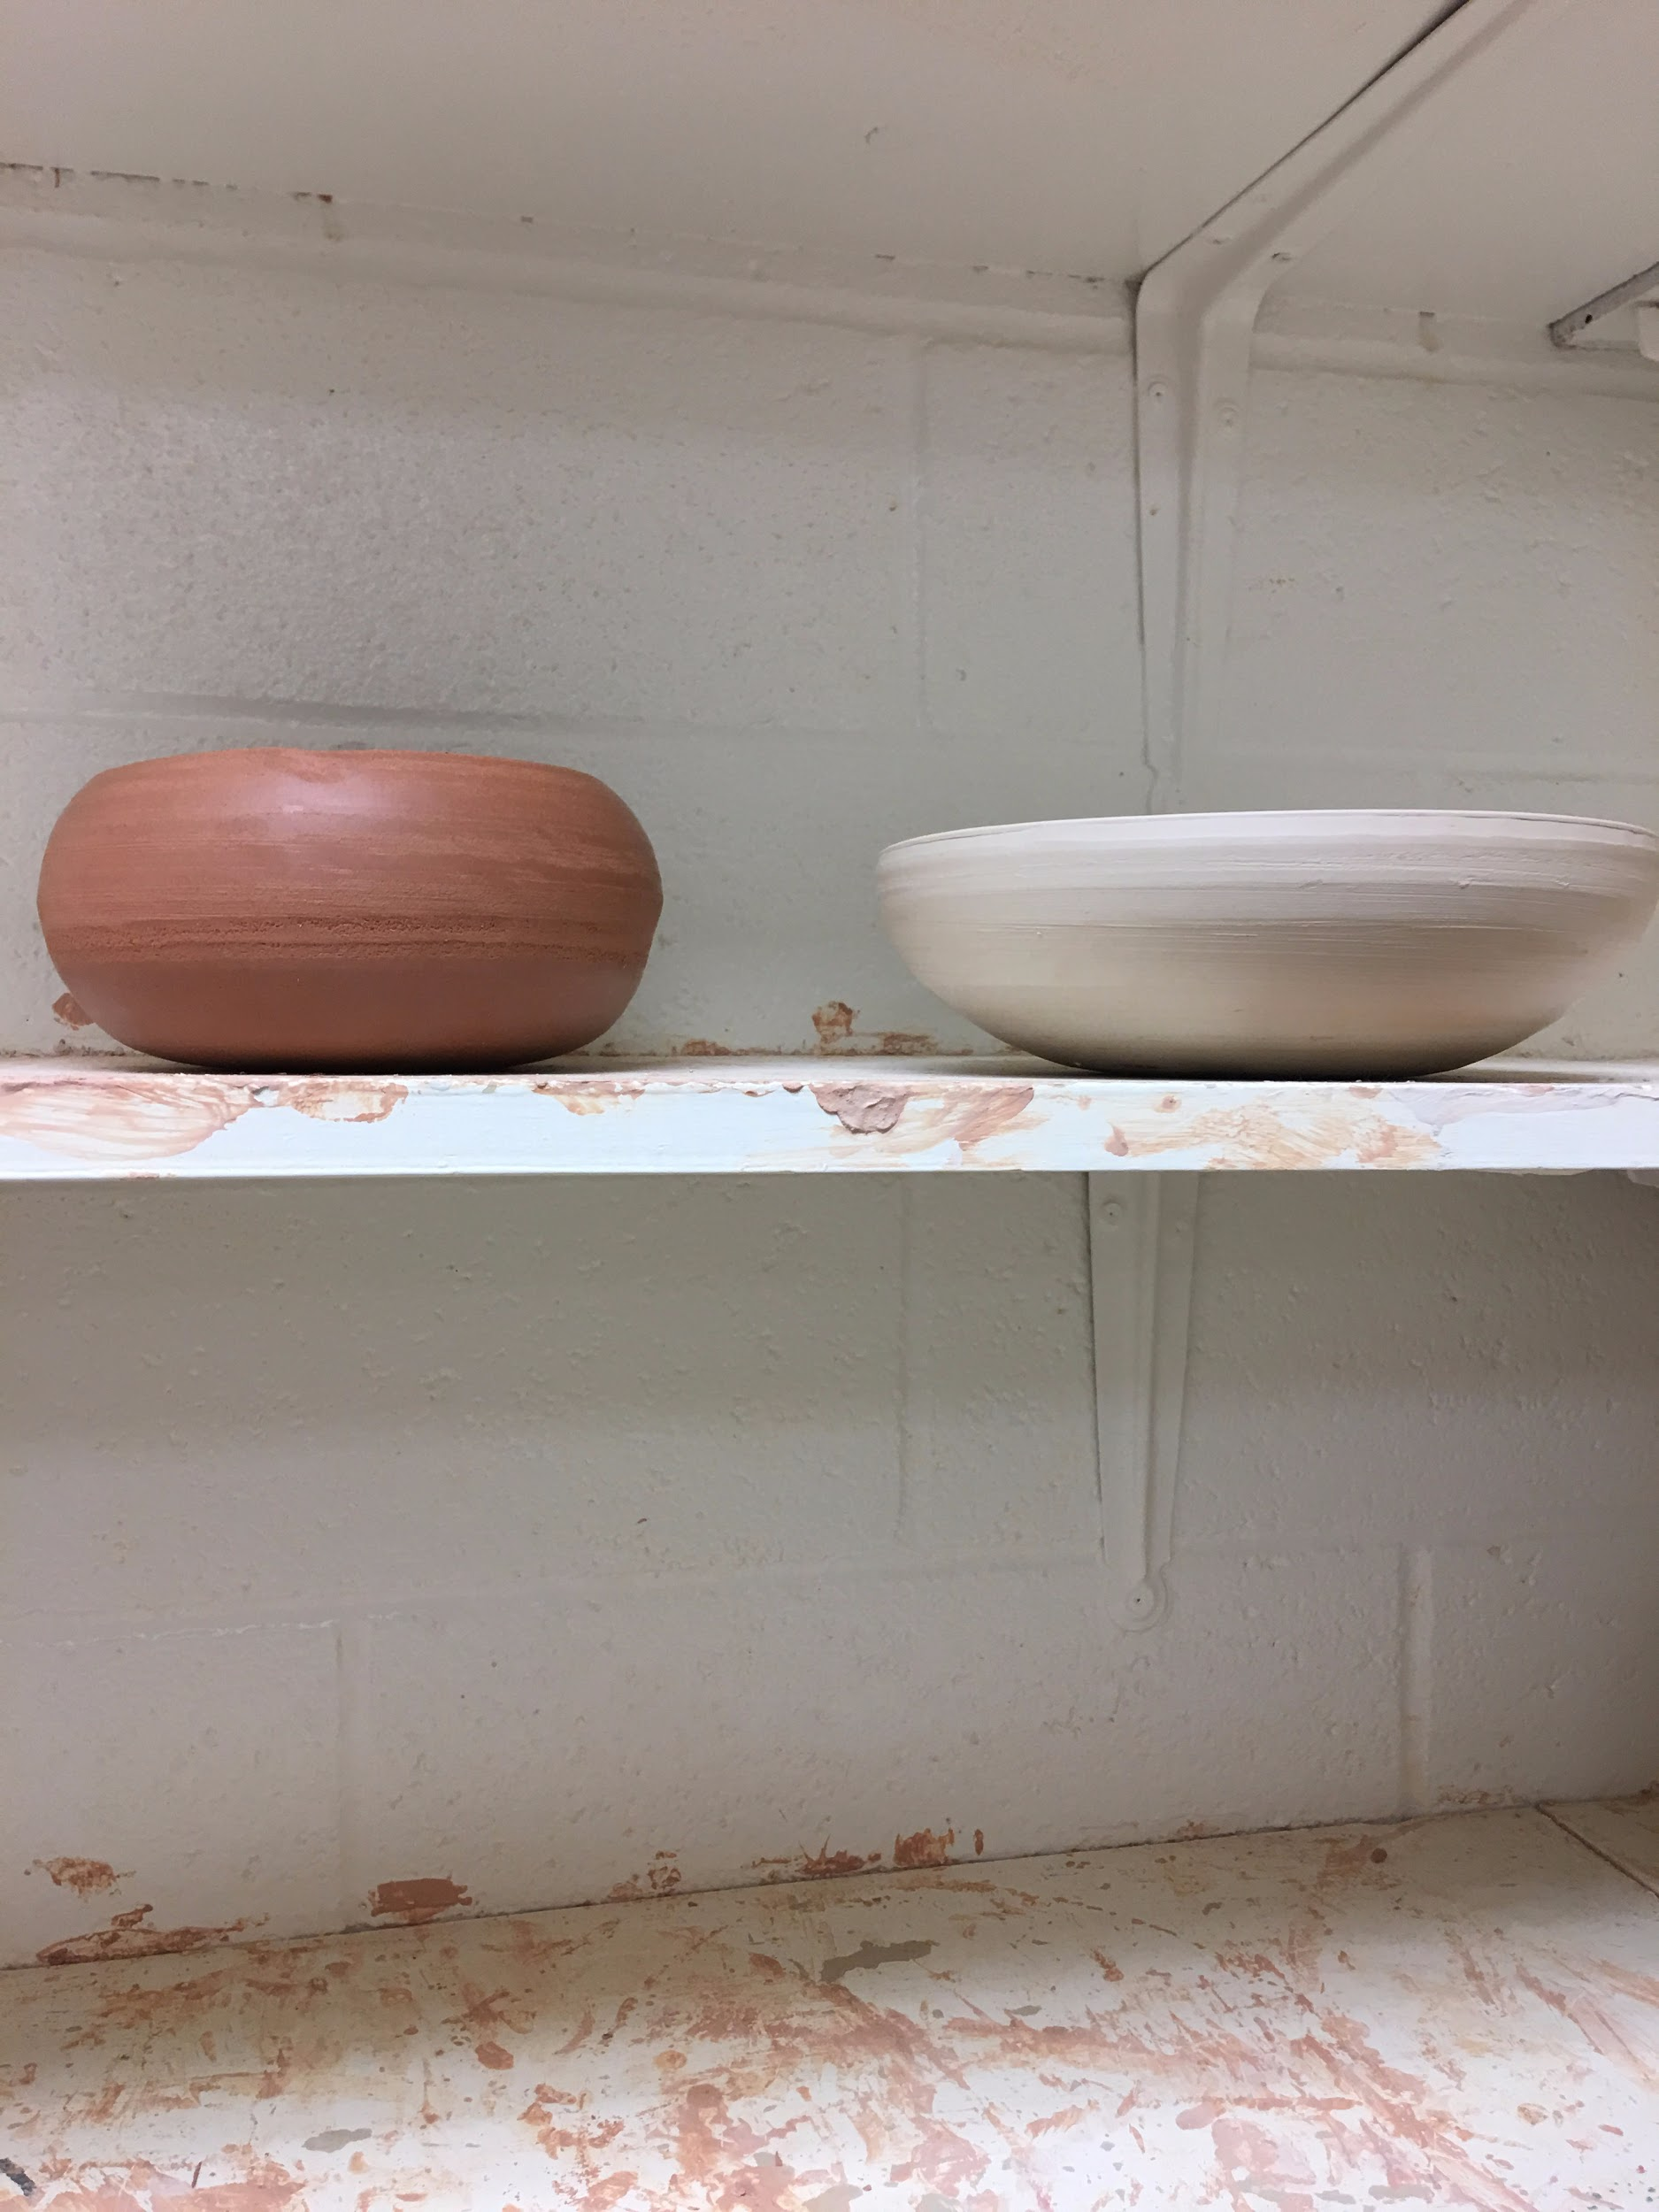
My Creation:

Slide 8
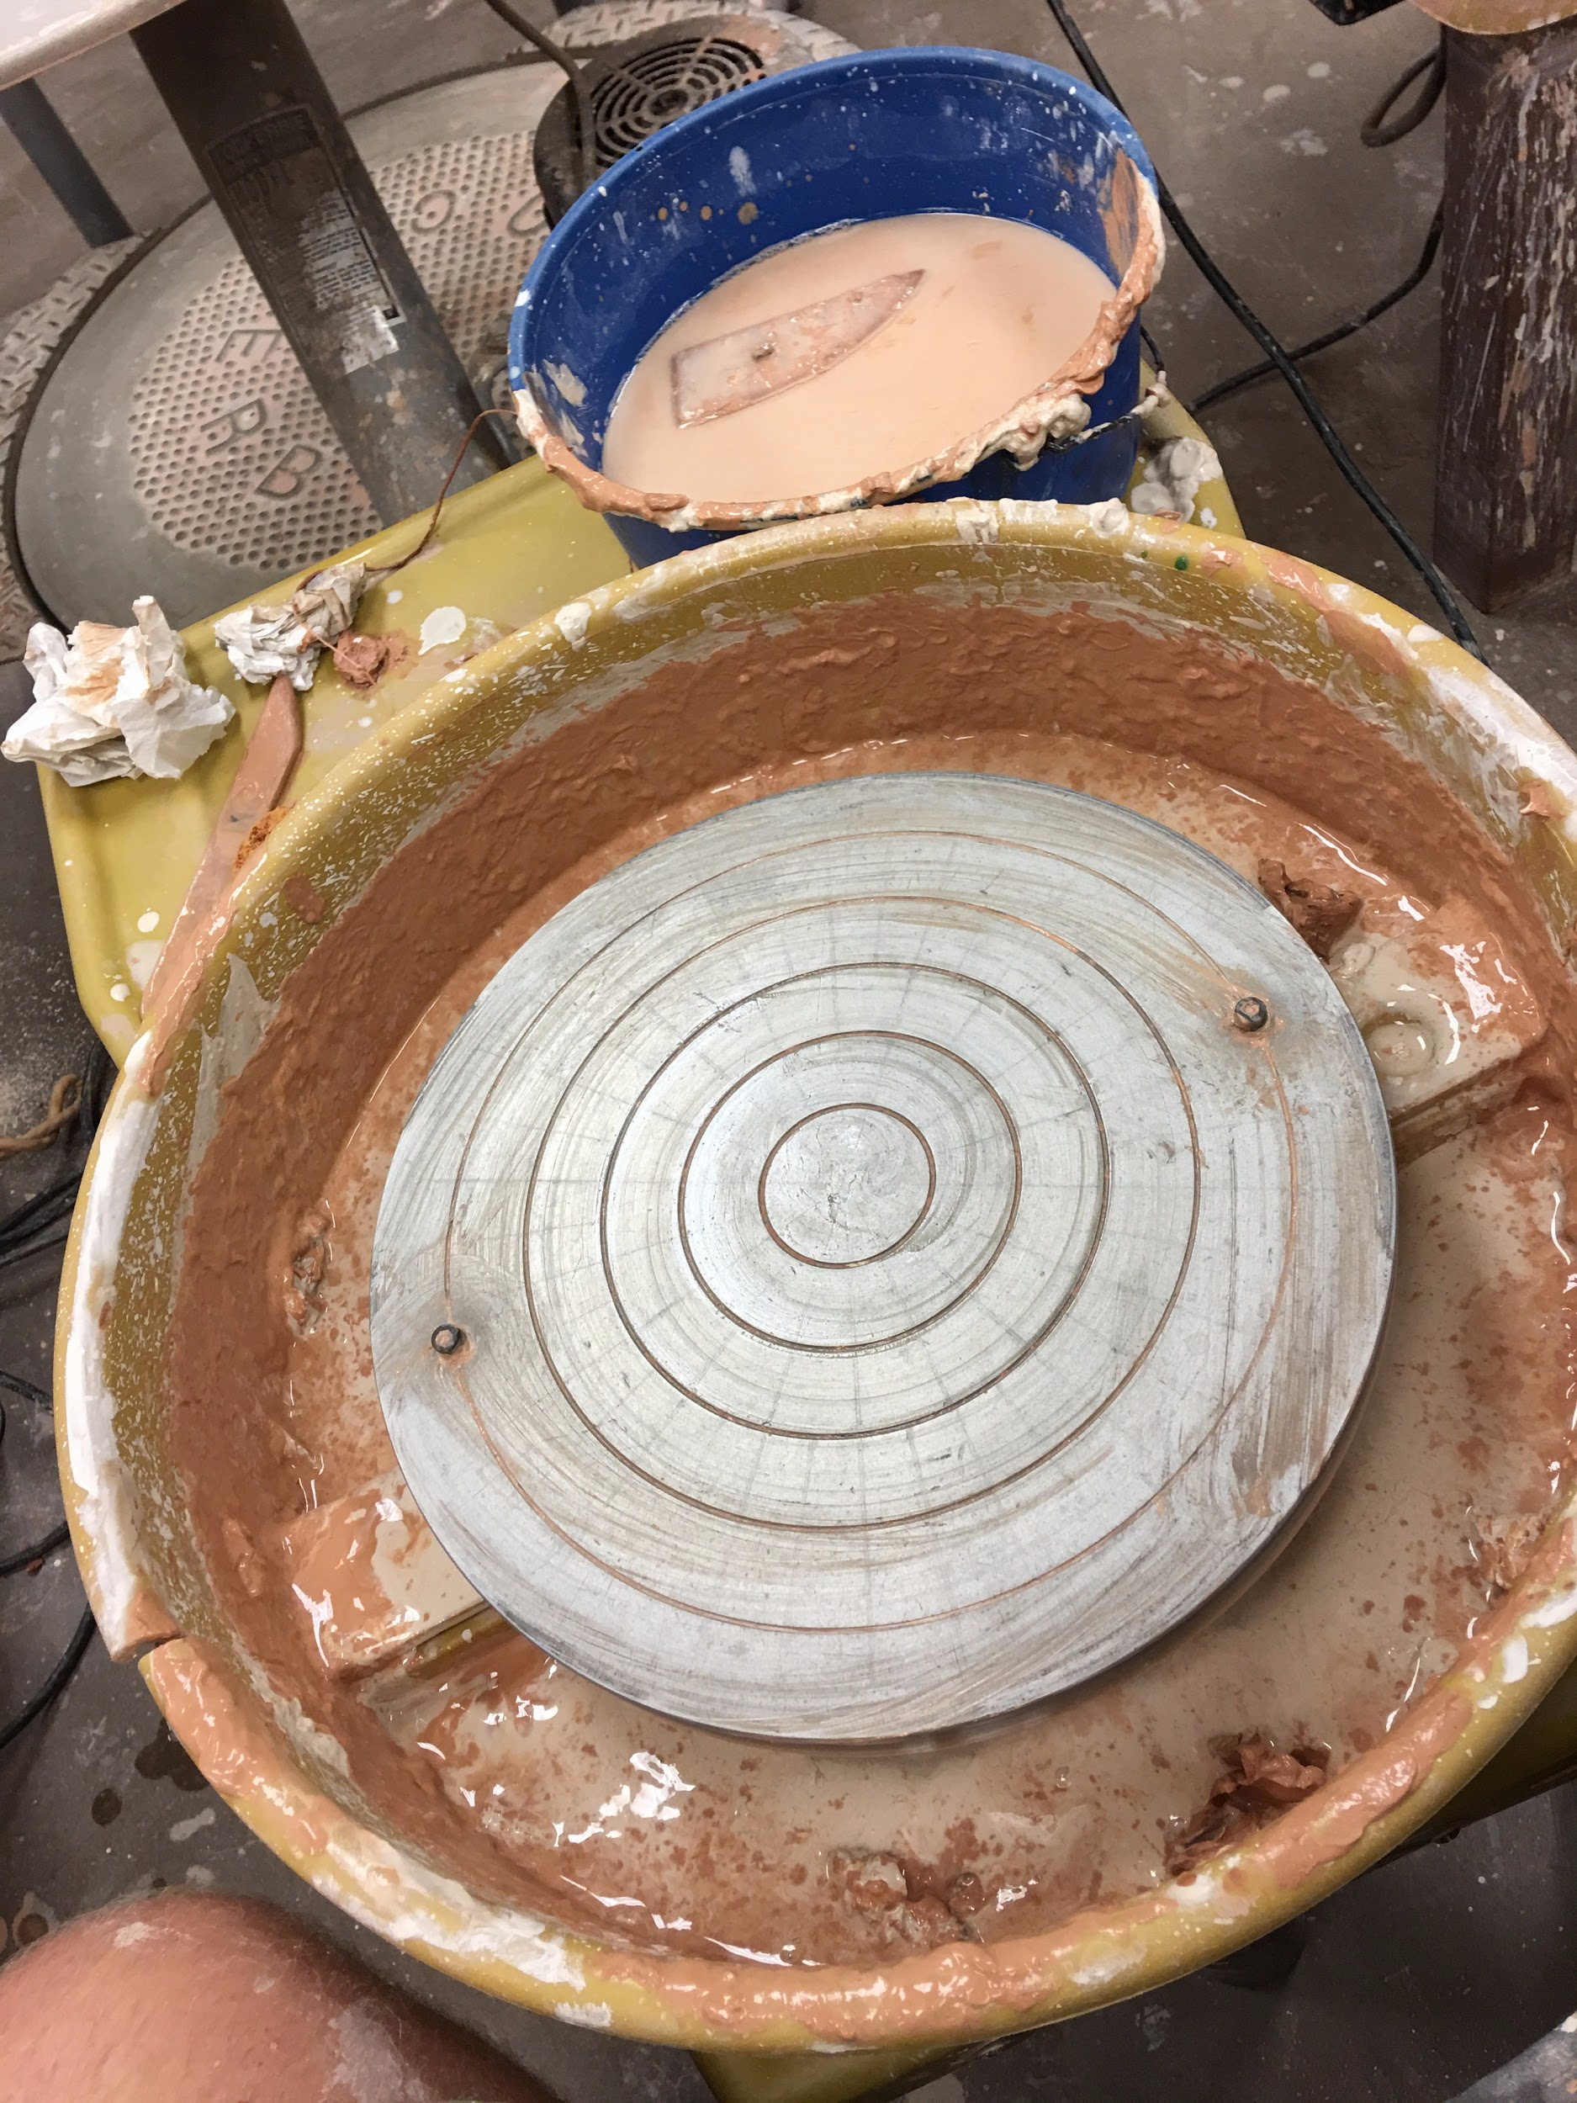
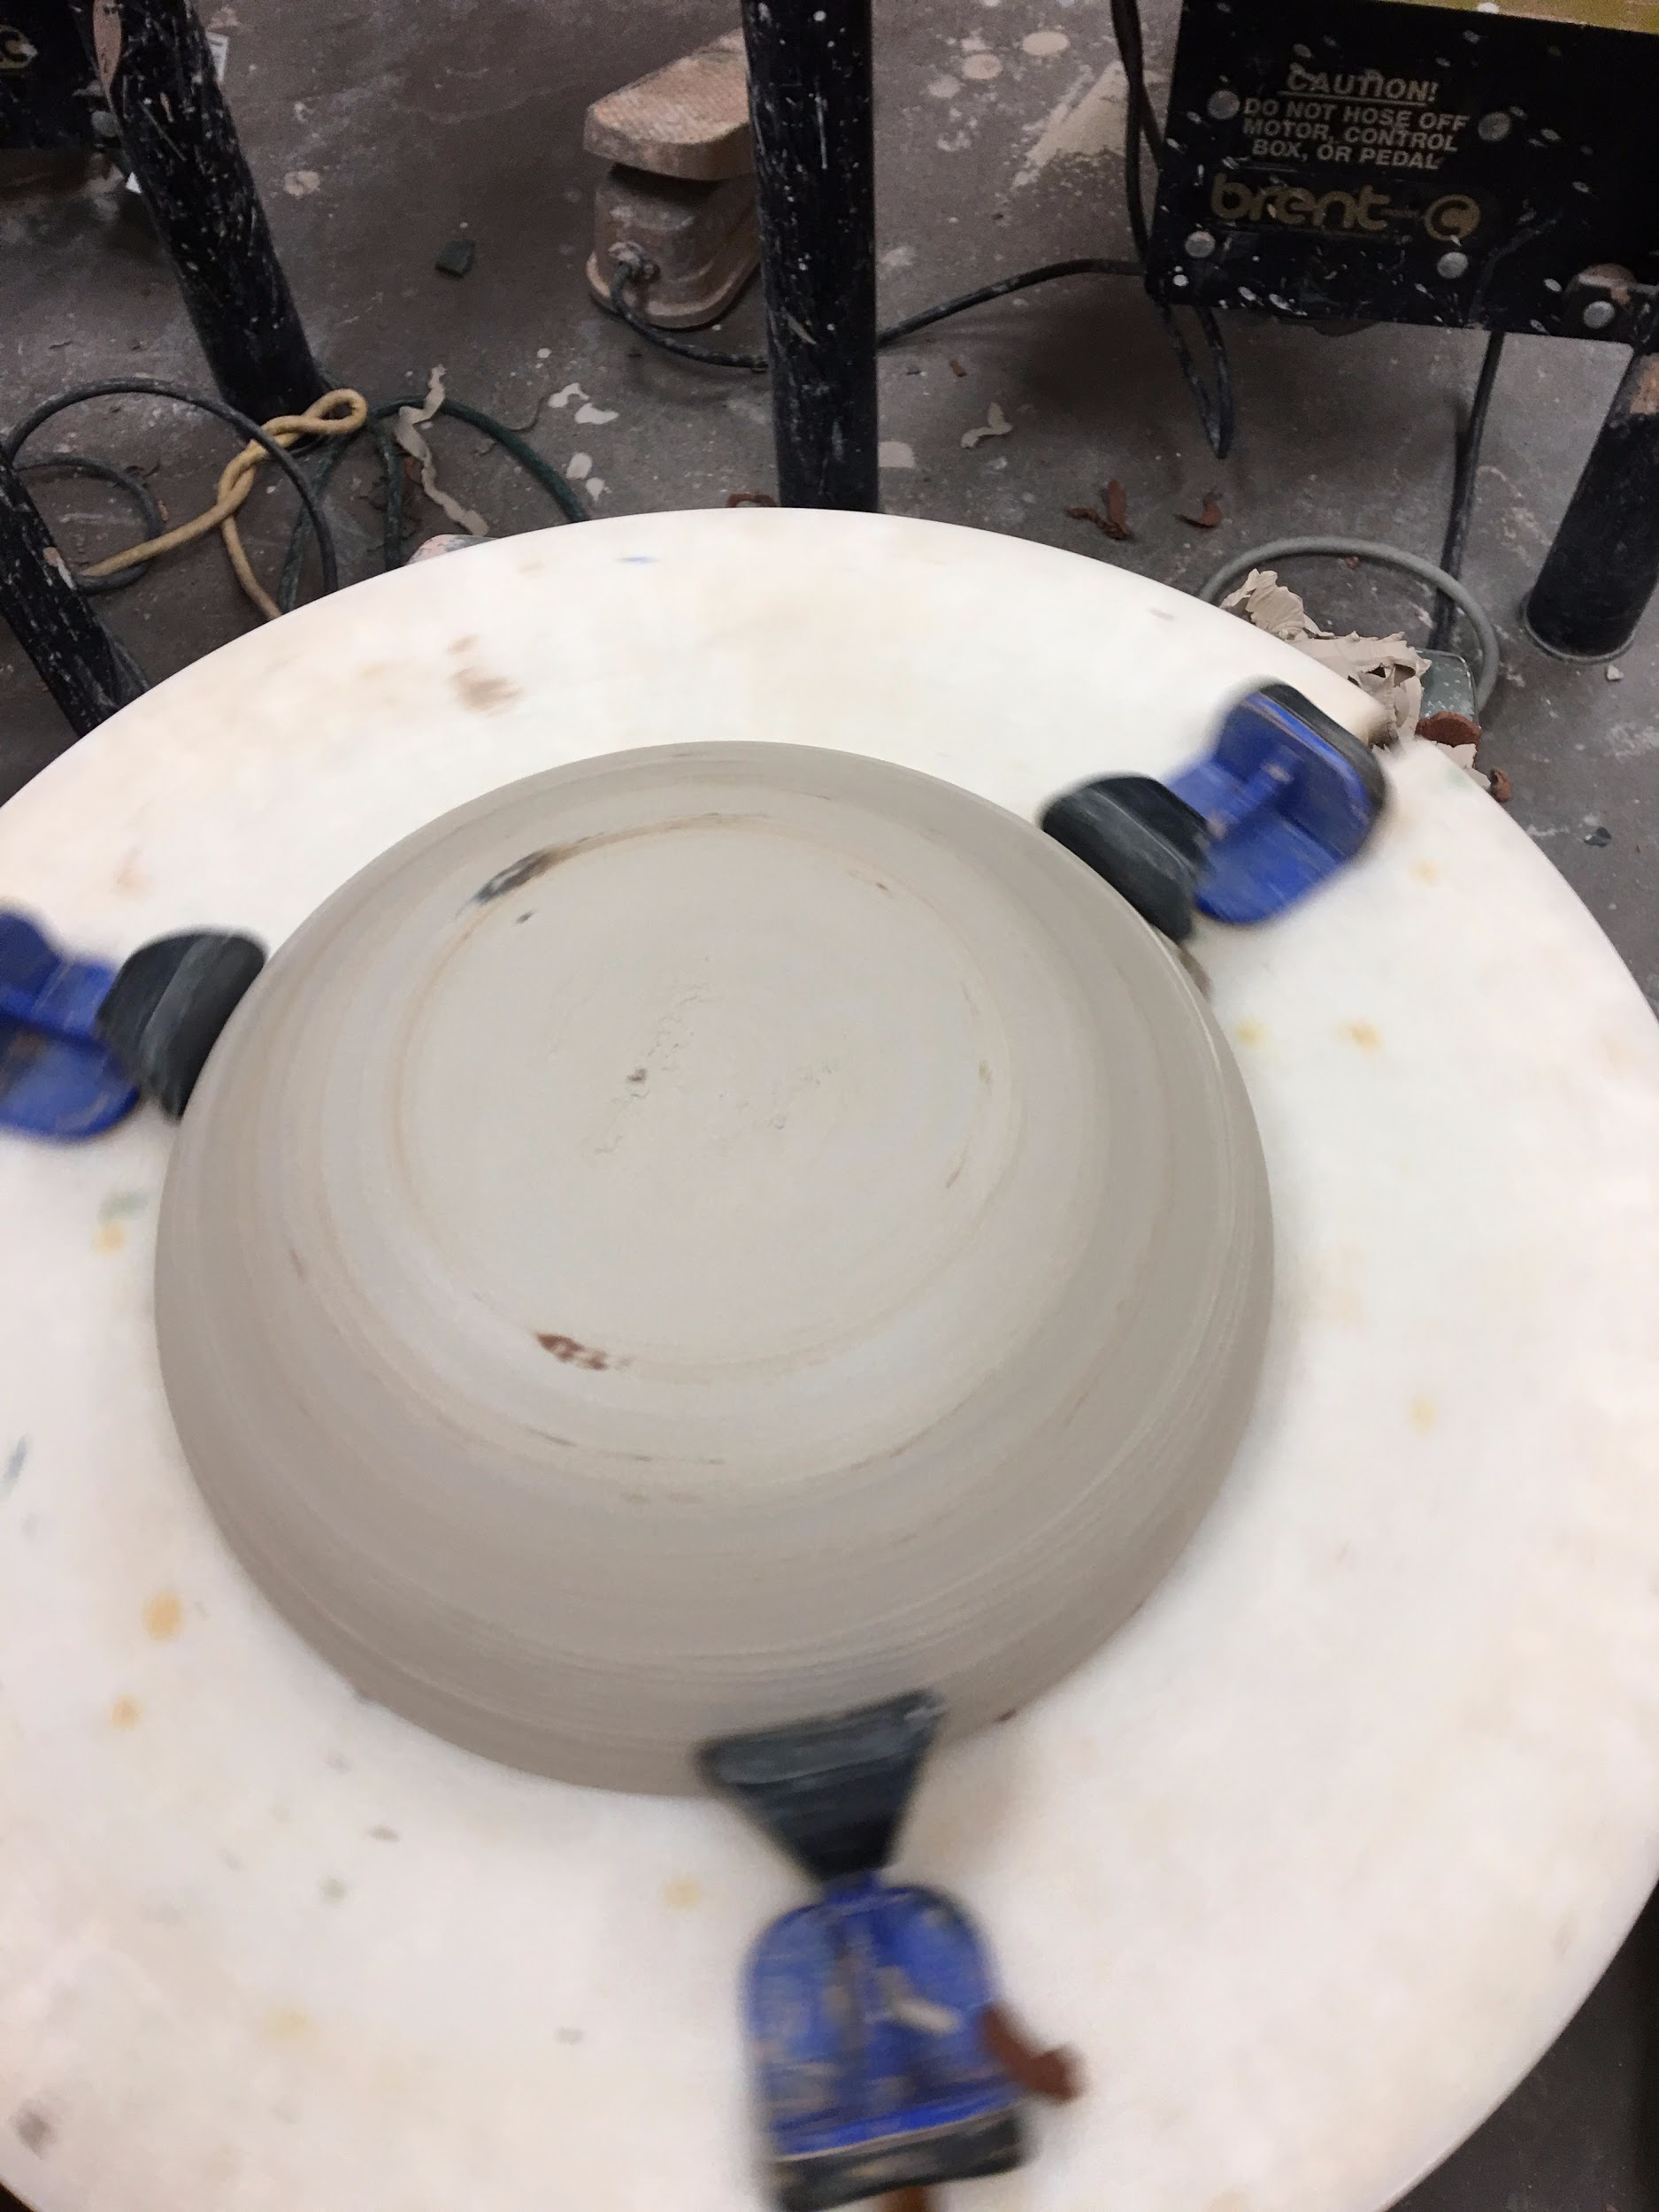
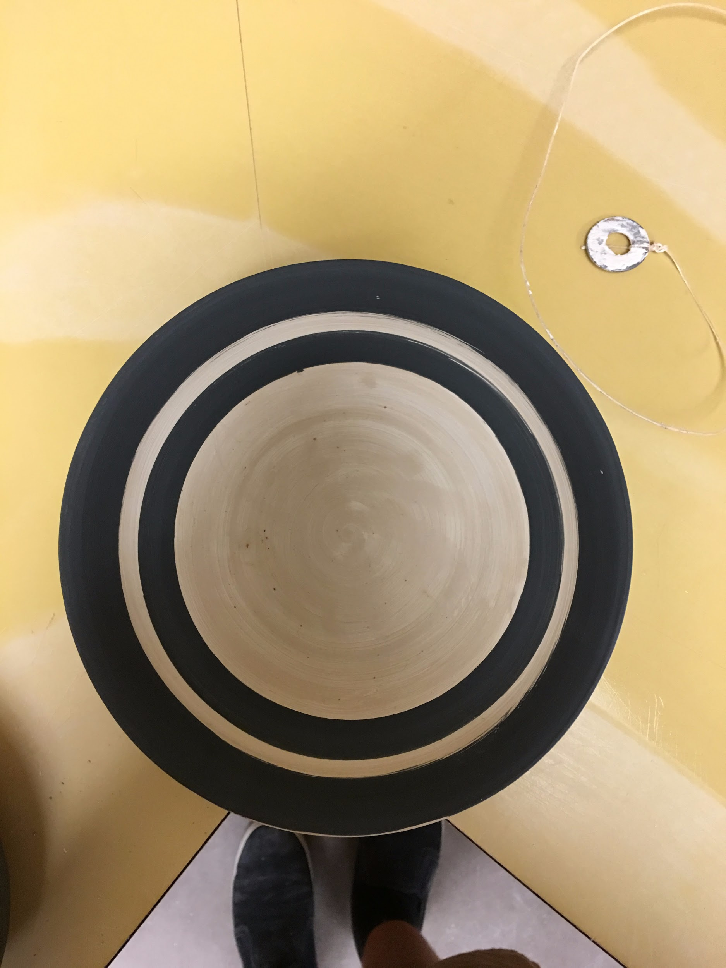
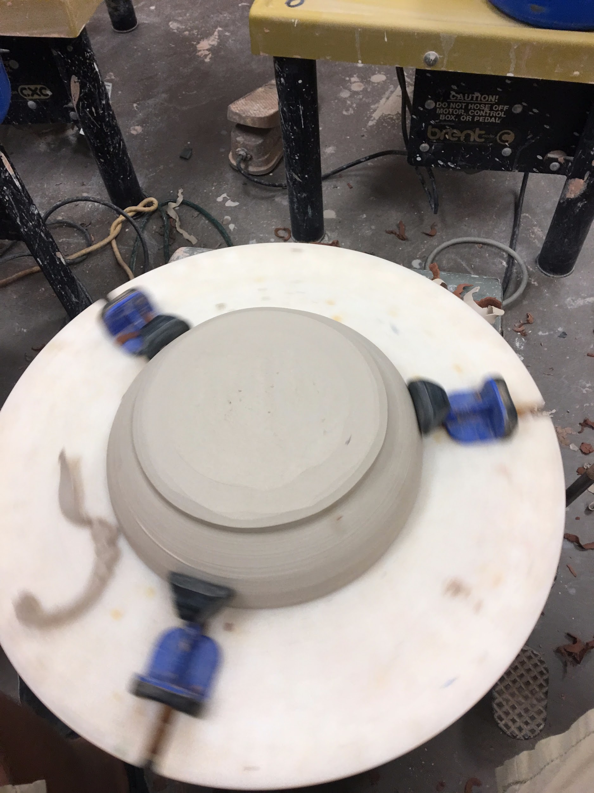
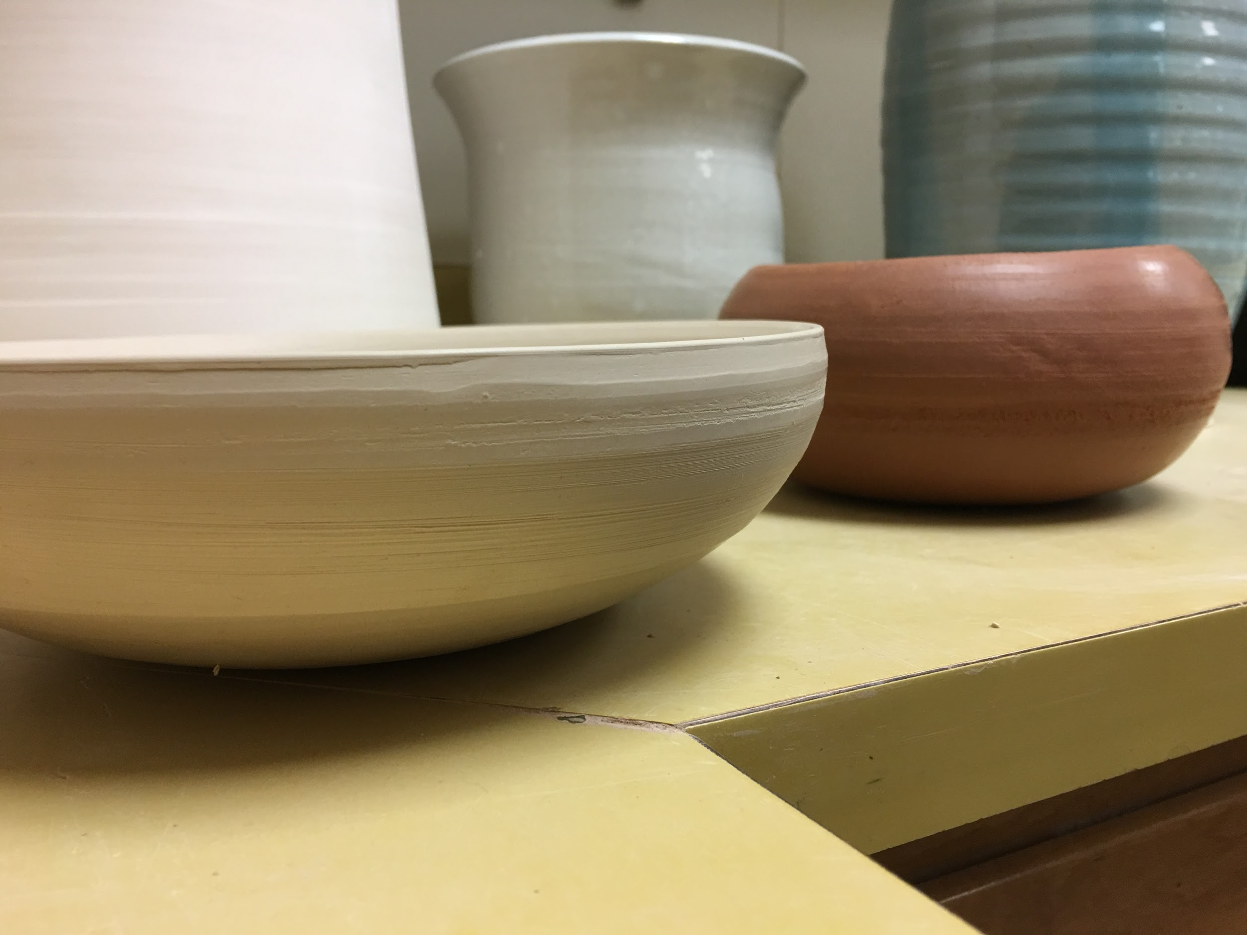
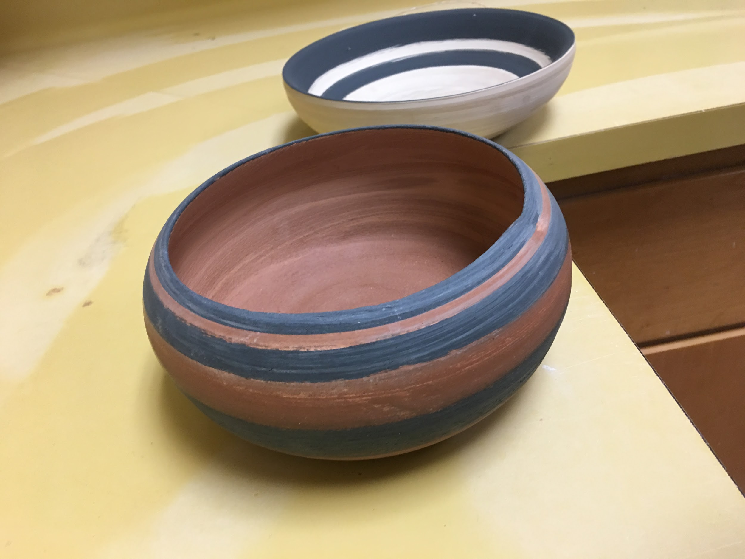

Slide 9
From the earliest stages of humanity, people and civilizations have often explored the many ways in which to better improve quality of life and ease. Between the Tigris and Euphrates Rivers, after the formation of major cities in the 3500s, humans stumbled upon a technological advancement. Clay. With waterproof properties, clay became a valuable resource. Clay was used to make the earliest forms of pottery capable of hold water and other items. In time, society graduated from storing items in baskets and woven materials to storing these items in more reliable ceramic vessels. After the invention of the potter’s wheel in the early 3000s, people were able to create more efficient vessels for storage. A more efficient design would consist of a wider base and a relatively tall form. Also rather than make pottery to store food and other materials, pottery graduated into a form of art. This helped build a society that became engaged in more leisurely activities. As a side note, modern society defines an advanced society as one that is engaged scholastically, architecturally, and artistically. Pottery, by definition, helped advance Mesopotamian Society. Although clay and pottery may have been the highest technology in ancient times, ceramics continues to influence and shape society today.

Slide 10
My project consist of the production of two ceramic bowls that modeled the style and type of pottery that would have been produced in the Ancient Mesopotamian Era. In addition to my two bowls I will present a slideshow illustrating some of the few throwing techniques and the uses of these ceramic vessels. Through my creating of these bowls I have experienced and learned the amount of detail and patience required to create such fine works of art. In addition to the struggle experienced while making by bowls, I must also factor in the fact that all wheels, for throwing, were man powered. Not only does it require incredible detail, it also draws from physical strength. In conclusion, ceramics in the Mesopotamian Era, as well as now, provided and continue to provide a continual source of information, artistic inspiration, and a way to preserve goods.

Slide 11
Bibliography
Bhugra, Ankita. "Ancient Mesopotamia Pottery." Ancient Mesopotamia Pottery,rock,potters Wheel,Pinch Potting, Slab Building. Thulasi K.Raj, Jan. 2017. Web. 02 June 2017.
Boundless. "Ceramics in Mesopotamia - Boundless Open Textbook." Boundless. Boundless, 17 Mar. 2017. Web. 02 June 2017.
M., Lydia. "Lydia M: Mesopotamia Pottery." Google Arts & Culture. Google, n.d. Web. 02 June 2017.
"Mesopotamian Pottery." British Museum. The British Museum, 12 Jan. 2017. Web. 03 June 2017.
Potts, D.T. "Mesopotamian Civilization." Google Books. Cornell University Press, 1997. Web. 02 June 2017.
Shneiderman, Dee. "Tools Made by People in Ancient Mesopotamia." Sciencing. Leaf Group, 25 Apr. 2017. Web. 03 June 2017.
Smithsonian. Ed. Smithsonian. Smithsonian, n.d. Web. 2 June 2017.

