Slide 1
Latin American Culture
By Kiana Arabian & Janae Huynh

Slide 2
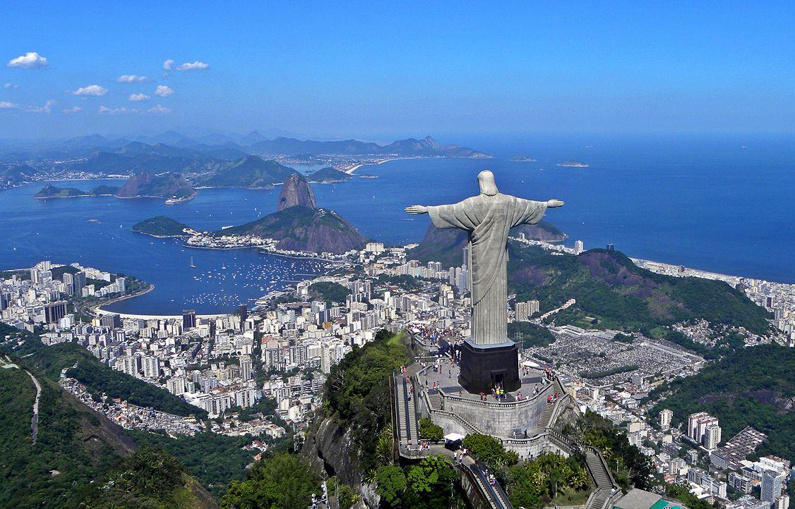
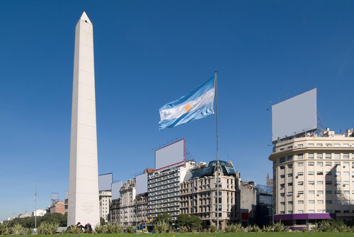
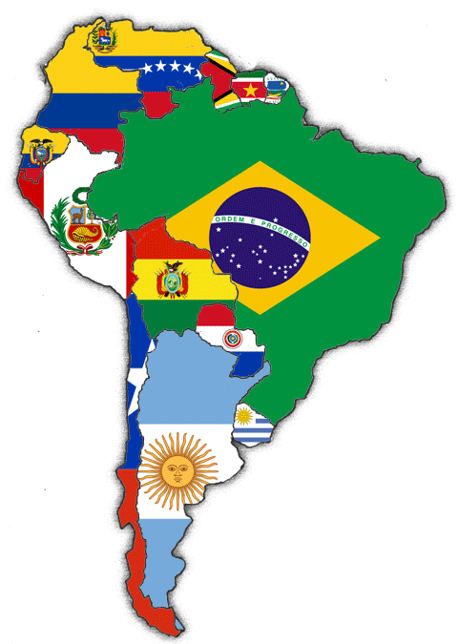
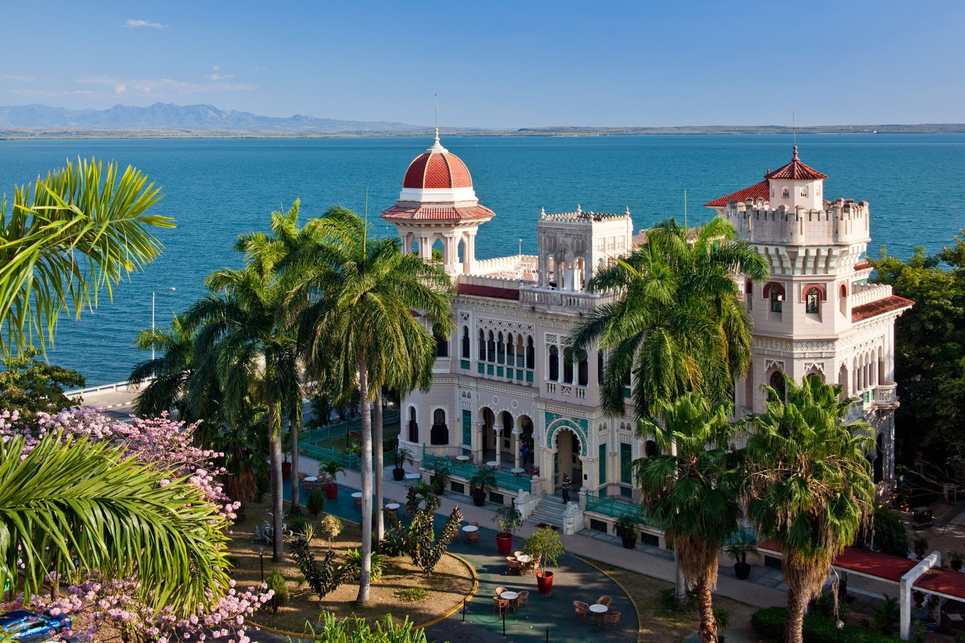
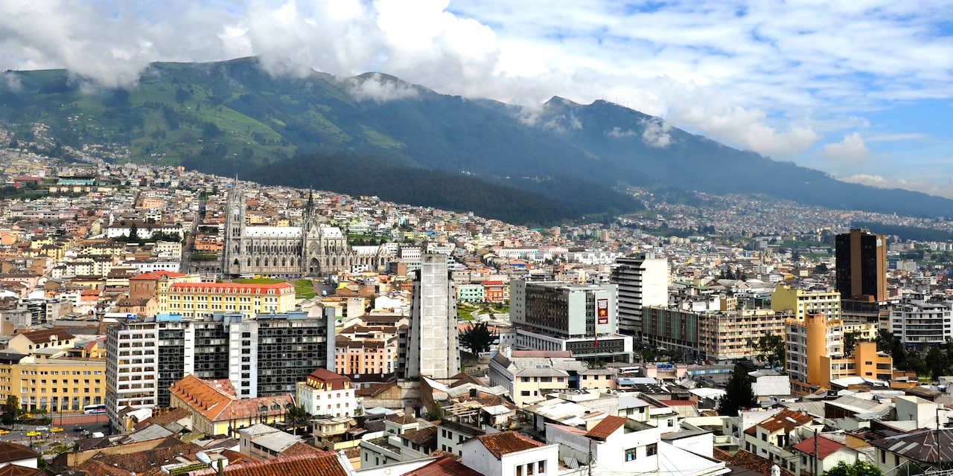
Intro

Slide 3
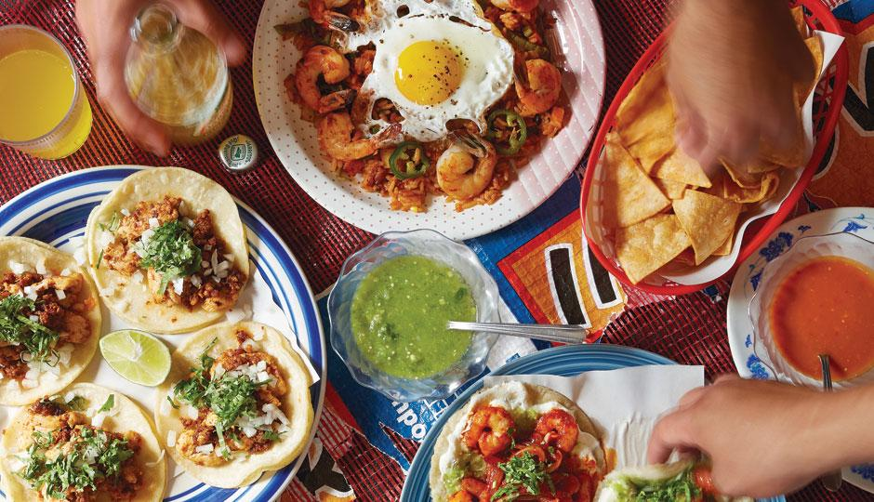
Food

Slide 4
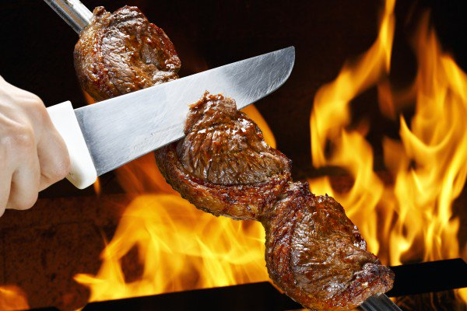
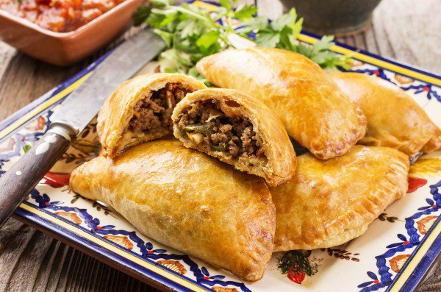
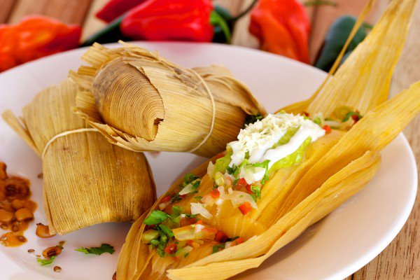
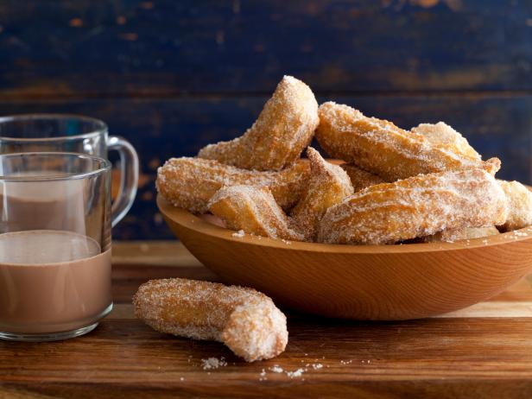
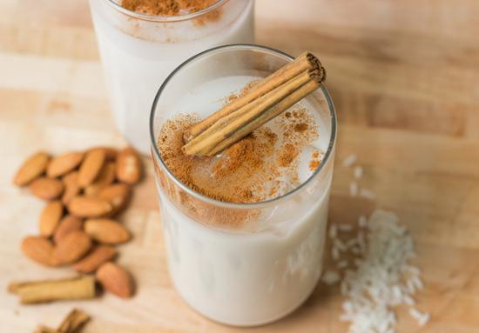
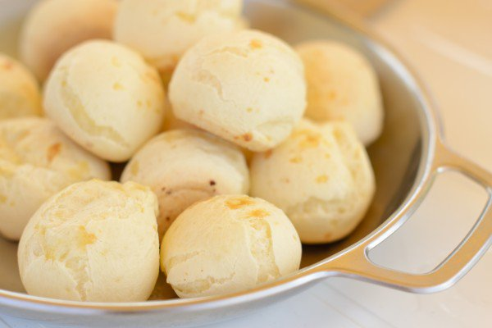
Churrasco
Empanada
Tamales
Chipa
Churro
Horchata

Slide 5
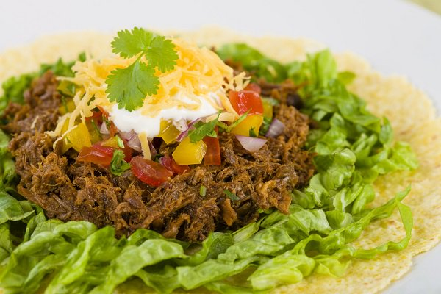
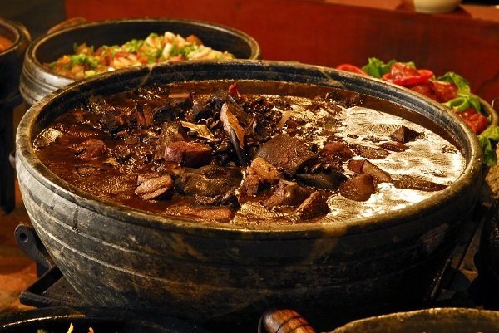
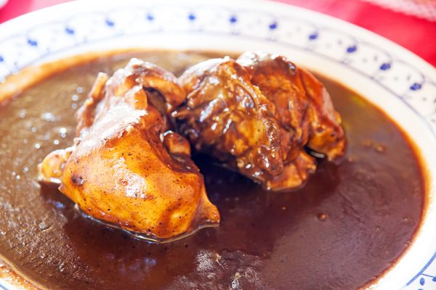
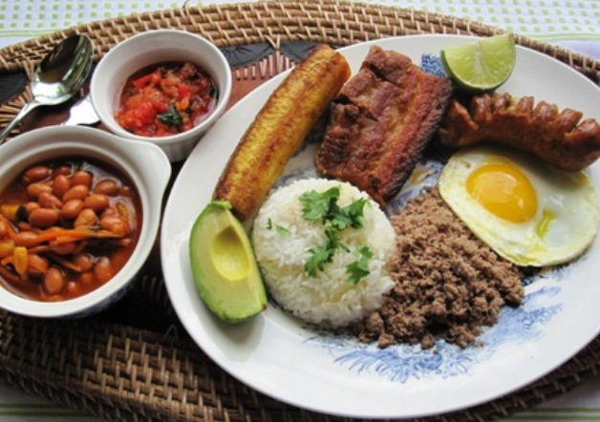
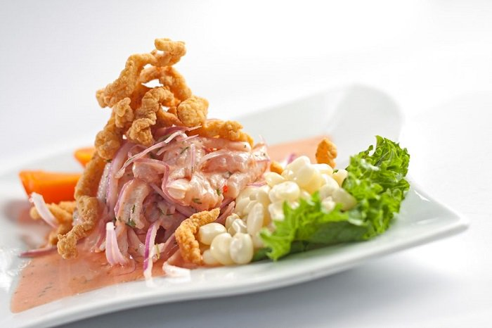
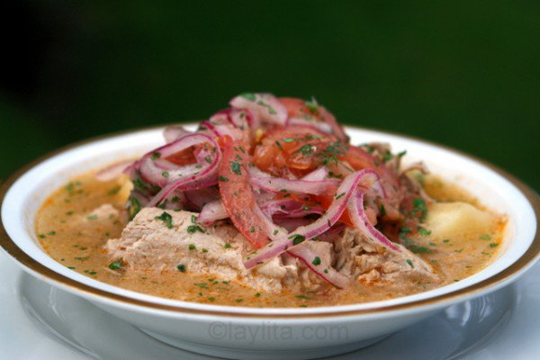
Ropa Vieja (Cuba)
Feijoada (Brazil)
Mole Poblano (Mexico)
Bandeja Paisa
(Colombia)
Encebollado (Ecuador)
Ceviche (Peru)

Slide 6
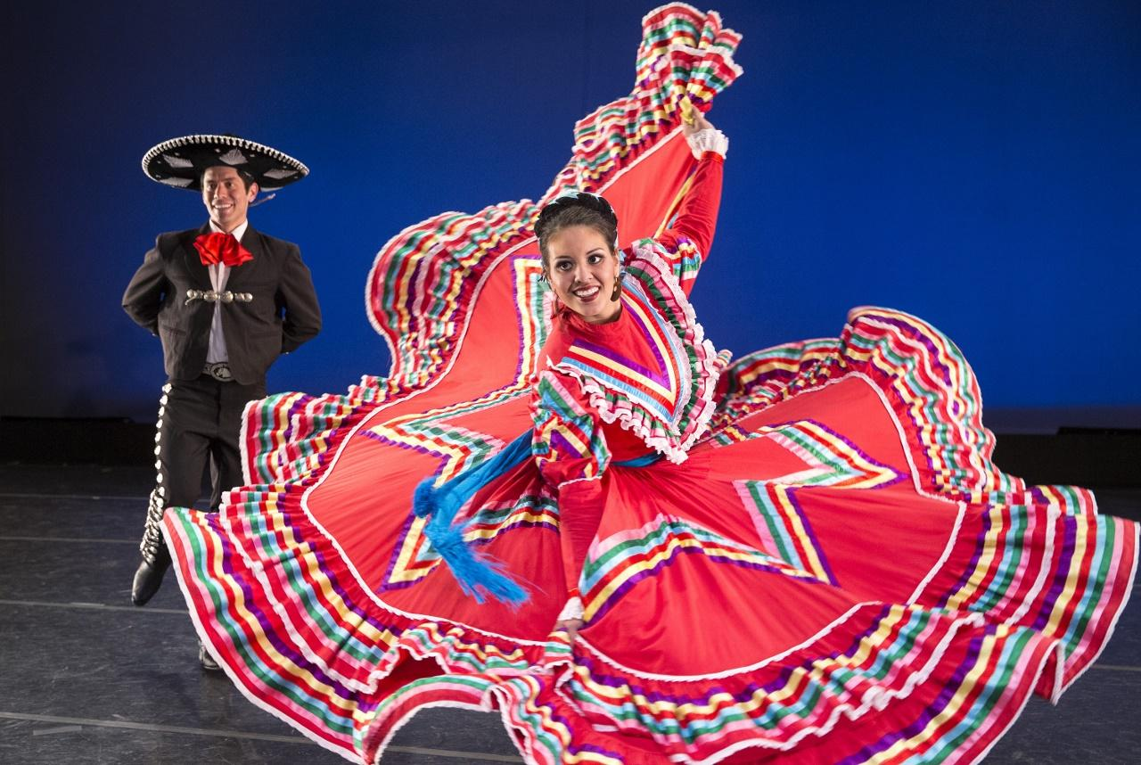
Dancing

Slide 7
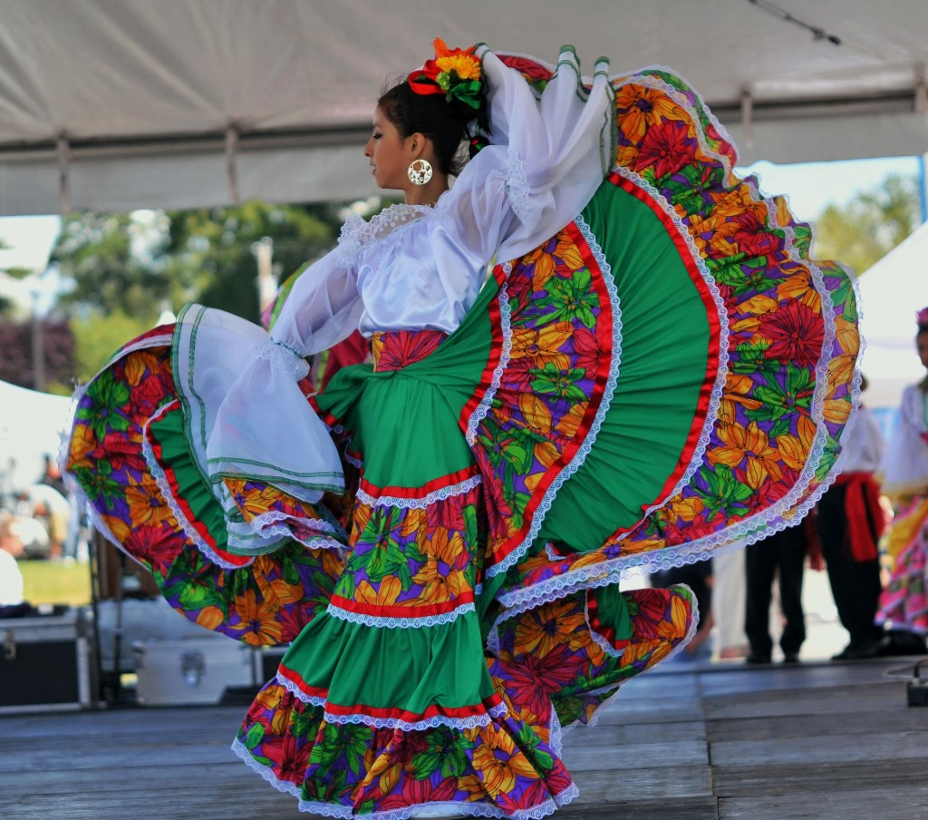
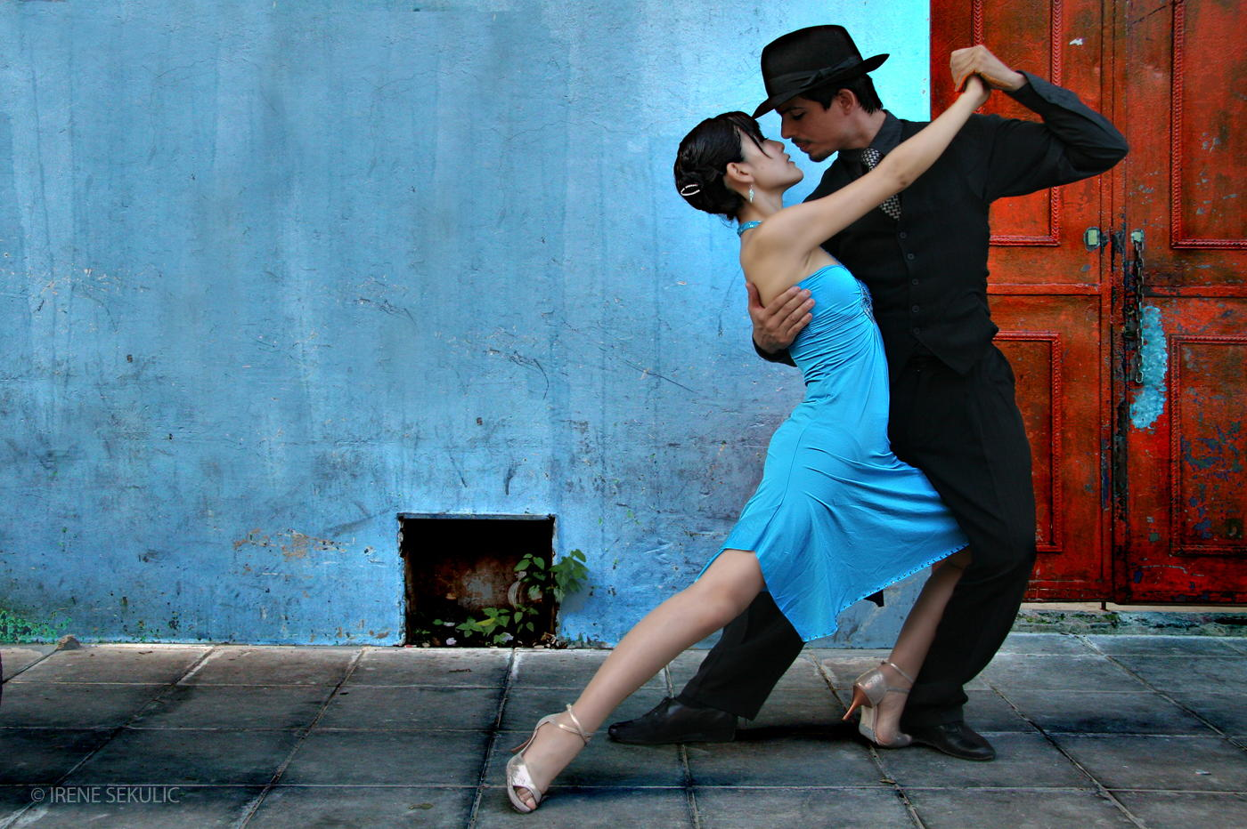
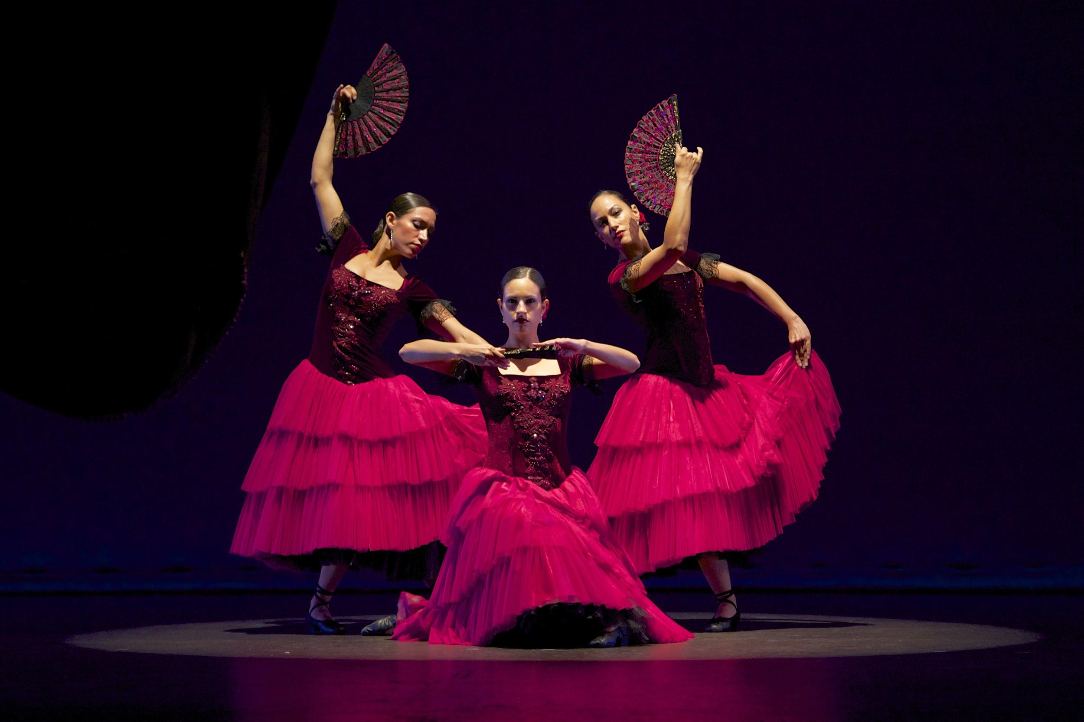
Ballet Folklorico
Tango
Flamenco

Slide 8
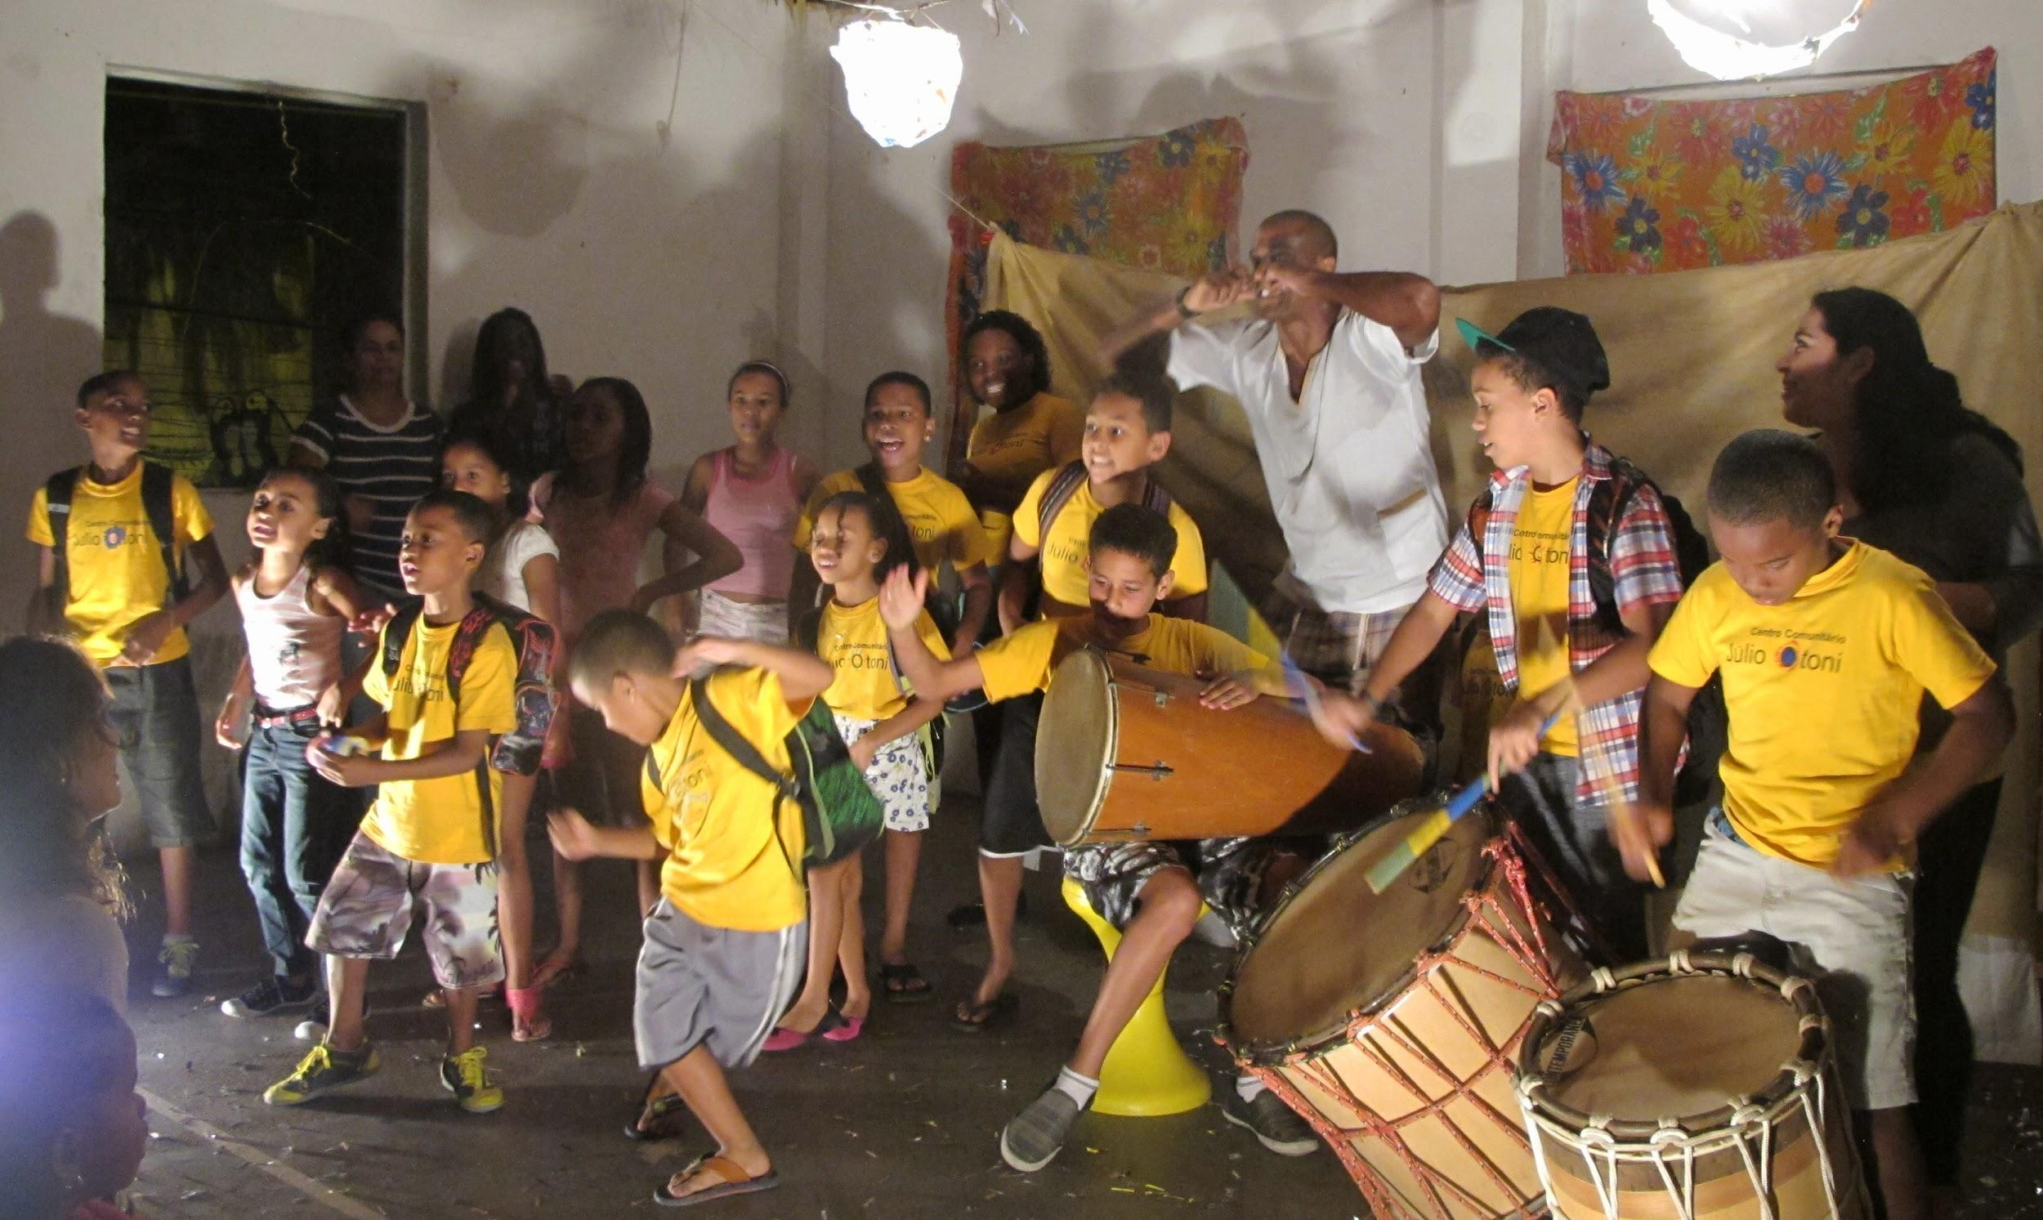
Music

Slide 9
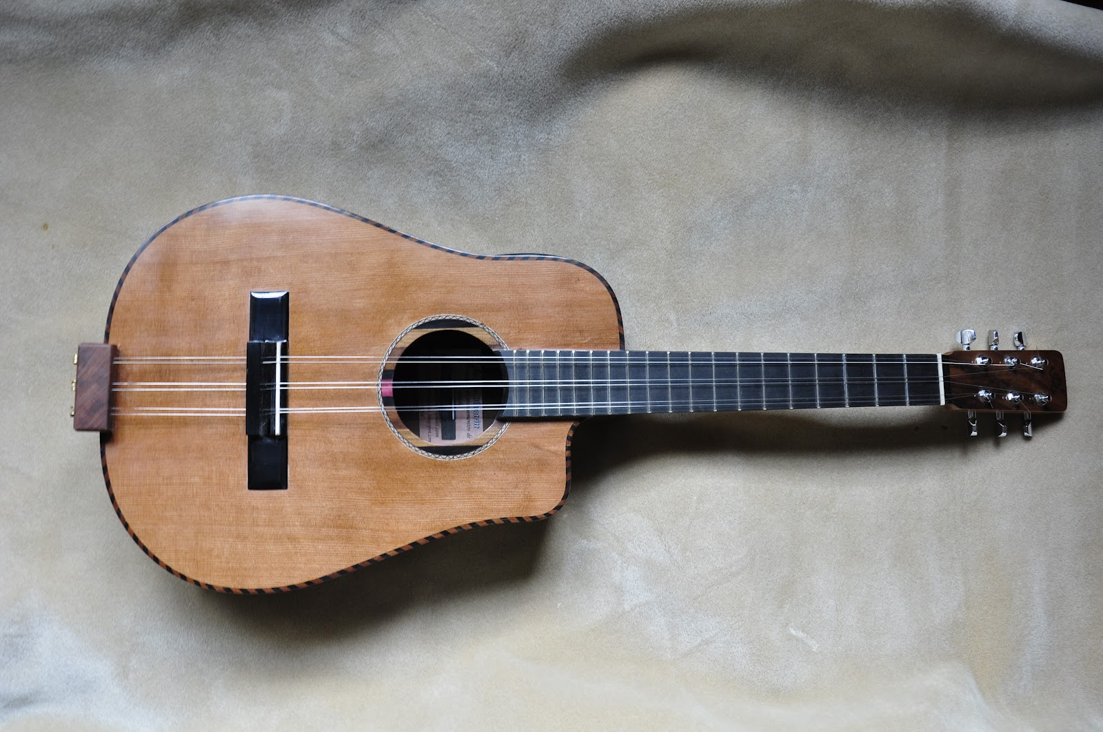
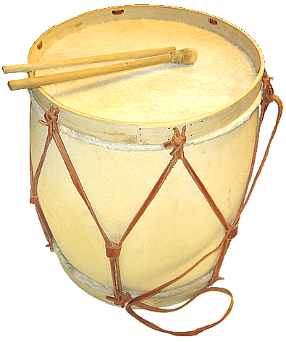
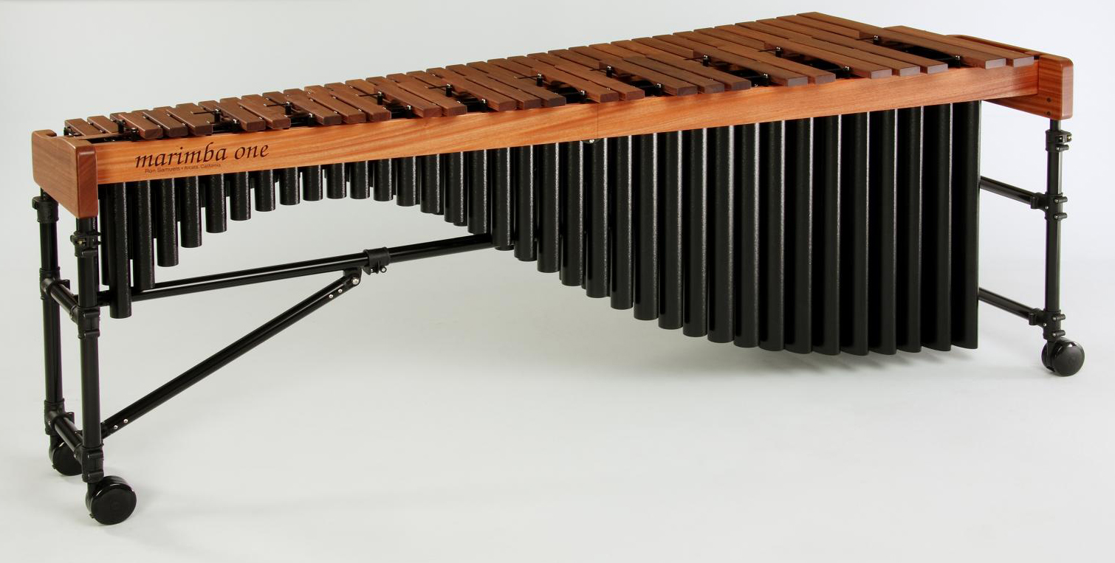
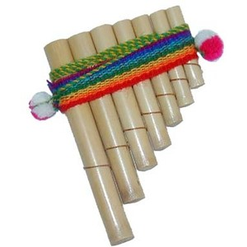
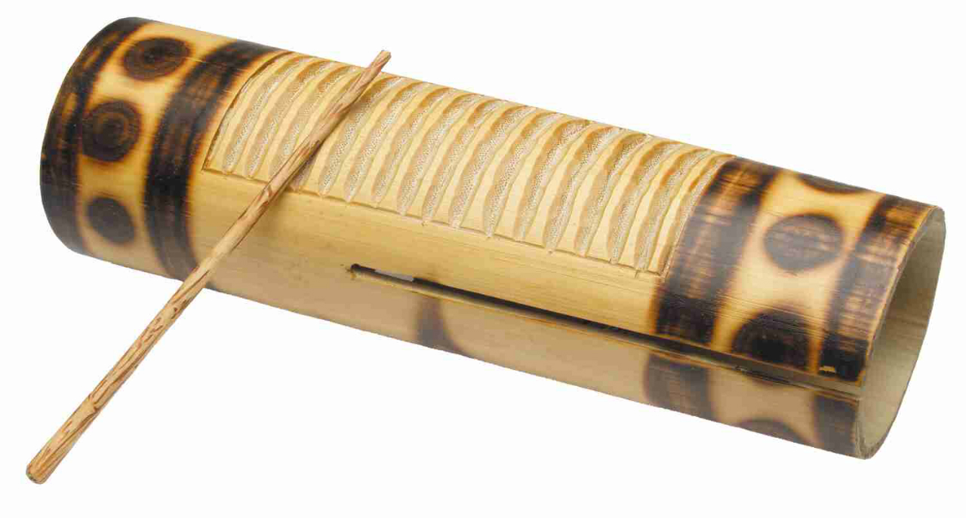
El tres
La marimba
El bombo leguero
El reco reco
La antara

Slide 10
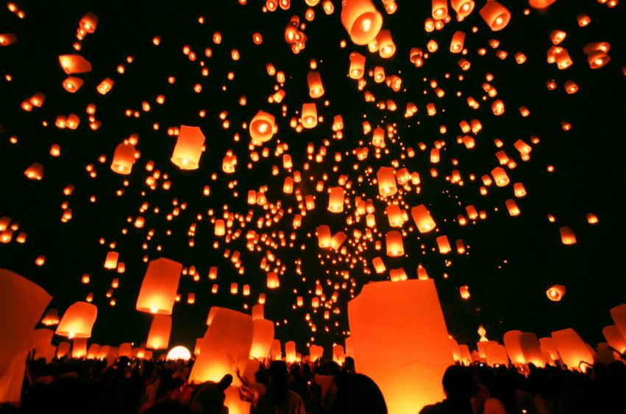
Customs & Traditions

Slide 11
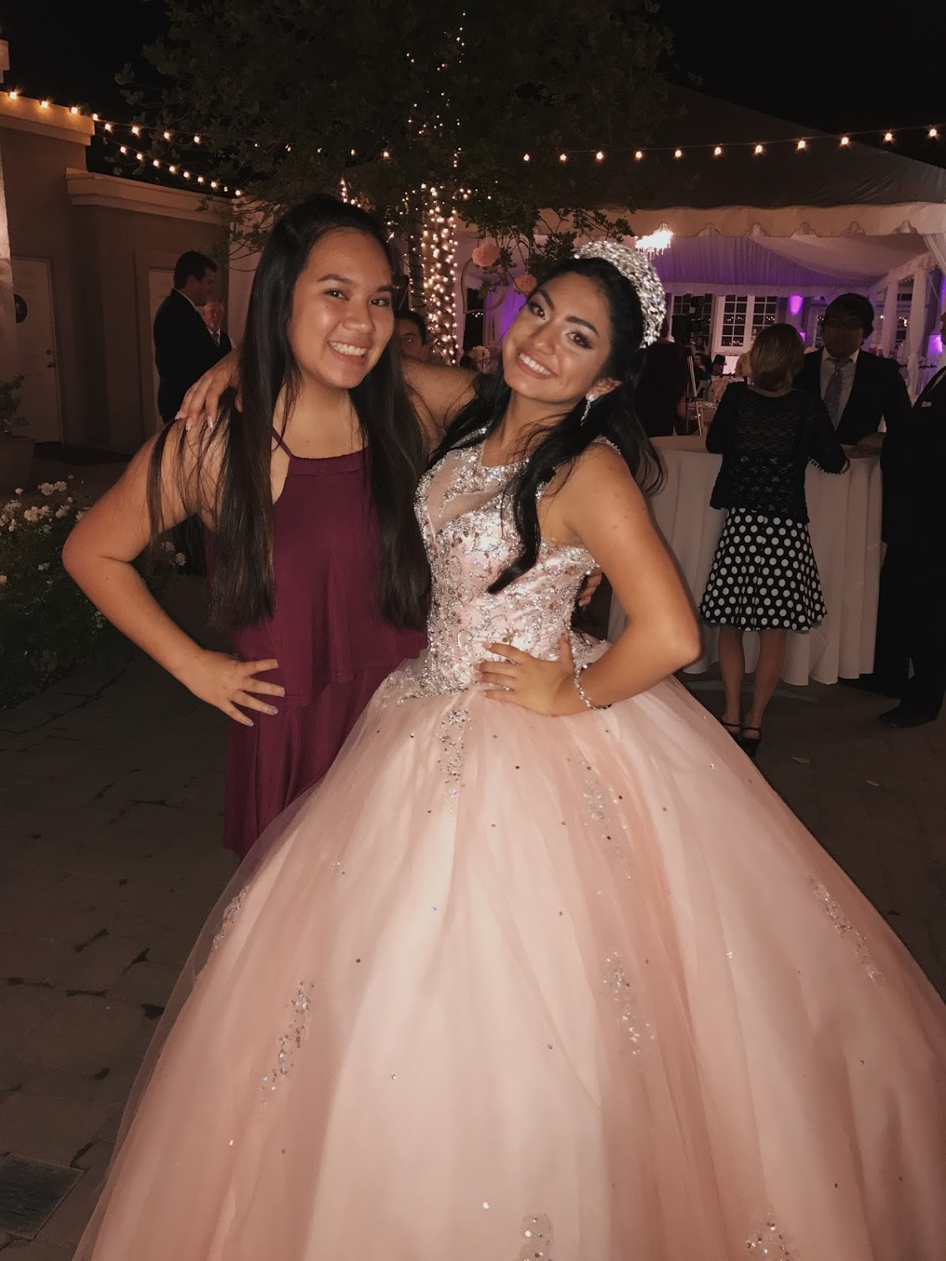
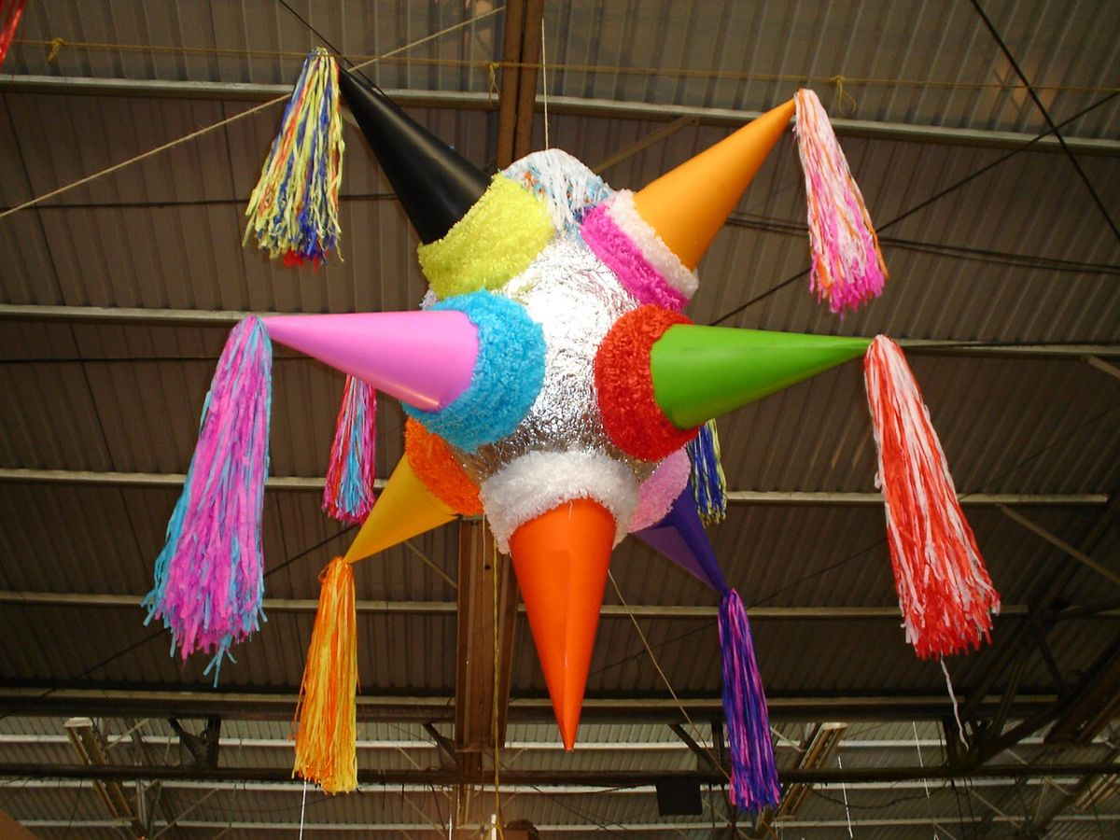
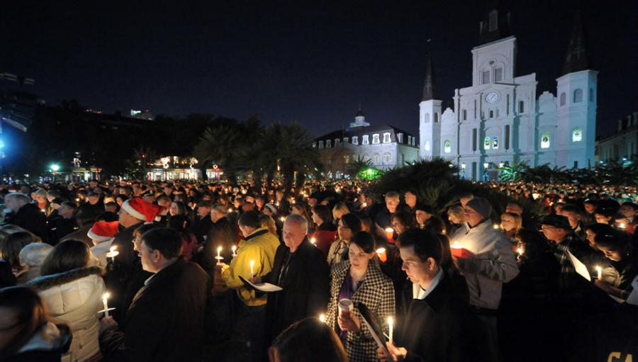
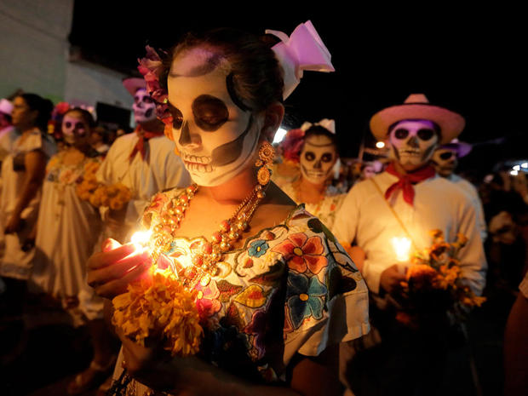
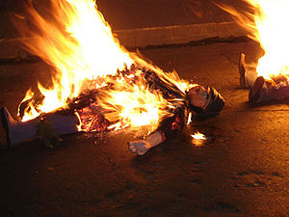
Quinceanera
Pinata
Las posadas
Los villancicos de navidad
La cena de Nochebuena
Dia de los Muertos
Año Viejo

Slide 12
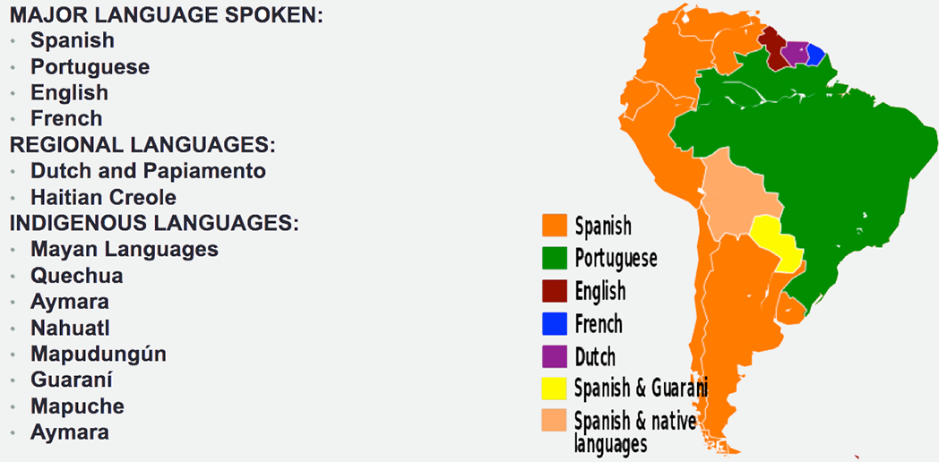
Language

Slide 13
Bibliography
"Cultural Differences in Spanish-Speaking Countries in Latin America." Translation Excellence. N.p., 01 July 2014. Web. 04 June 2017.
Hanson, Rachel. "History of Latin Dance." LoveToKnow. LoveToKnow Corp, n.d. Web. 04 June 2017.
"Hispanic Traditions." Latino Traditions - Hispanic Christmas Traditions. N.p., n.d. Web. 04 June 2017.
Kittleson, Roger A., and David Bushnell. "History of Latin America." Encyclopædia Britannica. Encyclopædia Britannica, Inc., n.d. Web. 04 June 2017.
"Latin American Culture." Learn Spanish. N.p., n.d. Web. 04 June 2017.
“Latin American Language Facts." The Language Factory. N.p., 19 Mar. 2015. Web. 04 June 2017.

Slide 14
"Latin American Spanish Dialects and Spanish Translations." Trusted Translations, Inc. N.p., n.d. Web. 04 June 2017.
Manos, DTI - Dos. "LATINAMERICA HISTORY." Dutch. N.p., n.d. Web. 04 June 2017.
Proctor, Maile. "Maile Proctor." TakeLessons Blog. Maile Proctor Https://tl-cdn.s3.amazonaws.com/images/logoTagline.svg, 07 Jan. 2016. Web. 04 June 2017.
Quintana, Carlos. "Learn About the History of the Different Genres of Latin Music." ThoughtCo. N.p., n.d. Web. 04 June 2017.
Ramirez, Tanisha Love. "12 Latino Holiday Festivities And Traditions That Prove Latinos Know How To Celebrate." The Huffington Post. TheHuffingtonPost.com, 15 Dec. 2016. Web. 04 June 2017.
"Top Dishes in Latin American Cuisine." Top Universities. N.p., 29 Sept. 2016. Web. 04 June 2017.

