Slide 1
Colonization and the Polynesian Islands
Makena Kobayashi
Period 4

Slide 2
Primary Research Question:
Analyze the social and political effects of European colonization on the Polynesian islands during 1450-1900.

Slide 3
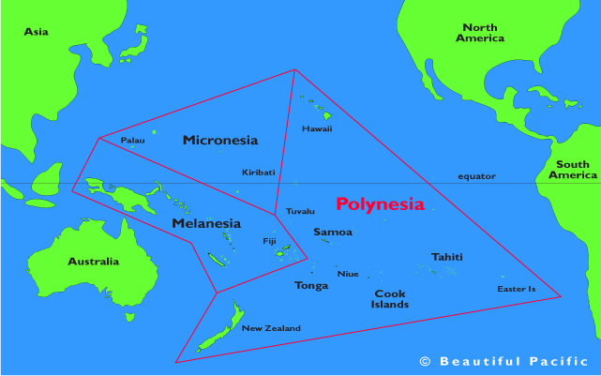
What are the Polynesian islands?
Polynesia is group of many islands that cover a triangular-shaped
region in the Pacific Ocean. There are
over 1,000 total islands in Polynesia,
but the most recognizable ones include
Hawaii, Tahiti, and Samoa.
http://www.beautifulpacific.com/south-pacific-maps/south-pacific/polynesia.gif

Slide 4
Overview of European Colonization
The first European explorer to visit Polynesia was a Spanish explorer in the 1500s. The Dutch came to Polynesia in the 1600s, and British and French trips followed in the 1700s. Polynesia was exploited for its various natural resources and was taken over for various strategic reasons. The effects of colonialism vary from island to island, so I will focus on three specific islands: Samoa, Tahiti, and Hawaii.

Slide 5
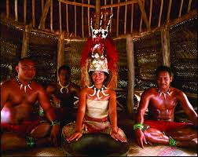
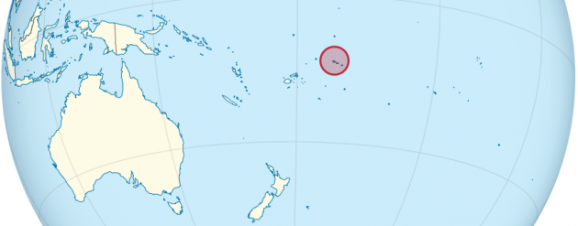
Samoa
Lasting Effects:
Samoans were taught to read/write and told to follow European beliefs
Economy remains largely dependent on aid from overseas nations, economy depends largely on tourism
Majority of the nation is Christian, major loss of traditional beliefs
American Samoa (eastern islands) remains a part of American territory
Able to maintain language and social customs
What happened:
First contact with Europe was with the Dutch in the 1830’s
Became a major trading center
Missionaries arrived, spread Christianity easily
Samoa became a colony inadvertently due to Europe’s need for natural resources
Island became split between the U.S., Britain, and Germany because of the race to gain as much land and power as they could

Slide 6
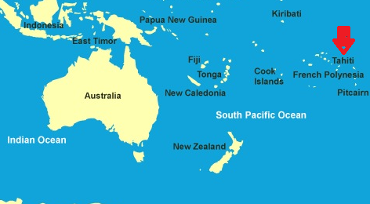
Tahiti
What happened:
Britain was the first to visit Tahiti even though Spain first discovered it
In the 1800’s, the Tahitian chief embraced Christianity & established a “missionary Kingdom”
The Tahitians favored the French presence over the British, and they were pressured to signed a request for French protection
France now had a tight hold over Tahitian affairs
Lasting effects:
European presence disrupted traditional culture
Brought prostitution, disease, and alcohol
Majority of the residents speak French
Tahiti is officially an overseas territory of France
French state controls currency, immigration, law & order, foreign affairs, etc.
Majority of the population is Christian

Slide 7
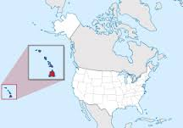
Hawaii
Lasting Effects:
Europeans exploited natural resources (sandalwood, whales, etc.) for their own gain
Spread of diseases such as measles and the plague, dramatically decreasing the pop.
The Hawaiian’s revealing clothing and “provocative” hula dances disturbed the Europeans, said they could be saved by following Christian morals
Oppression of traditional Hawaiian practices, such as banning public hula performances
What Happened:
Missionaries from New England est. operations to convert people in 1820
Rulers accepted Western changes because it would help make business deals
Europeans exploited their natural resources and trade began to boom
Commercial sugar plantations arose in 1835
Hawaii began to sell its land in order to avoid debt in 1850
Annexed by the U.S. in 1897 because white businessmen gained control over the native Monarchy

Slide 8
https://www.youtube.com/watch?v=9XLQs-THg7I

Slide 9
Bibliography
Overview of Colonization:
"POLYNESIA (Western Colonialism)." Whatwhenhow RSS. N.p., n.d. Web. 05 June 2017.
Samoa:
“Effects of Colonialism." Samoainfo - Effects of Colonialism. N.p., n.d. Web. 05 June 2017.
“History." History in Samoa | Frommer's. N.p., n.d. Web. 05 June 2017.

Slide 10
Bibliography (cont.)
Tahiti:
The Editors of Encyclopædia Britannica. "Tahiti." Encyclopædia Britannica. Encyclopædia Britannica, Inc., 31 Jan. 2017. Web. 05 June 2017.
“French Polynesia." Countries and Their Cultures. N.p., n.d. Web. 05 June 2017.
Hawaii:
Iiwinc. "1819 – 1850: Hawaiian Culture, Politics, and Economy Shift to a Western Model." Hawaii. N.p., n.d. Web. 05 June 2017.
“Topics Overview." + Hawaii Alive | Topics: Overview +. N.p., n.d. Web. 05 June 2017.

