Slide 1
Time Period IV: THE EARLY MODERN PERIOD, (1450-1750) “THE WORLD SHRINKS”

Slide 2
The World Map Changes
Several European countries acquire OVERSEAS EMPIRES
New LAND BASED EMPIRES emerge in Asia and eastern Europe
Russian, Ottoman, Safavid, and Mughal empires
GLOBAL TRADE ROUTES – no longer just Afro-Eurasia
Atlantic and Pacific routes established by 1750
The Americas and Oceania now part of global network

Slide 3
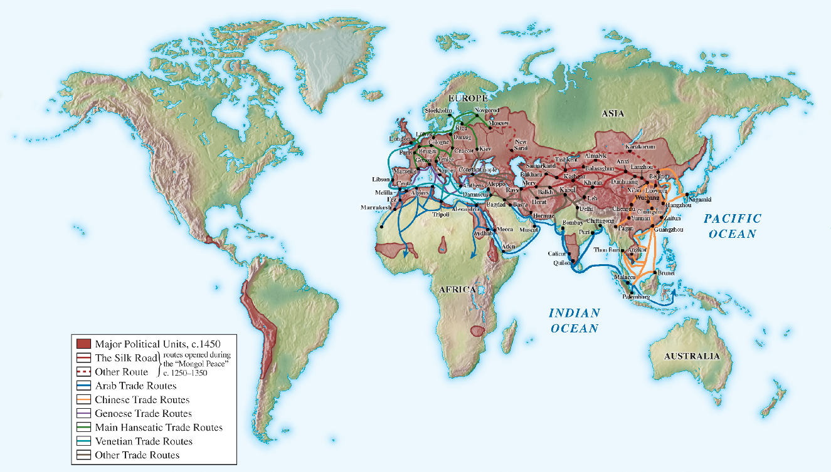
Major Political Units, c. 1450

Slide 4
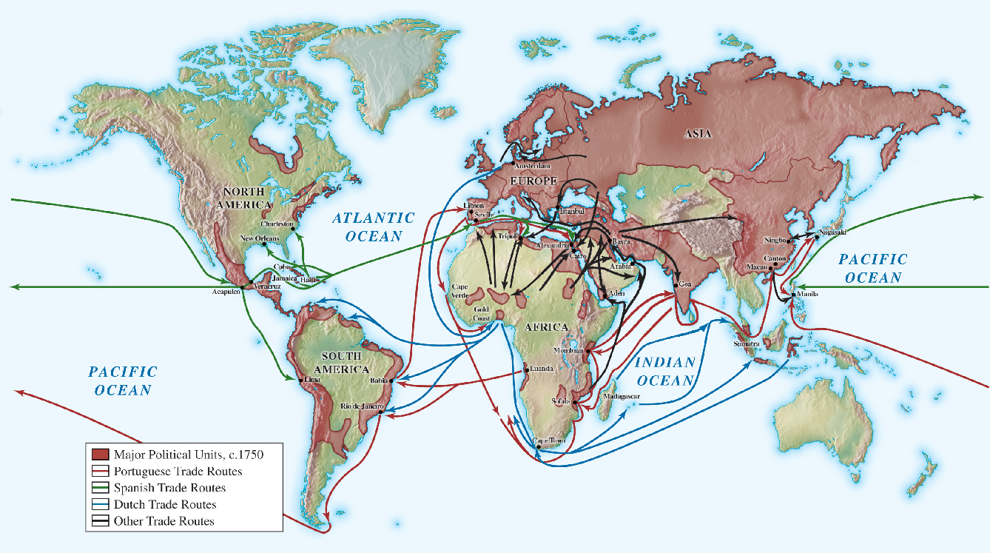
Major Political Units, c. 1750

Slide 5
Triggers for Change
REVIVAL OF EMPIRE BUILDING
Ottoman Empire– notable example
Steady progression of EXPLORATION by Europeans along Atlantic coast of Africa
Motivated by desire to find ways to trade with east Asia while circumventing Muslim-controlled regions
TECHNOLOGICAL ADVANCES
Compasses and navigational devices
Better ship designs and building
Guns and gunpowder

Slide 6
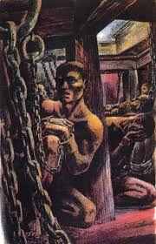
The Big Changes
A New GLOBAL ECONOMY
International trade increased in volume
Americas brought in to network for 1st time
Proto-globalization
Commerce was global
Intensity of contacts increased
More people now involved
Influenced political and social systems in addition to commercial ones
Migration across oceans
Some forced

Slide 7
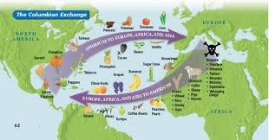
The Big Changes
Biological Exchange
All manner of living things now moved or were moved around the world
Foods from the Americas
Diseases from Europe
Slaves from Africa
Animals, plants, technologies
Columbian Exchange altered many relationships

Slide 8
New Empires
New empires represented significant SHIFTS IN POWER
Gunpowder empires– large political units
New land-based empires challenged political traditions in imperial territories
Forming of “multinational” units
Different cultures and ethnic groups embraced
World position of western Europe increased
Russia found new role
Systematic patterns of inequality emerge

Slide 9
Continuity
Preexisting trade routes continued to be important
Culturally– great deal of continuity
Notable developments– new influence of science
Spread of world religions continued
Global contacts didn’t overrun regional patterns
Gender relations adhered to established patriarchal patterns
No technological breakthroughs until after 1750
Politically
China prided itself on reviving and maintaining its system of government
African societies preserved earlier traditions of divine kingships

Slide 10
Impact on Daily Life: Work
Impact on ordinary people
Decimation of Native Americans due to influx of European and African immigrants
Diseases– small pox and measles
Chinese taxation of peasantry
Silver
Need for new sources of money caused many to fall deeper into poverty
Millions of Africans seized and subjected to slavery
Terrifying and often deadly passage to America

Slide 11
Impact on Daily Life: Work
Most general social change– pressure to work harder
World now increasingly commercial and crowded
Population increases demanded more from workers to sustain society
New forms of race-based slavery
Increase in child labor
Masters compelled workers to increase production

Slide 12
Trends and Societies in the Early Modern Period
Chapter 16: THE WORLD ECONOMY
New global trading patterns
Changes in naval technology and warfare
Chapter 17: TRANSFORMATION OF THE WEST
New trading opportunities and colonial expansion
Chapters 19: EARLY LATIN AMERICA
Formative period for new society in Latin America
Chapter 20: AFRICA AND THE ATLANTIC SLAVE TRADE

Slide 13
Trends and Societies in the Early Modern Period
Chapter 18: THE RISE OF RUSSIA
Russia– Westernization; gunpowder empire
Major impact on power balance in eastern Europe
Chapter 21: MUSLIM EMPIRES
New Muslim states in the Middle East and south Asia
Emergence of other gunpowder empires
Chapter 22: ASIAN TRANSITIONS
Dynastic rebirth in China and Isolation in Japan

Slide 14
Trends and Societies in the Early Modern Period
Each chapter deals with reactions to world trade, biological exchange, and new pressures on labor
Highlights diversity of patterns, depending on cultural orientation and shifts in positions of power

Slide 15
Key Concepts
Globalizing Networks of Communication and Exchange
Global Trade
Tech and Innovation
New forms of Social Organization and Modes of Production
Commercial Markets
Columbian Exchange
Religious Changes
Arts and Education
State Consolidation and Imperial Expansion
Rulers
Early Imperialism and Militarism
International and Regional Competition

