Slide 1
PEOPLE
EATING
PEOPLE
The History and Evolution of Cannibalism in the Human Species
Created By Tahnee Creek Burns

Slide 2
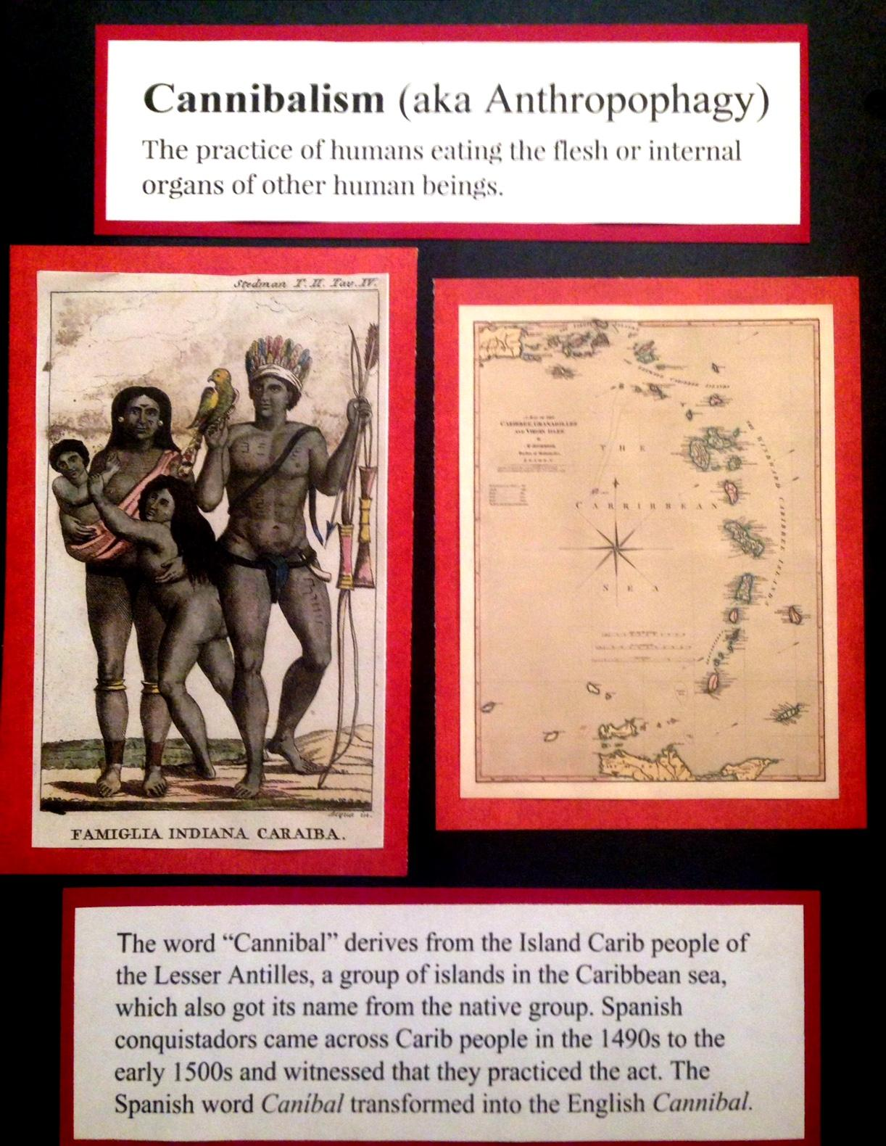

Slide 3
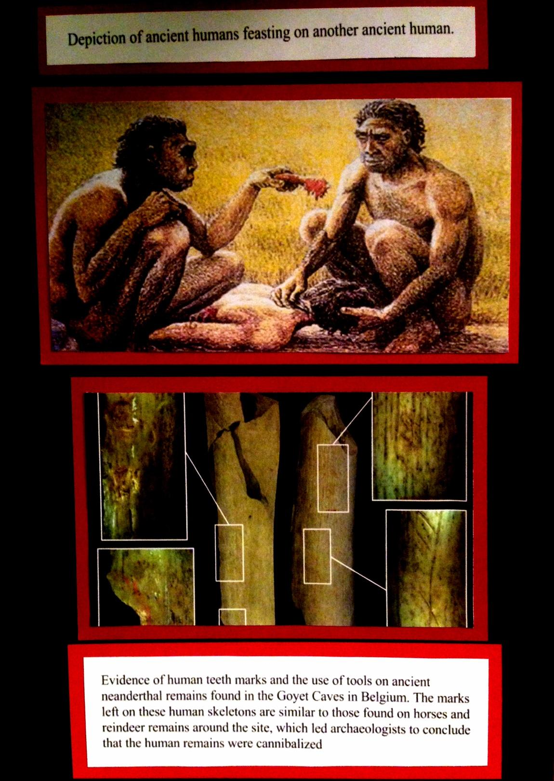

Slide 8
