Slide 1
WORLD WAR I REVIEW What do we remember? What have we forgotten? What questions do we still have?
Section 8.1 ~ A World Crisis

Slide 2
World War I Brainstorm
What do you know and remember about World War I?
Brainstorm a list of people, places, events, or ideas associated with World War I.
(Think back to your World History Class last year)

Slide 3
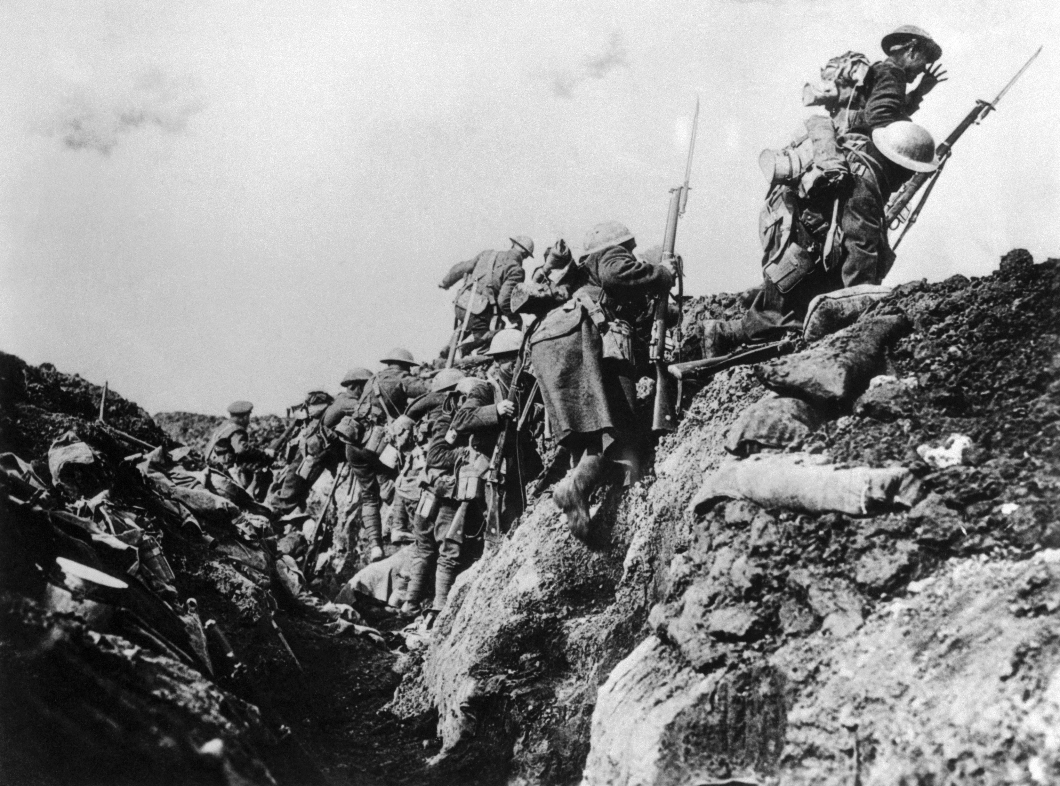

Slide 4
The 4 M.A.I.N. Causes of WW1
Militarism
Alliances
Imperialism
Nationalism
https://www.youtube.com/watch?v=XRcg_t2oJkc

Slide 5
The 4 M.A.I.N. Causes of WW1
MILITARISM
Expansion and build up of military size and power
New Weapons: machine guns, poison gas, tanks, airplanes
Why does the condition of Militarism make a war more likely?
ALLIANCE SYSTEM
Traditional alliances throughout Europe
Many alliances based on trade, mutual defense, and/or familial relations
Why does the existence of Alliances make a war more likely?

Slide 6
The 4 M.A.I.N. Causes of WW1
IMPERIALISM
Decades of international competition over resources, territories, and power
European competition over undeveloped world (Africa, Latin America, Southeast Asia)
Imperial conflict on continental Europe dating back to the Dark Ages
Why does Imperial competition make a war more likely? (think about both those in power and the peoples who were conquered and colonized)
NATIONALISM
Build of national pride (patriotism, racial and national superiority) was contagious throughout Europe
Why does the build up of Nationalism make a war more likely?

Slide 7
War Breaks Out
Austria-Hungary declared war on Serbia
Russia mobilized its army to the German border.
Germany declared war on Russia and then two days later on France
Germany moved troops through neutral Belgium (Schlieffen Plan)
Great Britain supported Belgian neutrality and declared war on Germany

Slide 8
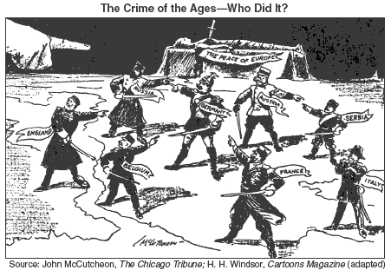

Slide 9
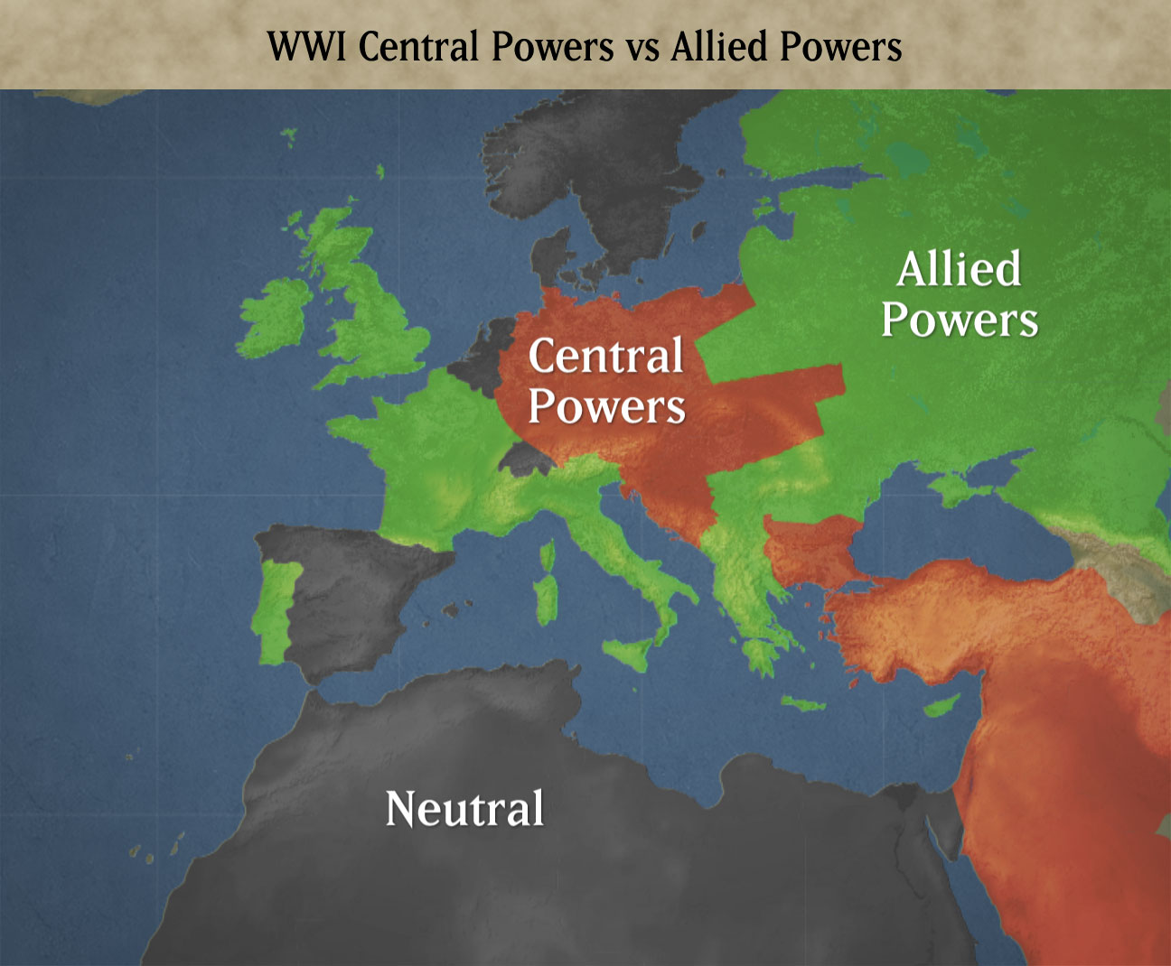
Europe Chooses Sides
Central Powers
Allied Powers
Germany
Austria-Hungary
The Ottoman Empire
Great Britain
France
Russia
By the end of the war 30 nations will be involved

Slide 10
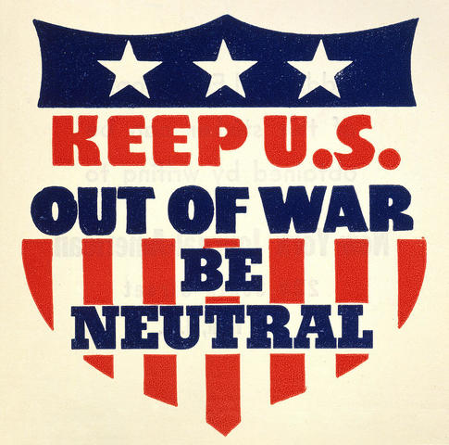
Europe Chooses Sides
Brainstorm a list of reasons why the United States would remain neutral for the first few years of the war?

